Slide 1
EVENT COORDINATION AND COMMODIFICATION
MY WINTER QUARTER S.O.S. EXPLORATION
Archer Hobson-Ritz

Slide 2
Cultivation of an Experience
Reality is mediated by perception
PERSON X PLACE X TIME
Curation of space creates moments extend through their legacy

Slide 3
Influencing perception and creating an experience
Distorted reality becomes Moment
Community
&
space
Ontological design
Ambiance

Slide 4
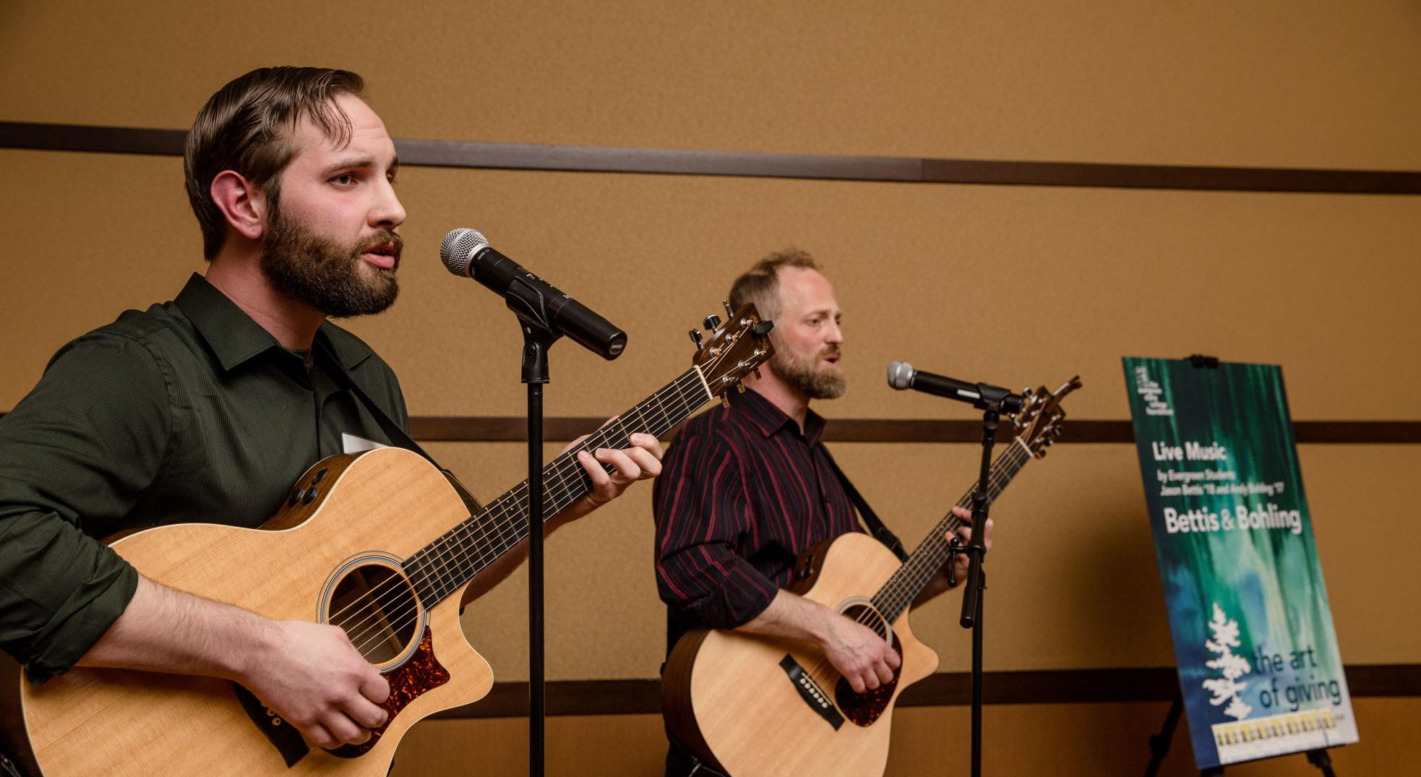
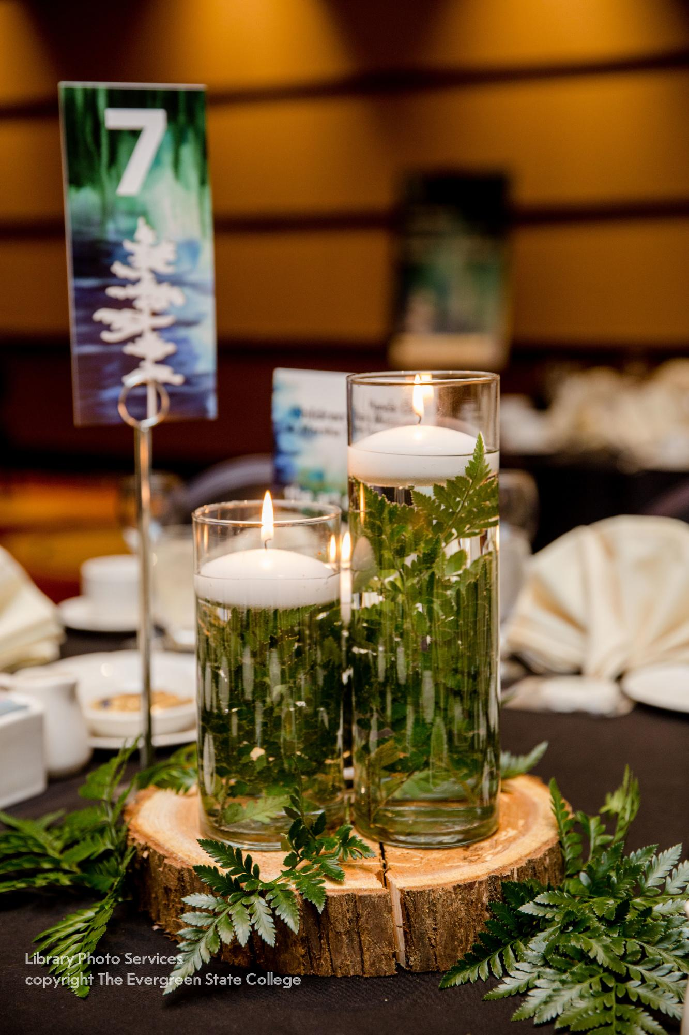
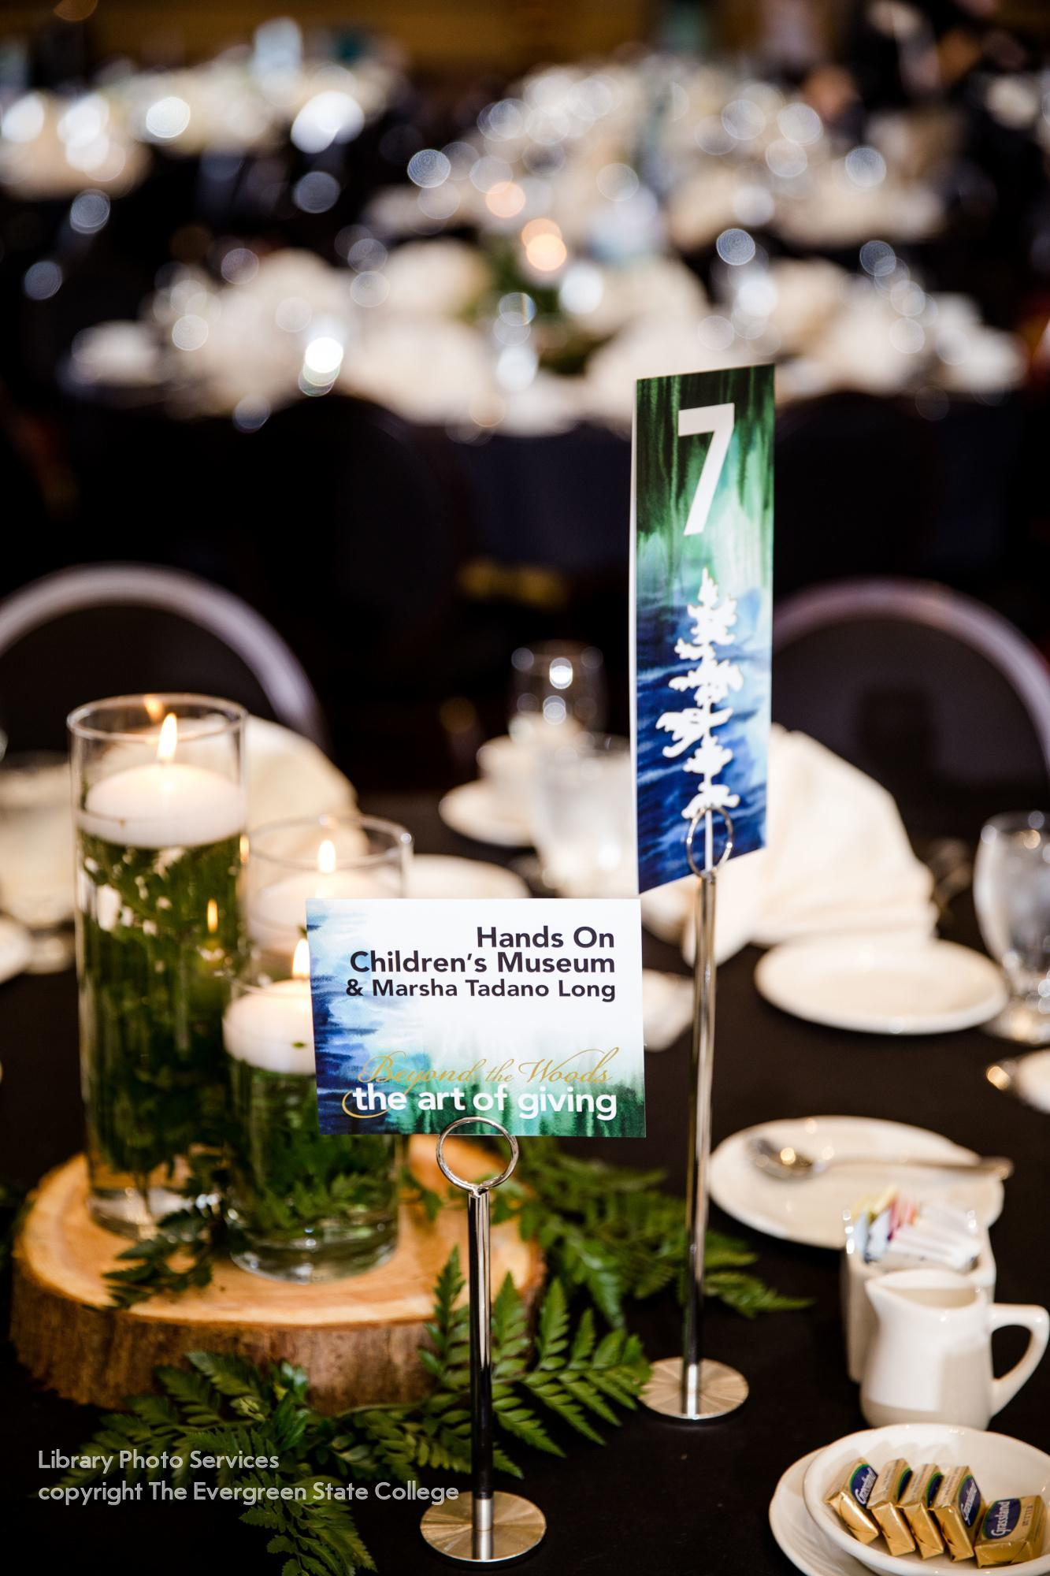
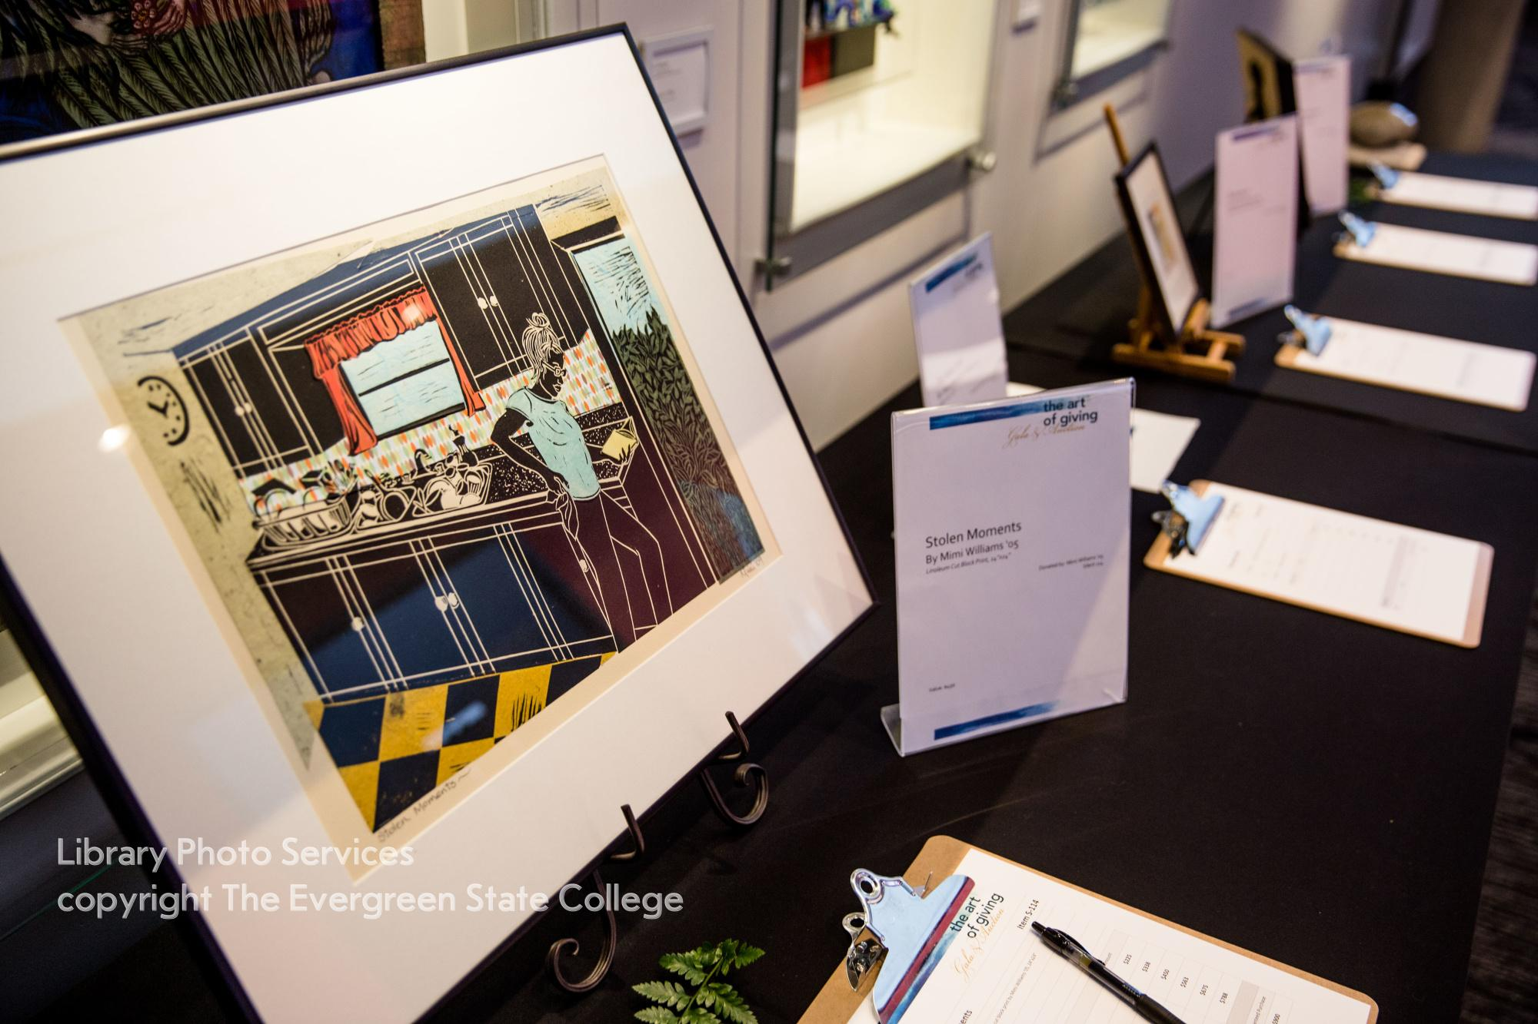
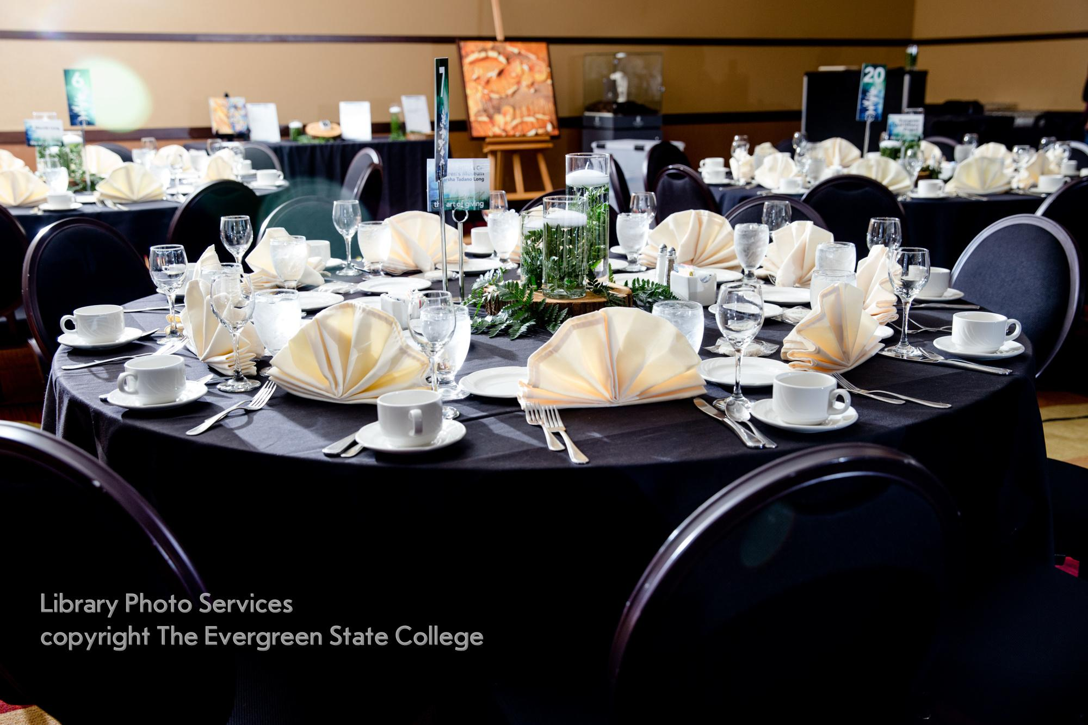
Ambiance
Beyond The Woods
Certain music can change how you process a scene
Lighting can influences your mood
Theme
Students performing acoustic music that fit the mood
Low lighting with the glow of candles
Auction items set up to incorporate theme

Slide 5
Strategic Programing
How you arrange your order of events will determine its flow

Slide 7
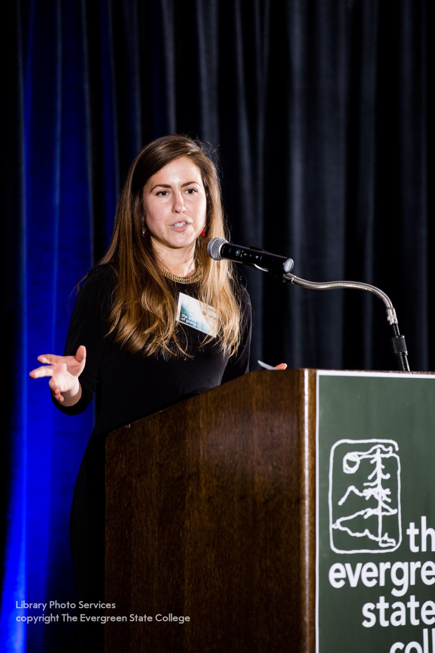
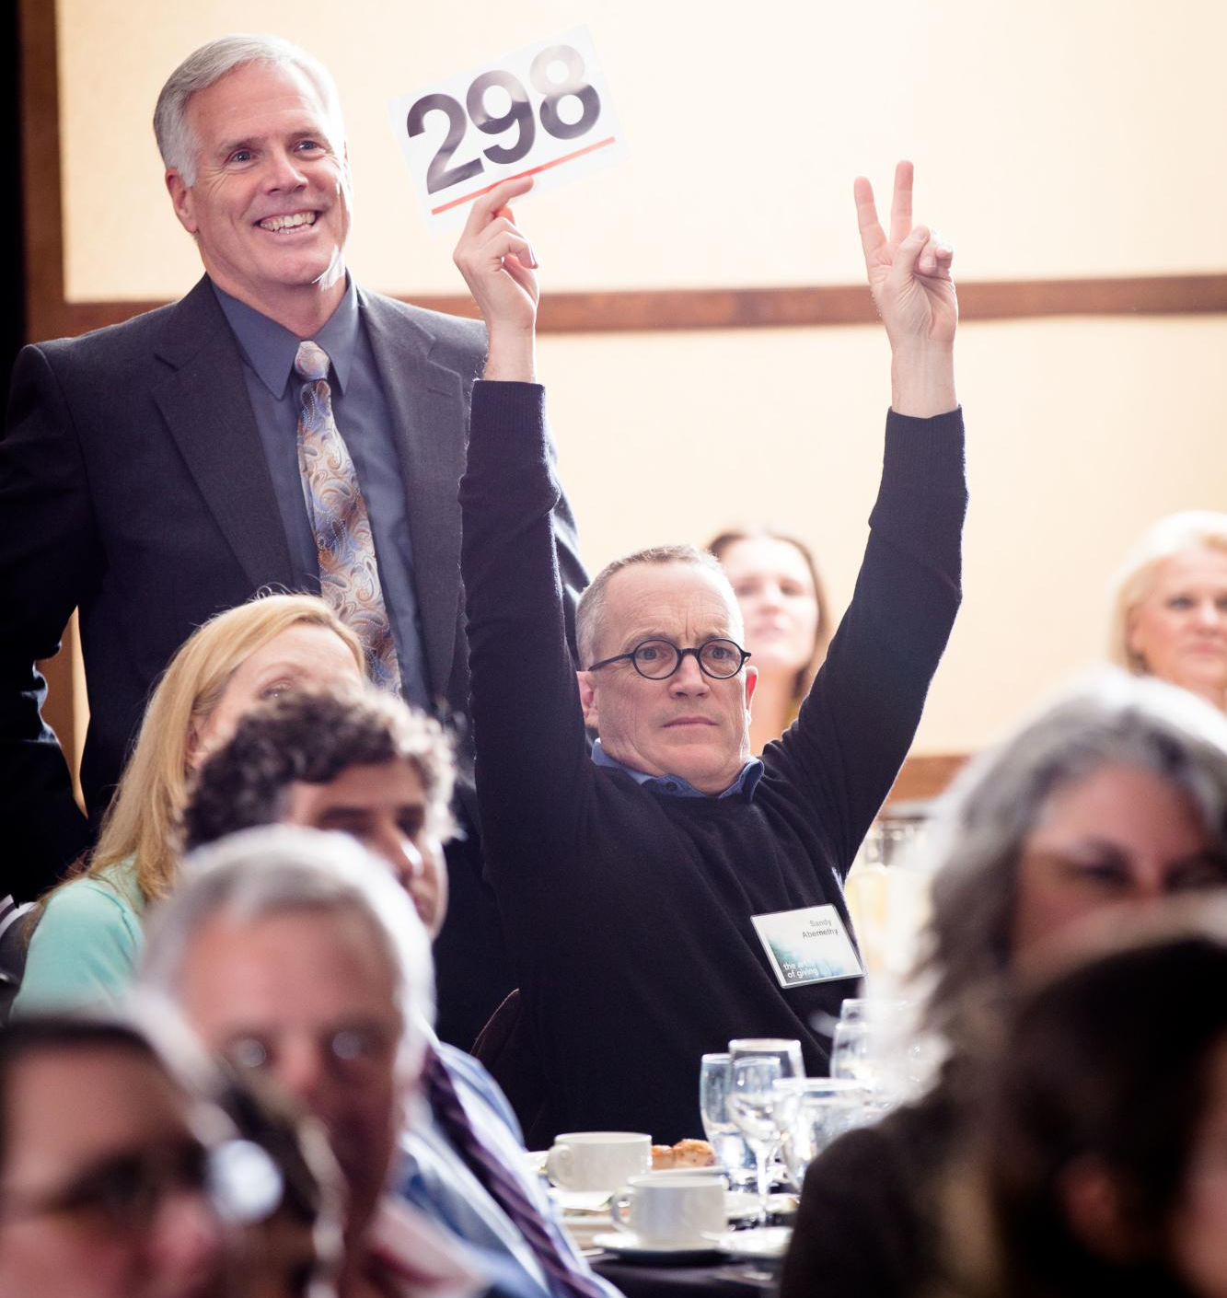
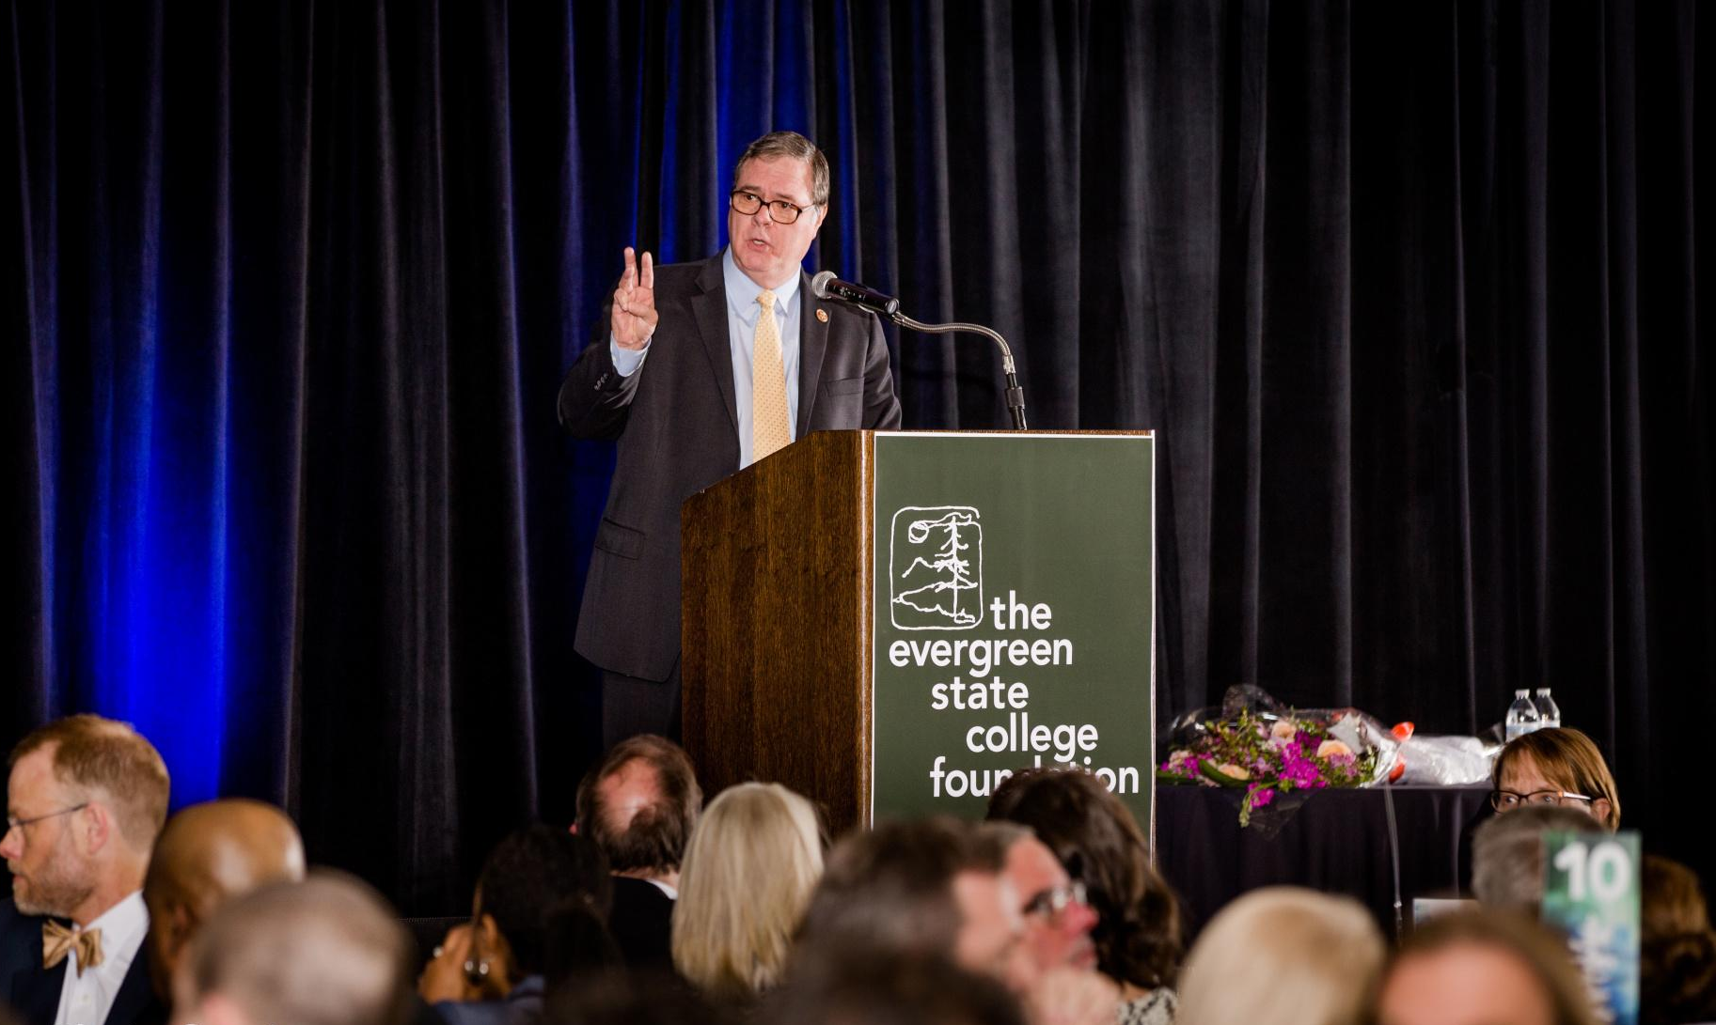
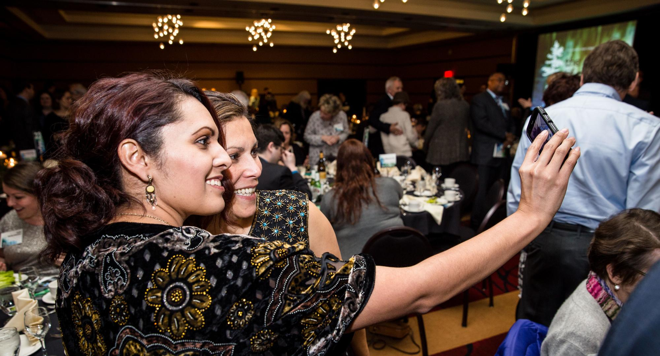

Slide 8
S.W.O.T
Strengths
Energy, Look, & Feel
Balled on a budget
Weaknesses
Wine Situation
Check-in area was too small; hard to hear
Opportunity
More sponsorships
Building relationships with regional vendors
Threats
Money
More advanced time for phone calling

Slide 9
Thank you! Cheers!
Think about who you are in the moment and how you change as you sip wine from Bordeaux as the lovely Annie Sloan tantalizes and teases your mind apart.

