Slide 1
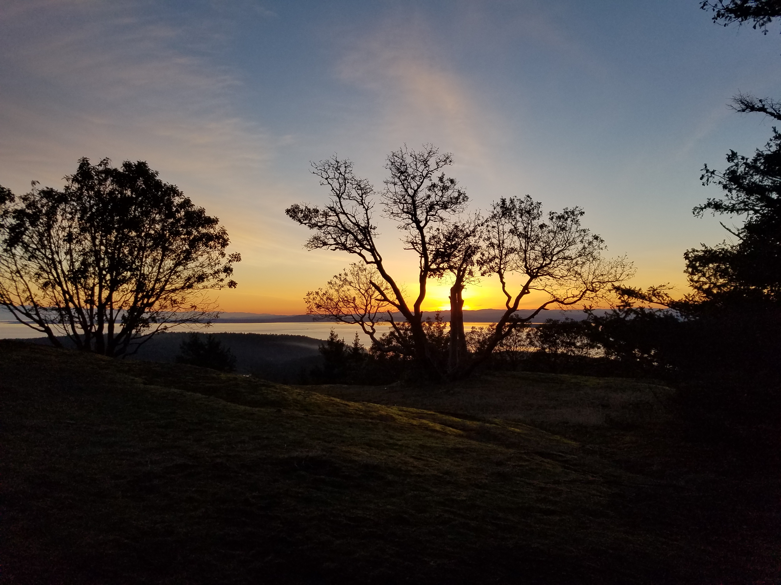

Slide 2

“If measures are taken to restructure agriculture and the larger food system based around small scale farming, agroecology, and local markets, global greenhouse gas emissions could be cut by half within a few decades.”
UNCTAD. “Trade and Review 2013: Wake Up Before It’s Too Late.” United Nations (2013). Environment

Slide 3
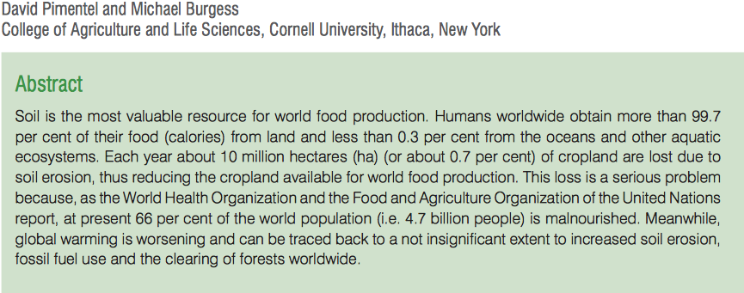
0.7% percent of cropland lost due to erosion annually
66% of the world population malnourished
UNCTAD. “Trade and Environment Review 2013: Wake Up Before It’s Too Late.” United Nations (2013).
UNCTAD. “Trade and Environment Review 2013: Wake Up Before It’s Too Late.” United Nations (2013).

Slide 4
“If you look at what people ate five or six generations ago on an annual basis, there are hundreds of types of food. Research is now showing that most American eat less than twelve foods on a regular basis.”
Elise Krohn, traditional foods specialist, Northwest Indian College

Slide 5
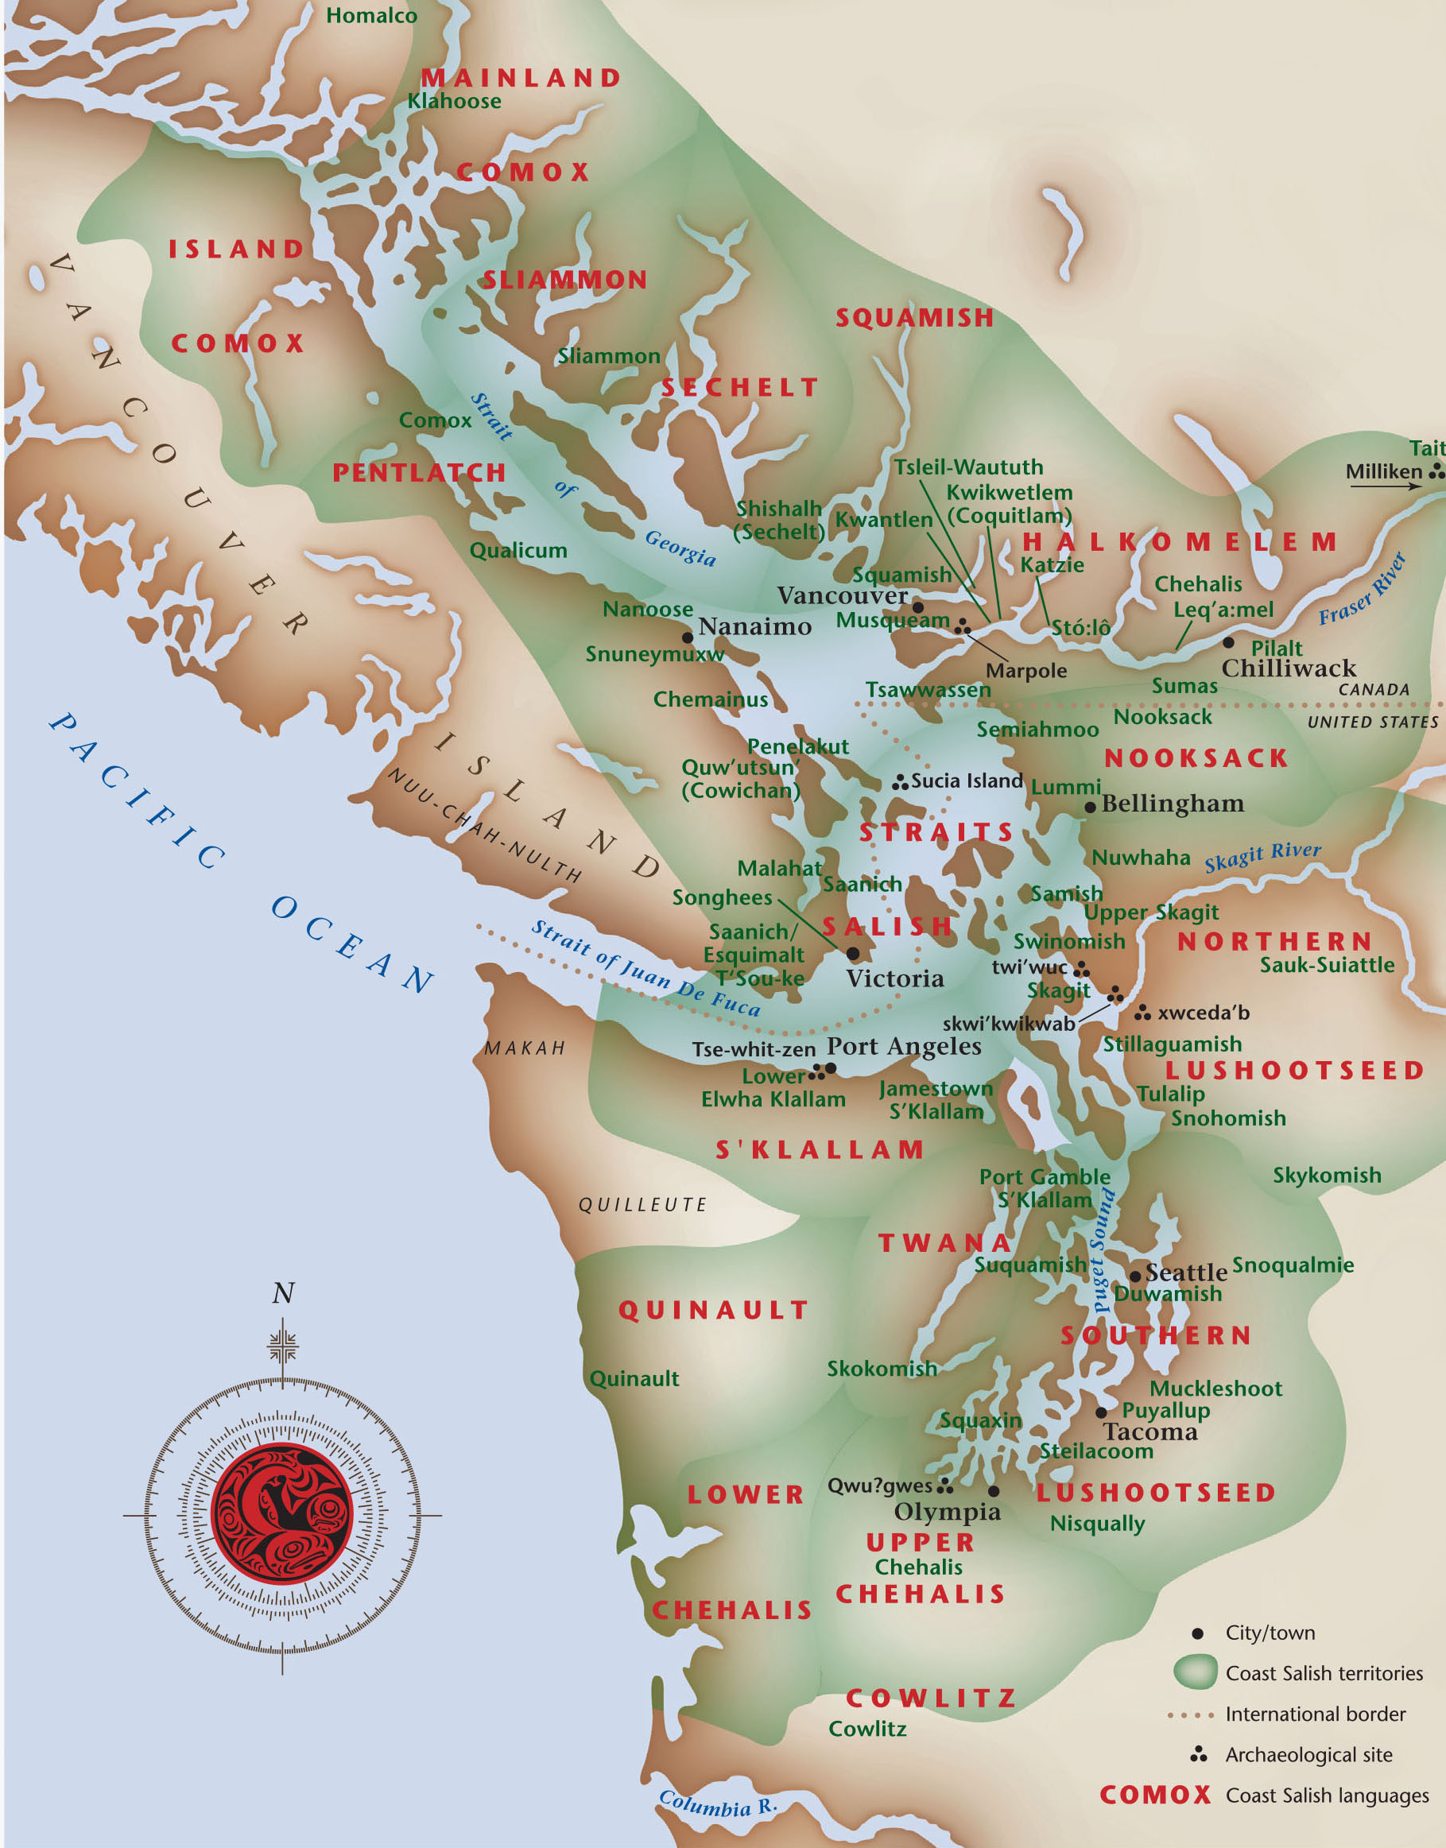
uvac.uvic.ca/gallery/salishcurriculum/coast-salish-territories-maps/

Slide 6
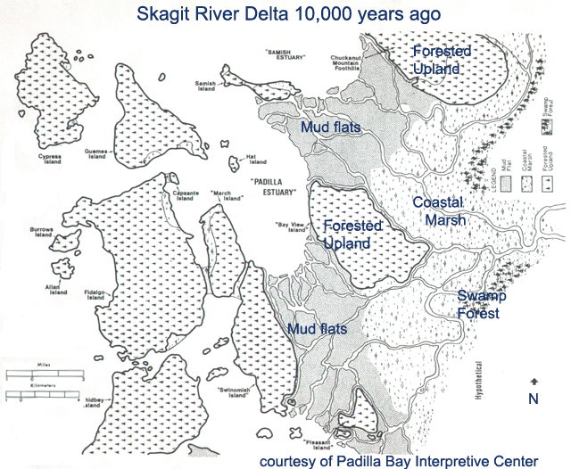
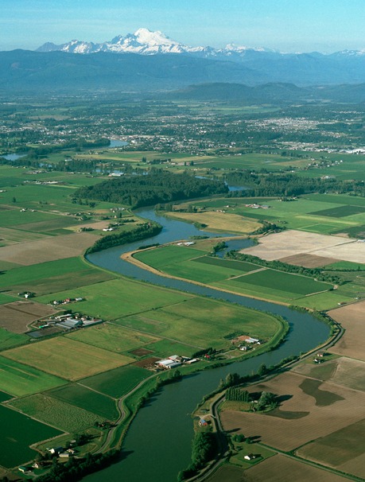
PC- Lee Mann

Slide 7
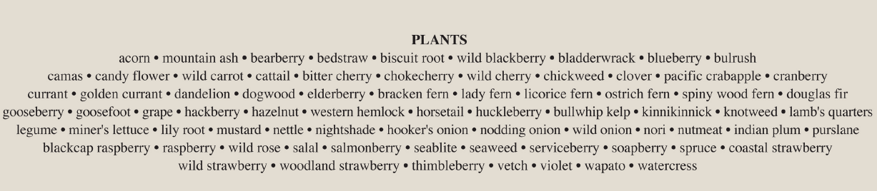
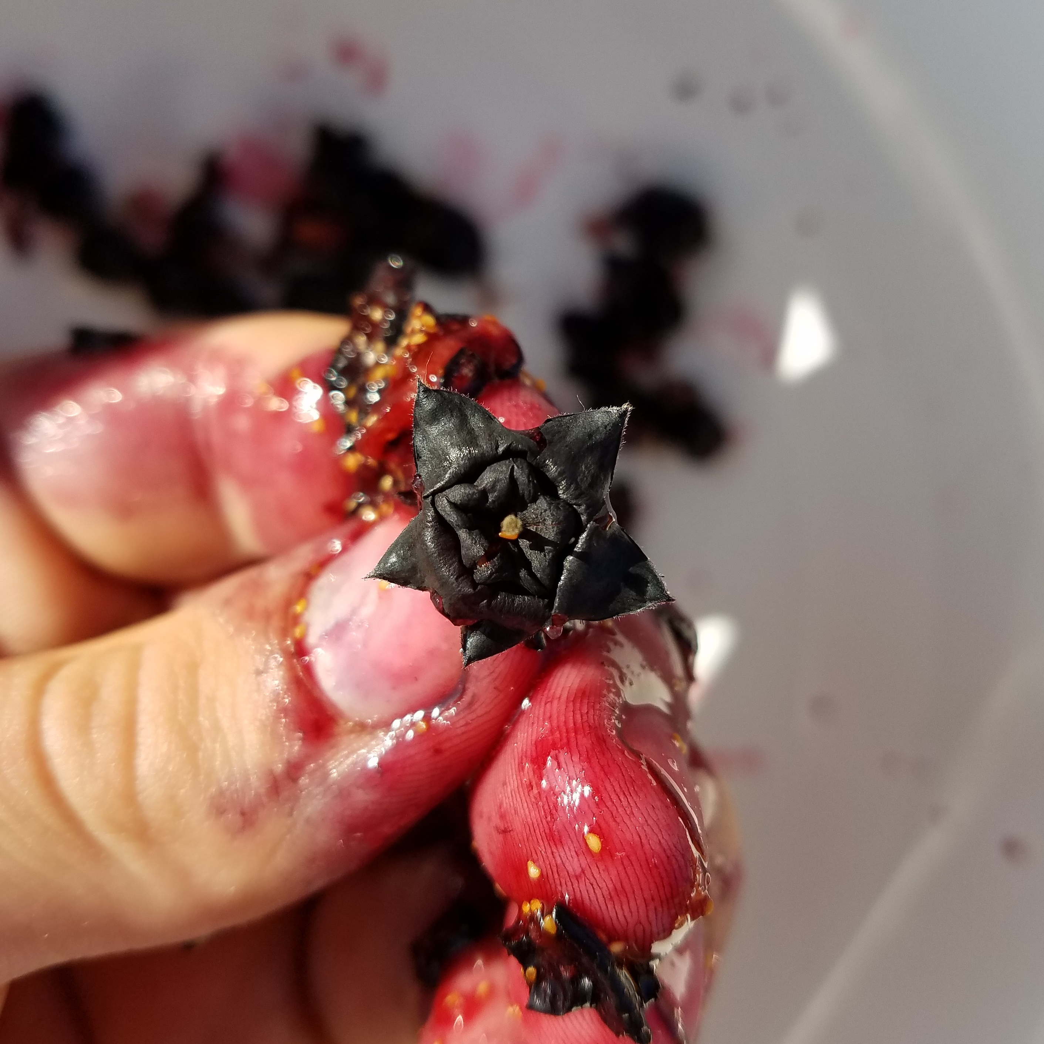
Burke Museum

Slide 8
4 companies own 90 percent of the global grain-trade
Archer Daniels Midland - 1902
Bunge - 1818
Cargill - 1865
Louis Dreyfus - 1851
Murphy, S., Burch, D., & Clapp, J. (2012). Cereal secrets: the world's largest grain traders and global agriculture. Cereal secrets: the world's largest grain traders and global agriculture.

Slide 9
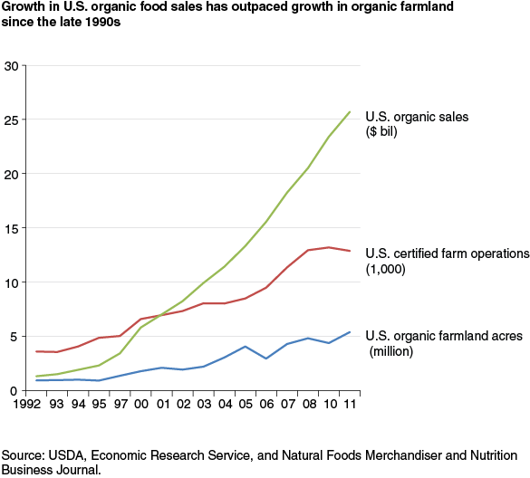
Organic Trade Association 2016

Slide 10
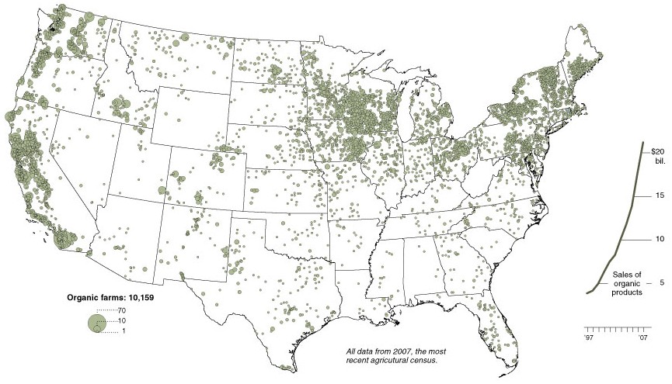

Slide 11

qai.com

Slide 12
www.kashi.com

