Slide 1
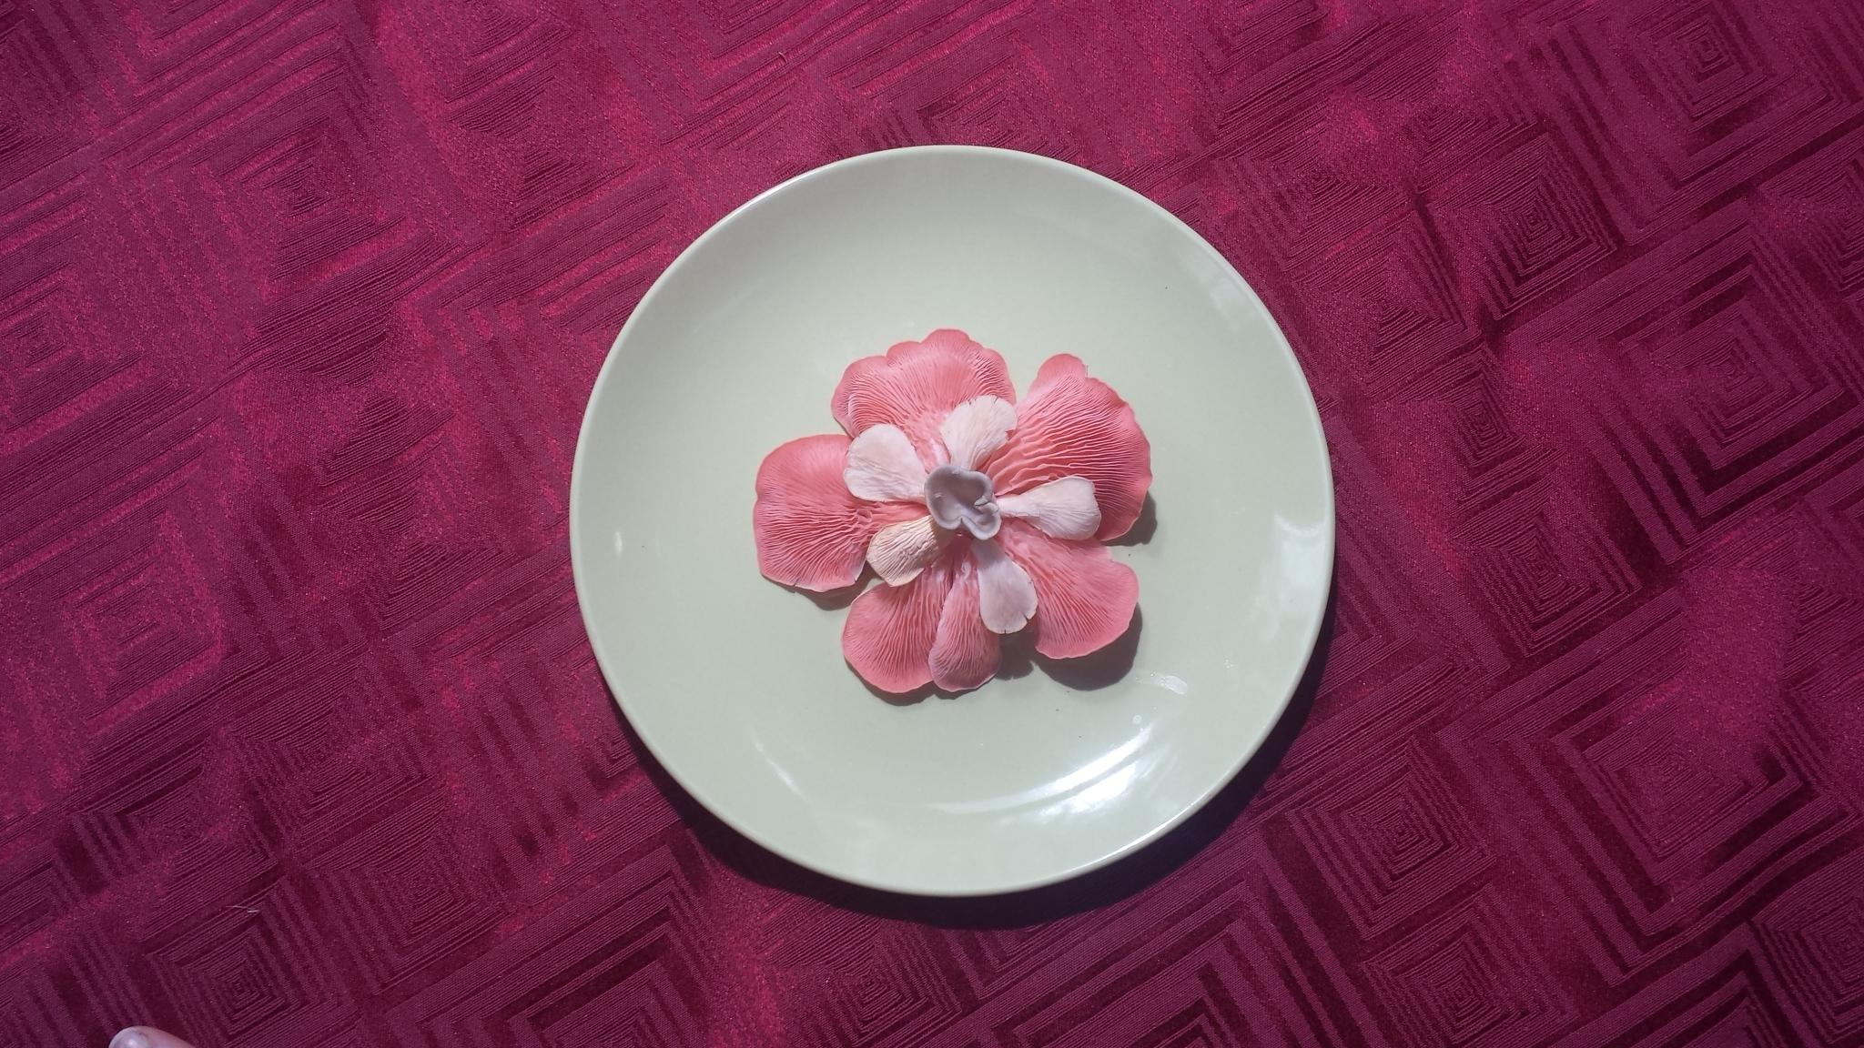
Frankie’s journey to Oyster Mushroom madness

Slide 2
Description
This contract, entitled Urban Mushroom Farming for Health, is a contract designed to educate the student of the medicinal properties of oyster mushrooms, how oyster mushrooms evolved to possess medicinal properties, how Oyster mushrooms can combat the destructive pressures that are hostile to our earth and how to grow oyster mushrooms in an urban environment. The student will write a research paper focused on the medicinal qualities of oyster mushrooms and relate them to evolutionary concepts. The student will create a sculpture that symbolizes the positive aspects of oyster mushrooms, and how they can help mitigate destructive forces currently threatening our earth. The student will learn to how to cultivate and grow mushrooms in an urban environment

Slide 3
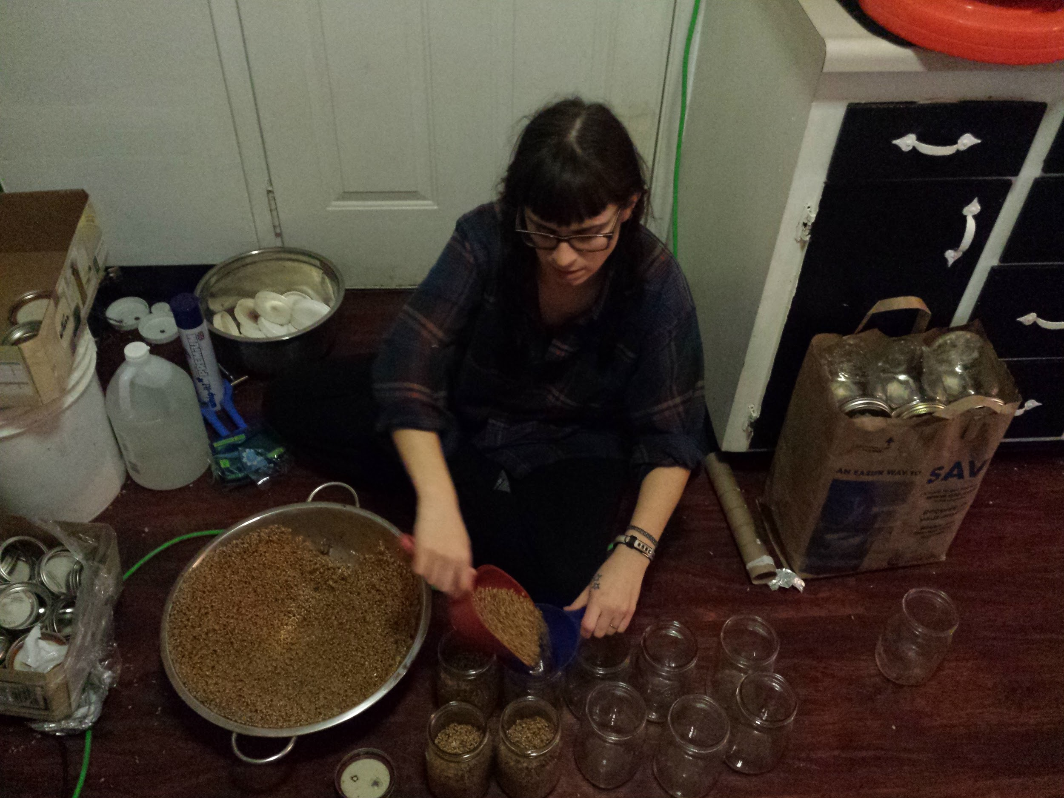
“Sterilization! After letting the grain strain and cool for 12 hours, I filled 20 jars with grain, screwed on my newly made lids and popped them into the pressure cookers”

Slide 4
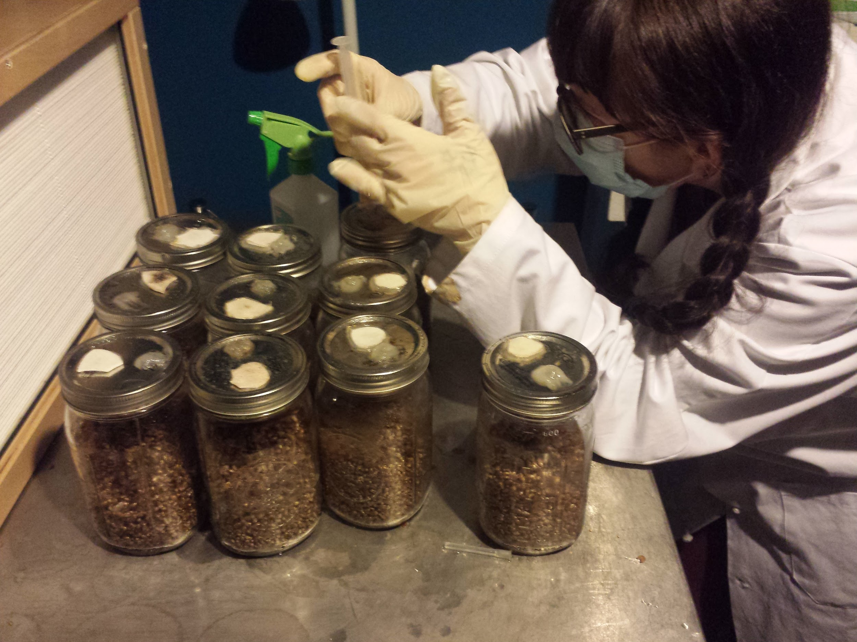
“Inoculating! This is the part I found to be the most exciting. It’s also a careful process. Contamination happens really easily, so being extra careful is necessary”

Slide 5
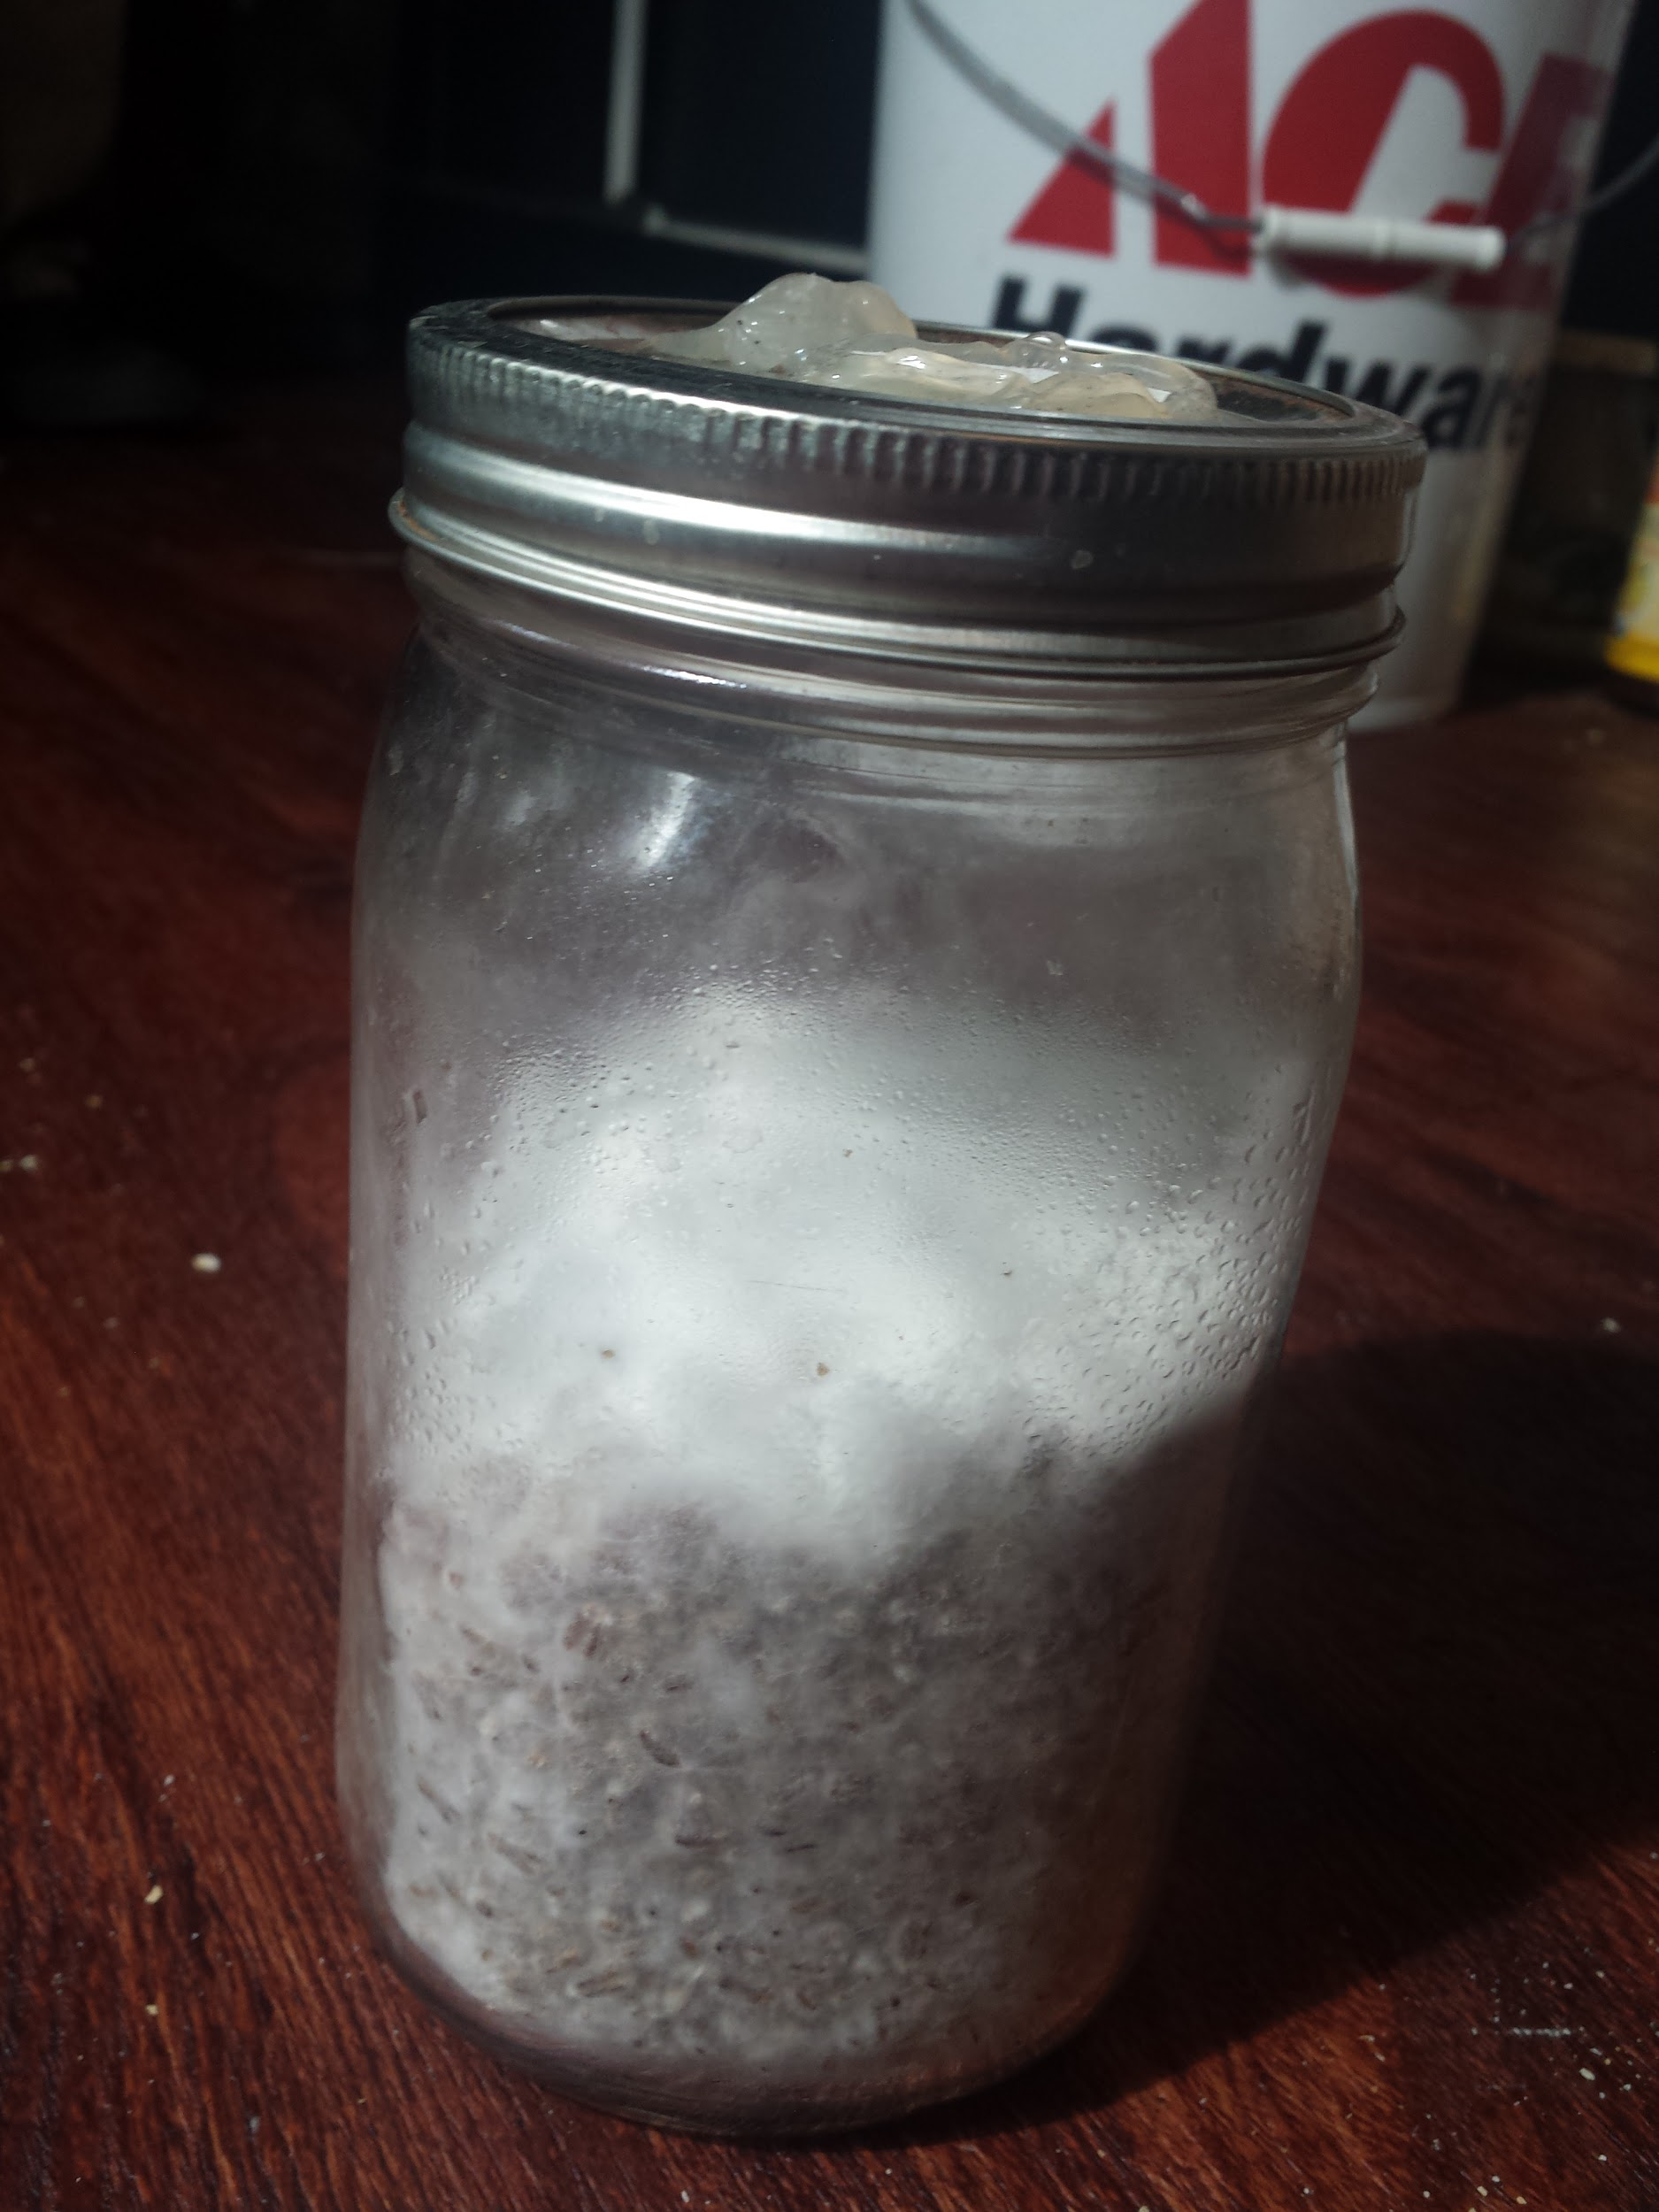
“This week my Blue oyster mushrooms have fully colonized the spawn (The mycelia has completely grown over the grain) and is now ready to be transferred to straw”

Slide 6
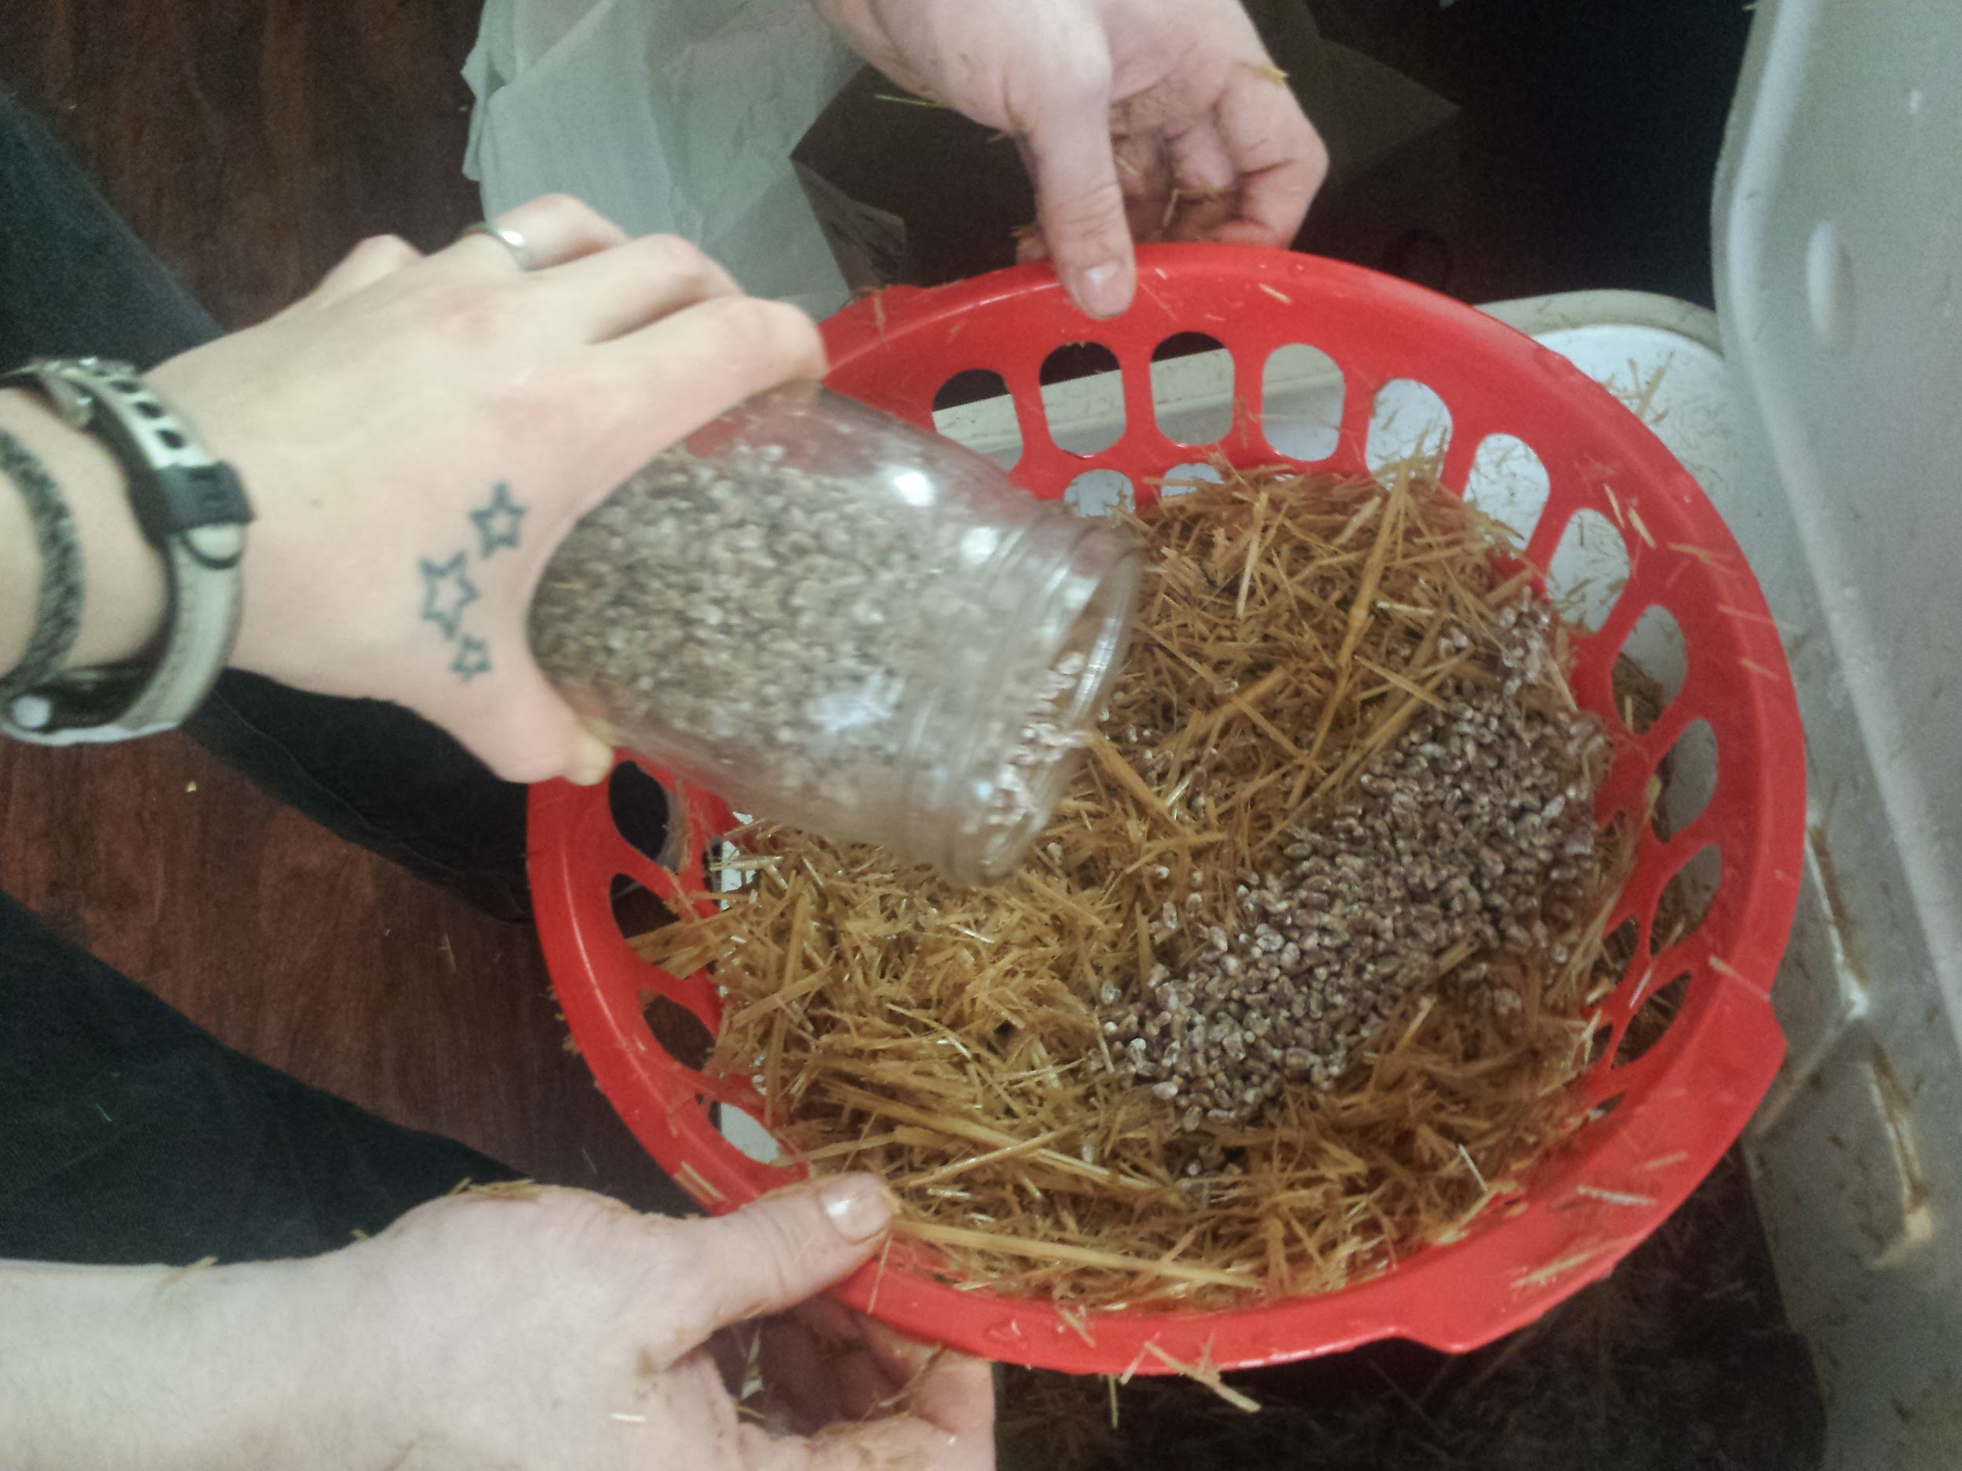
“I filled six plastic baskets (I bought the day before from the dollar tree), with five layers of straw, the cultivated grain and gypsum. The straw is mostly supplying nitrogen as well as some macronutrients. The gypsum provides sulfur and trace minerals. This will feed and give energy to mycelia so it can begin to pin”

Slide 7
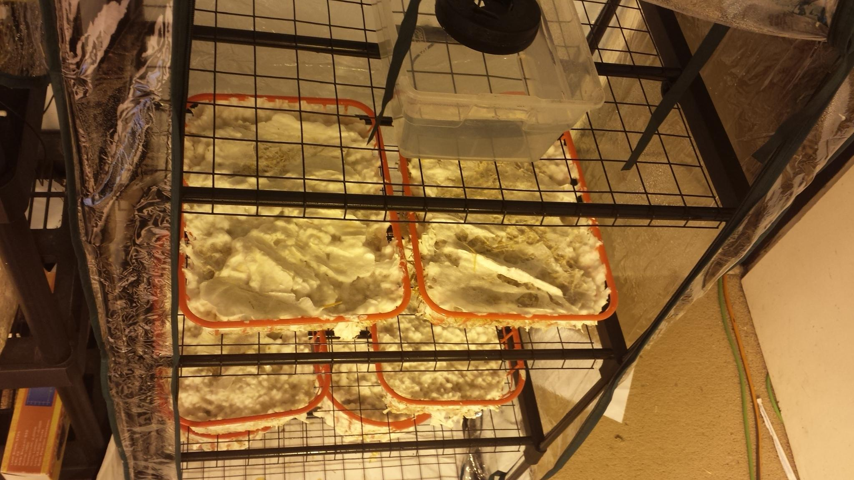
“I built a fruiting chamber, which involved putting together rods and plastic pieces to form a 4 level greenhouse structure”

Slide 8
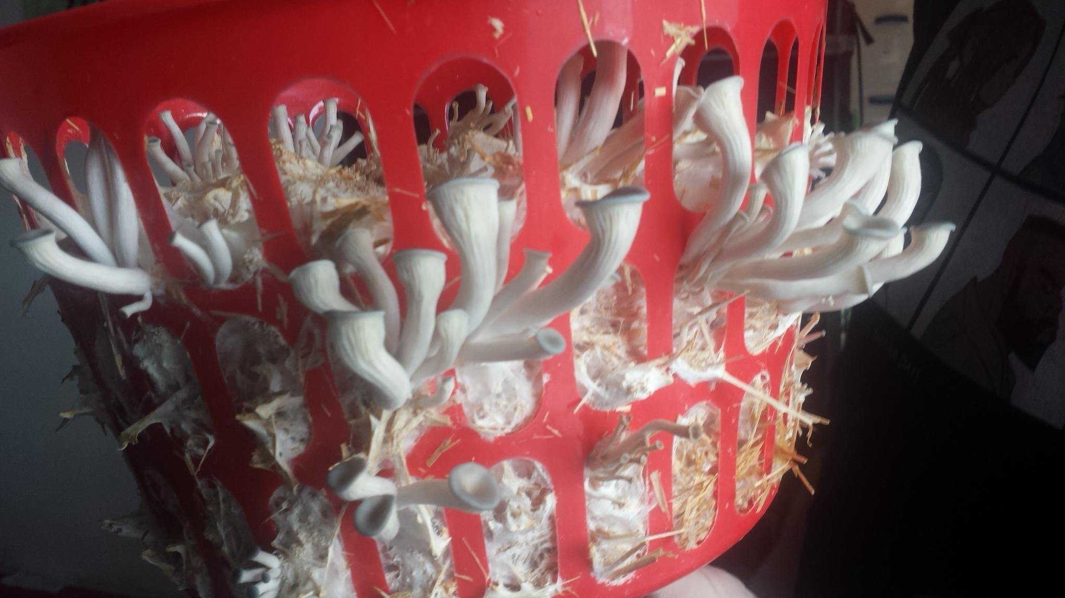
“my mushroom are growing!!! Its was so exciting the day they started pinning (the beginnings of little mushroom caps). Every day since I have seen major growth. It’s so exciting”

Slide 9
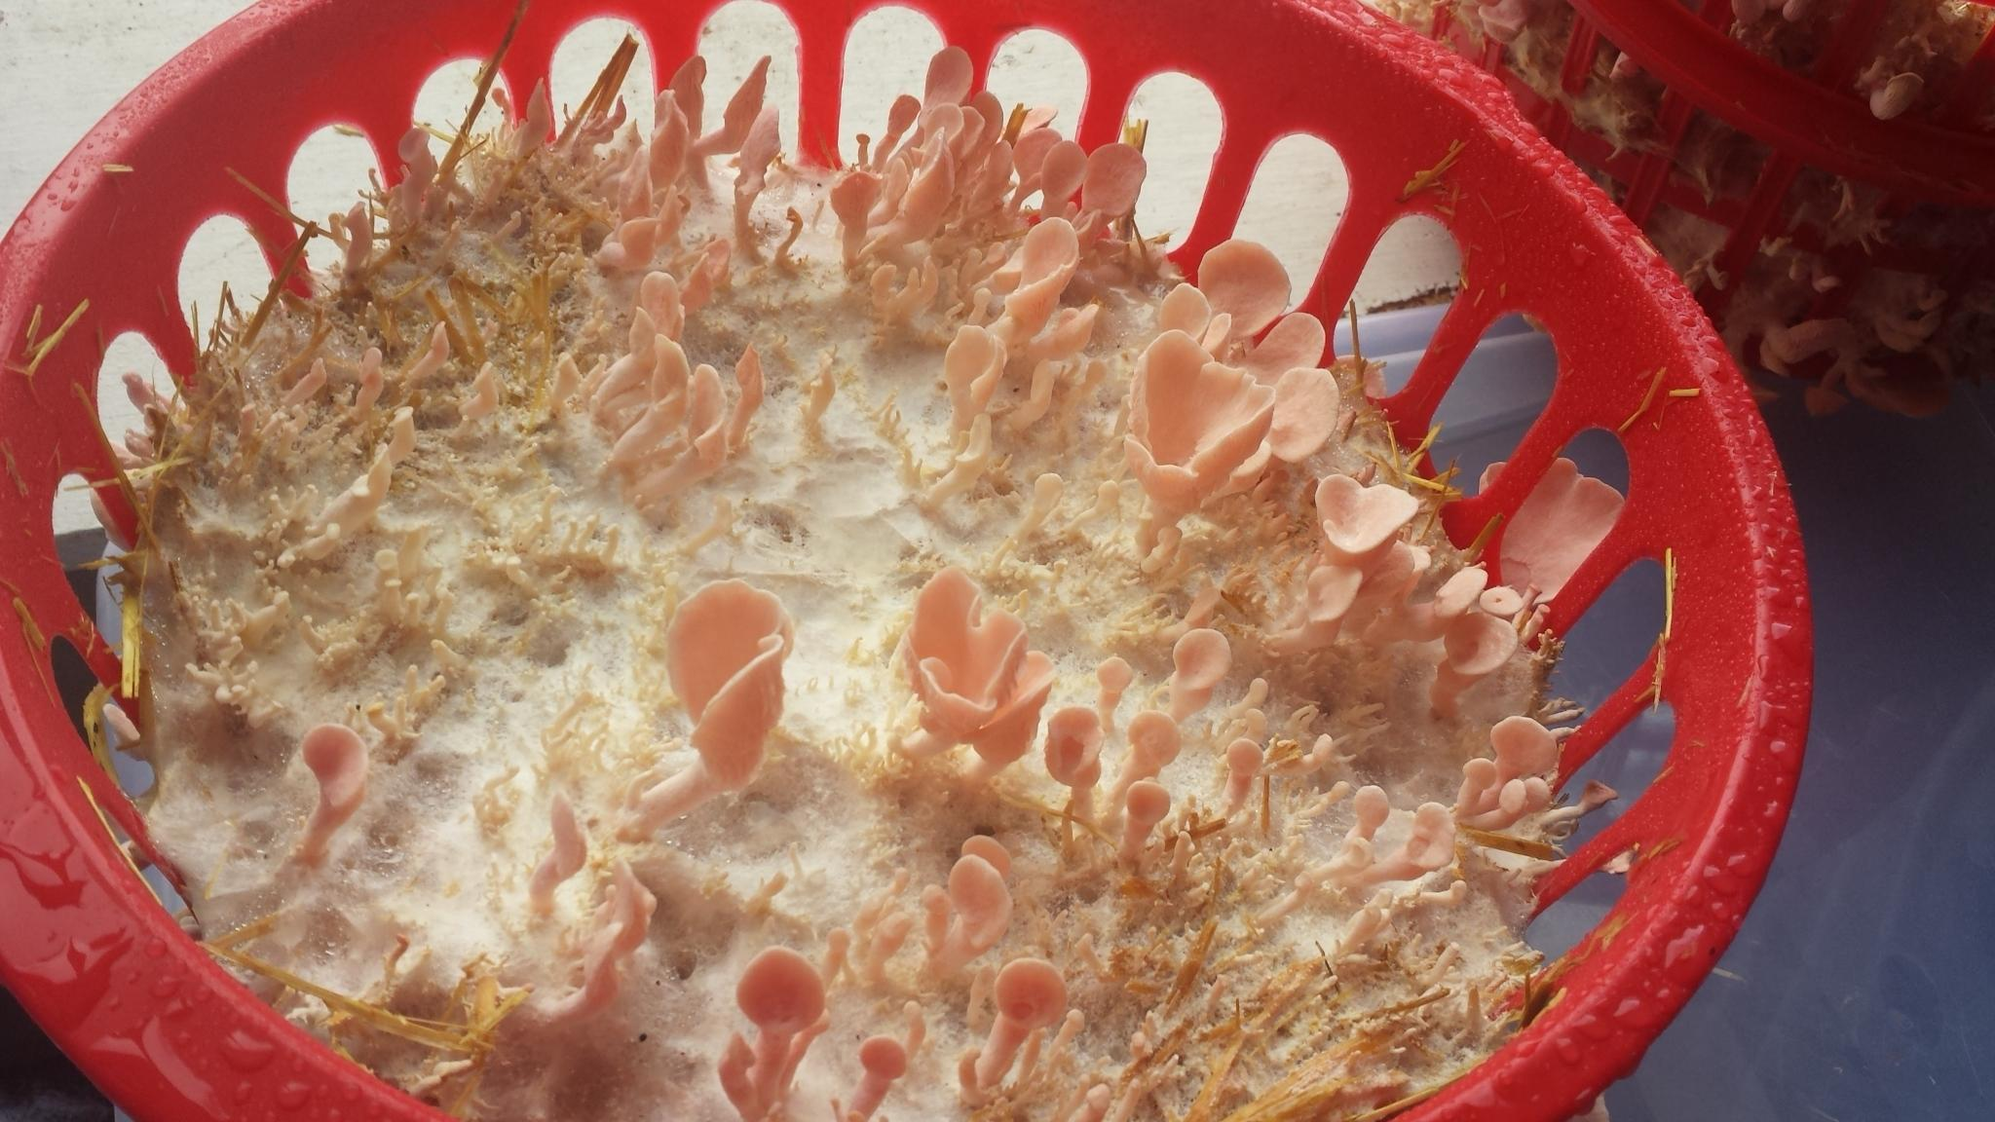
“The pink oyster mushrooms have begun to grow!! And man are they PINK! The blue Oyster mushroom had a blue tint to them for sure, but the pinks are super pink”

Slide 10
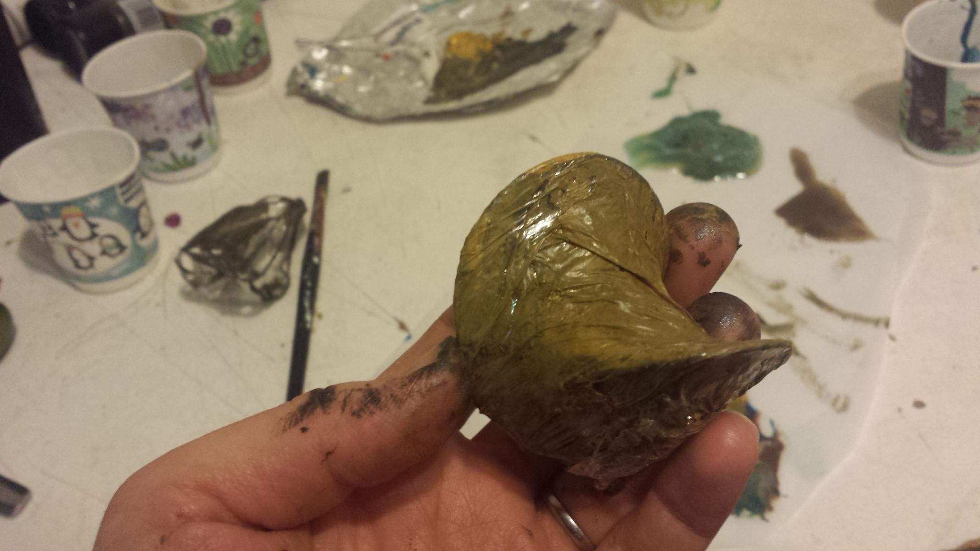
“I think I really like the look the painted, melted cellophane gives. To me, at least, it looks the most like the oil and trash one might find floating in the water”

Slide 11
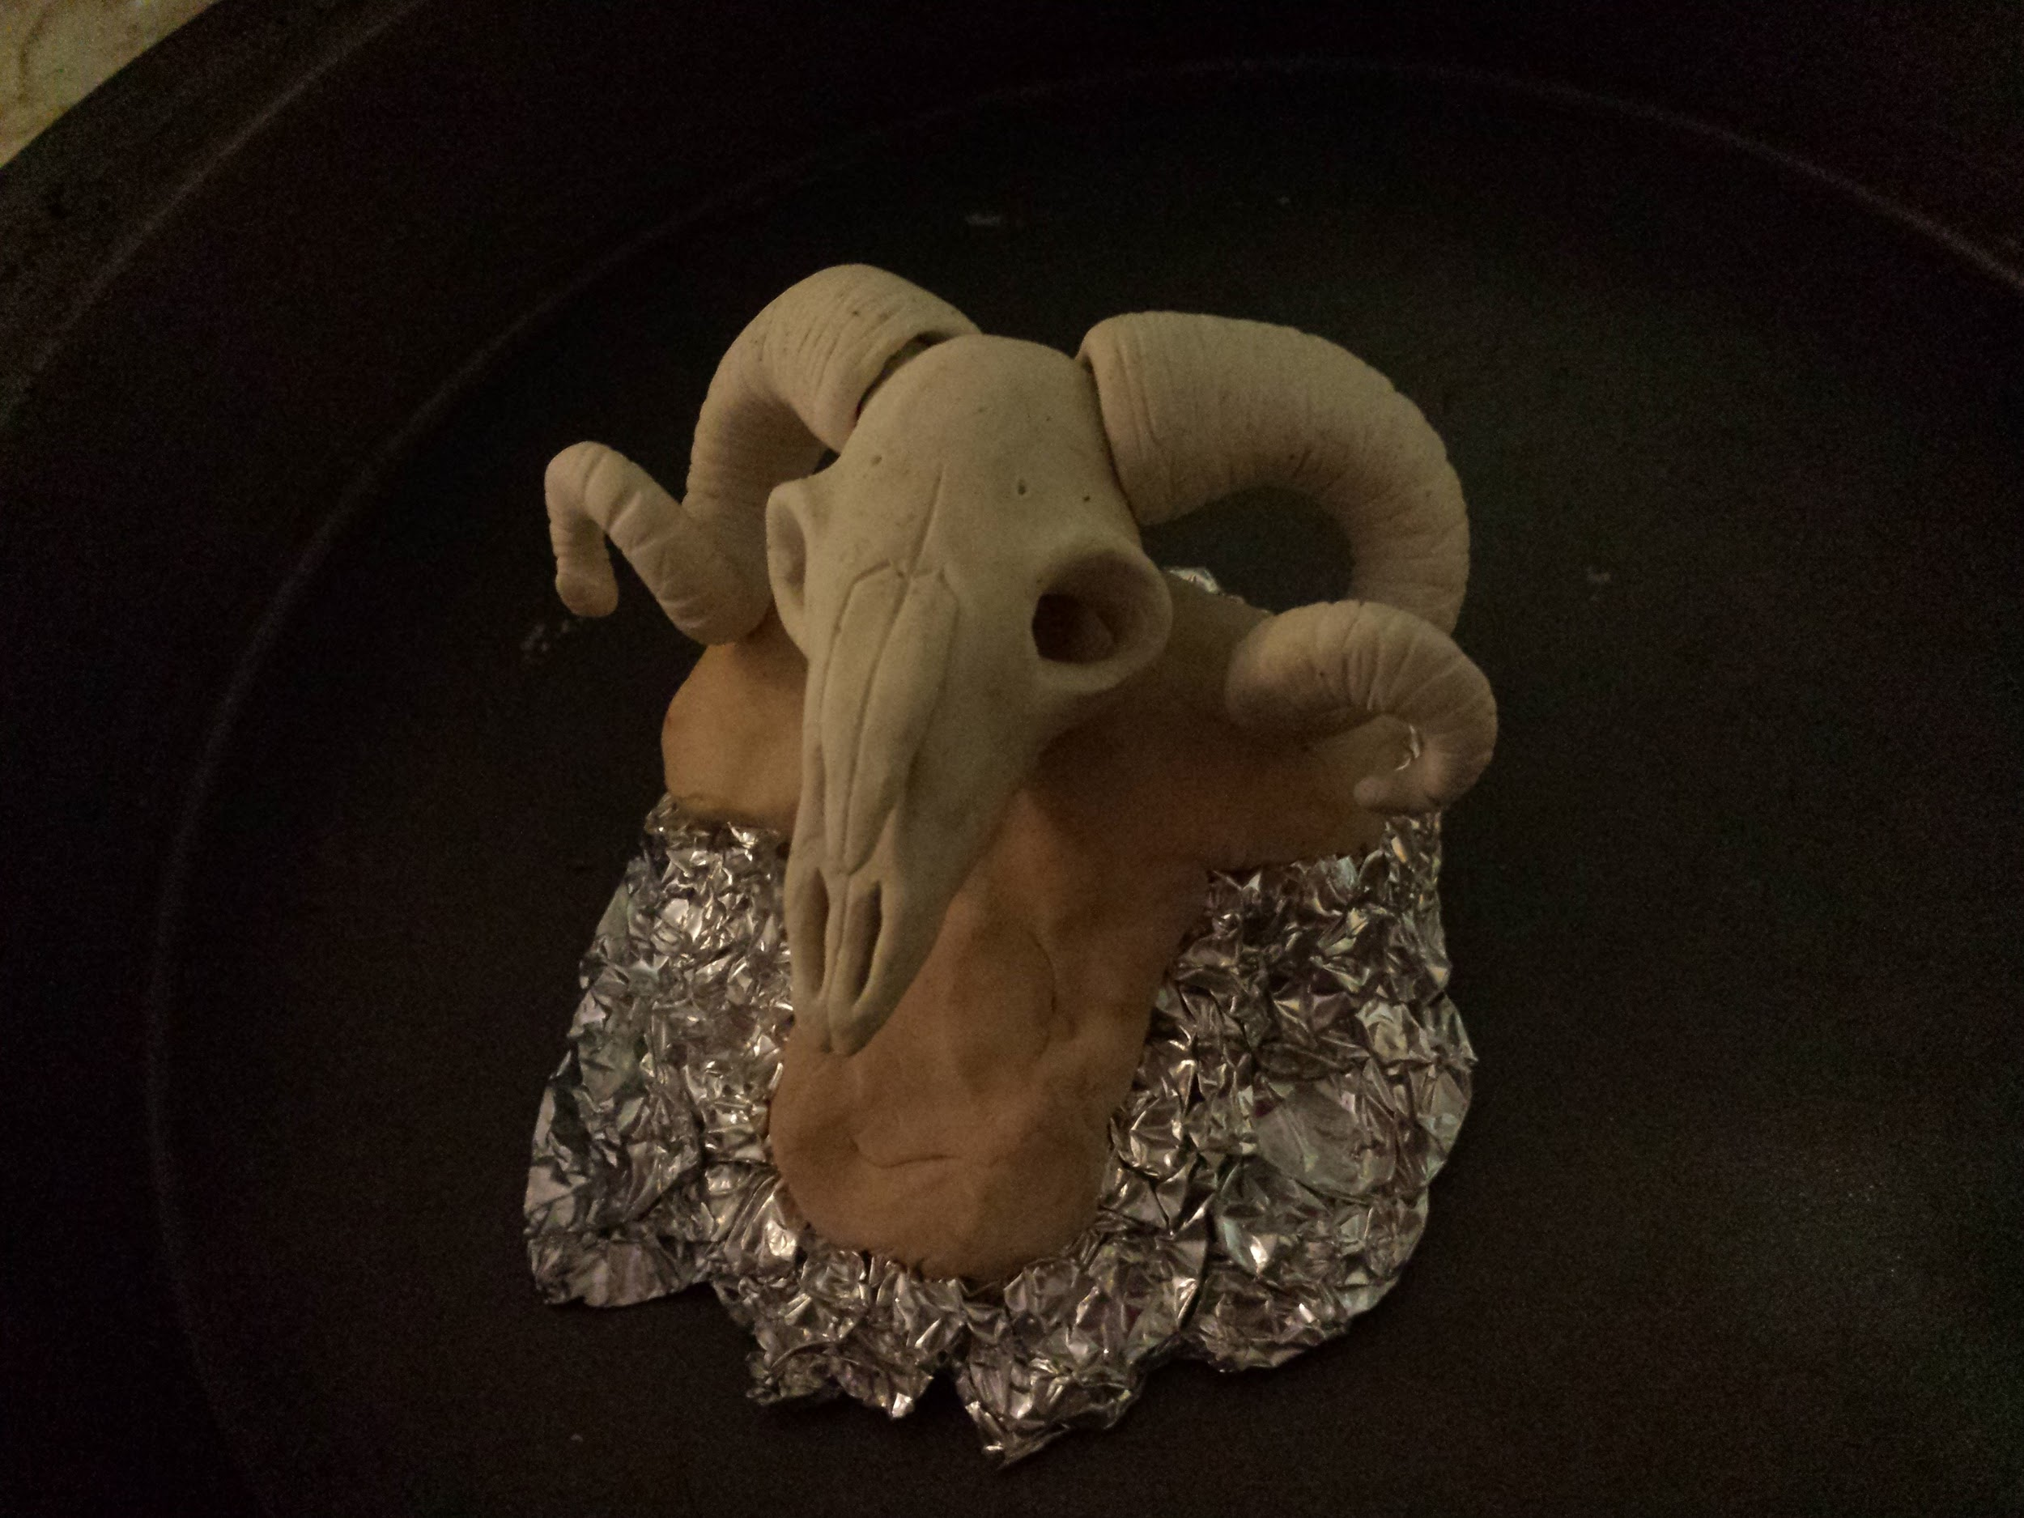
“As for the sculpture itself, I plan on making an oil monster wearing a skull mask. I began by making two demo skull masks (mostly to gain a feel for what I wanted) out of sculpey clay. However, I ended up really liking my second skull mask (a ram skull)”

Slide 12
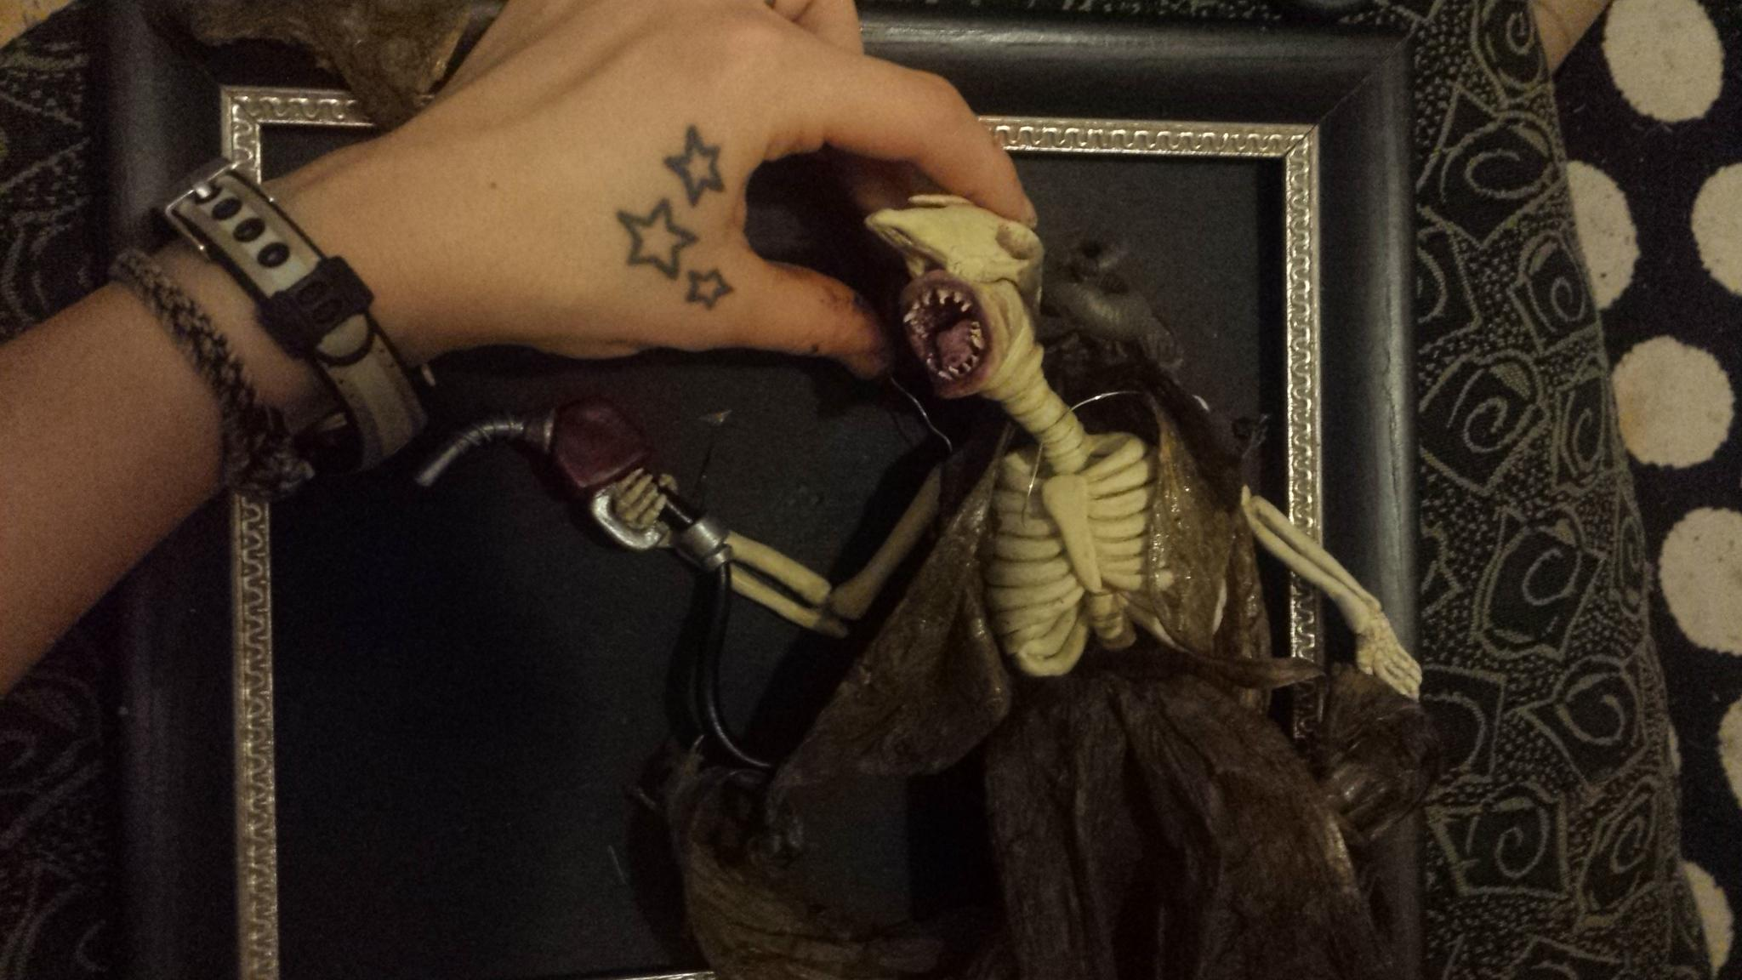
“This week I’ve finished painting a lot of the sculpture and am now working on my sculptures clothing”

Slide 13
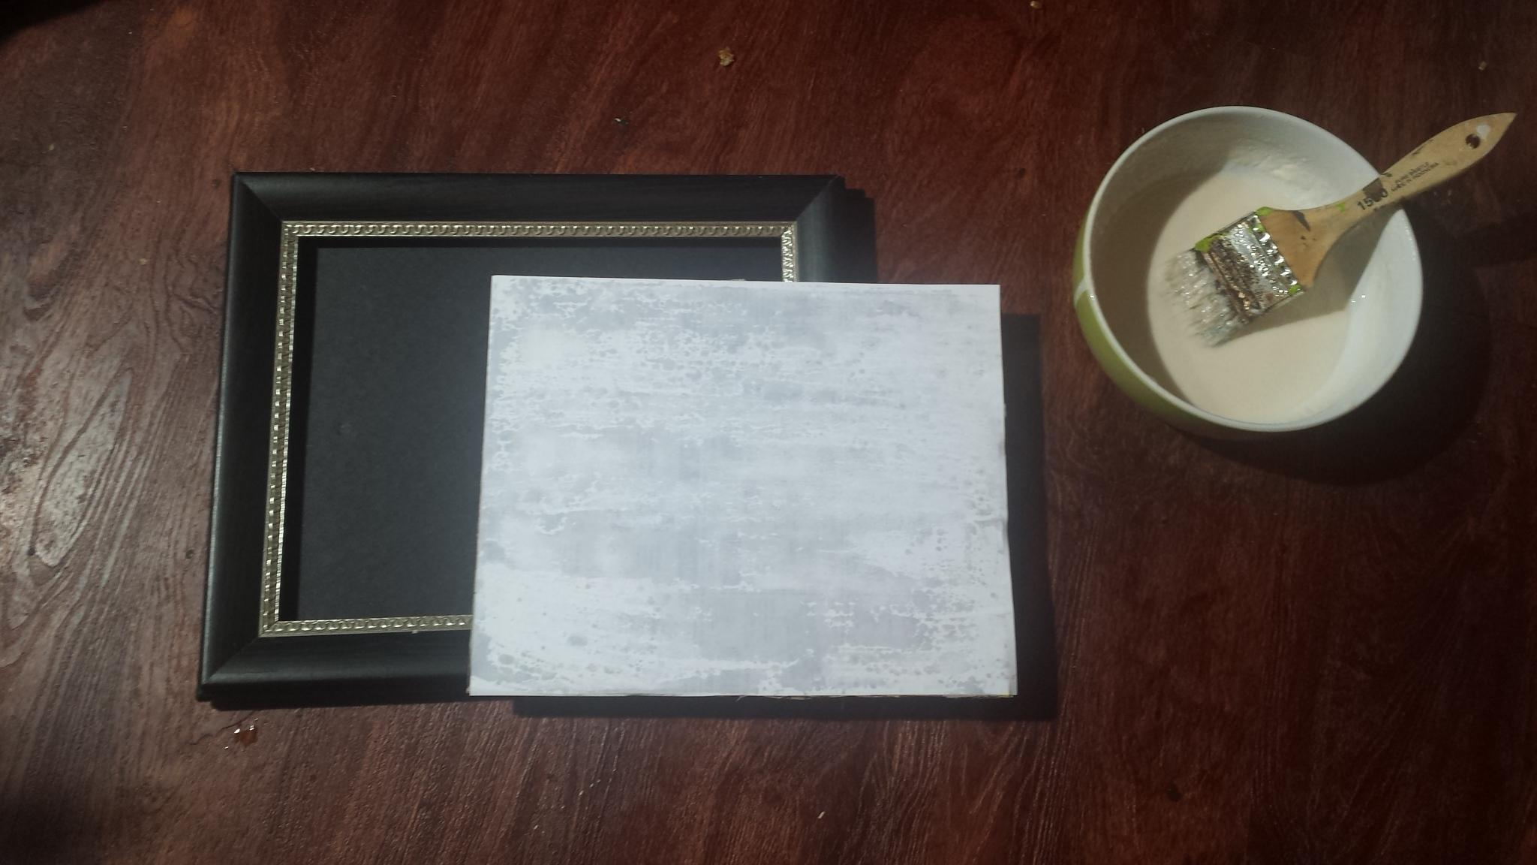
“I began the background by making a canvas (not actually made of canvas). I took the existing glass from the frame, made a layer of paper mache, followed by a sheet of white paper”

Slide 14
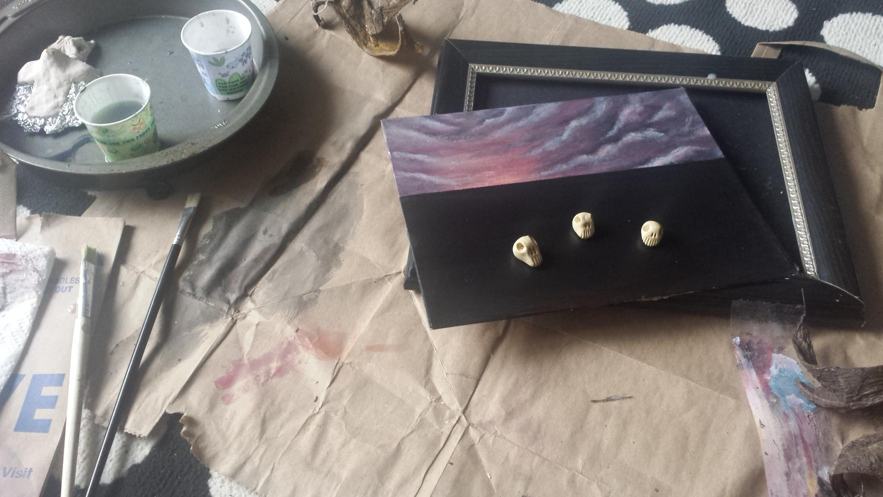
“I want to paint a beach scene with an evil red stormy sky and sea. I totally watched several Bob Ross videos while painting”

Slide 15
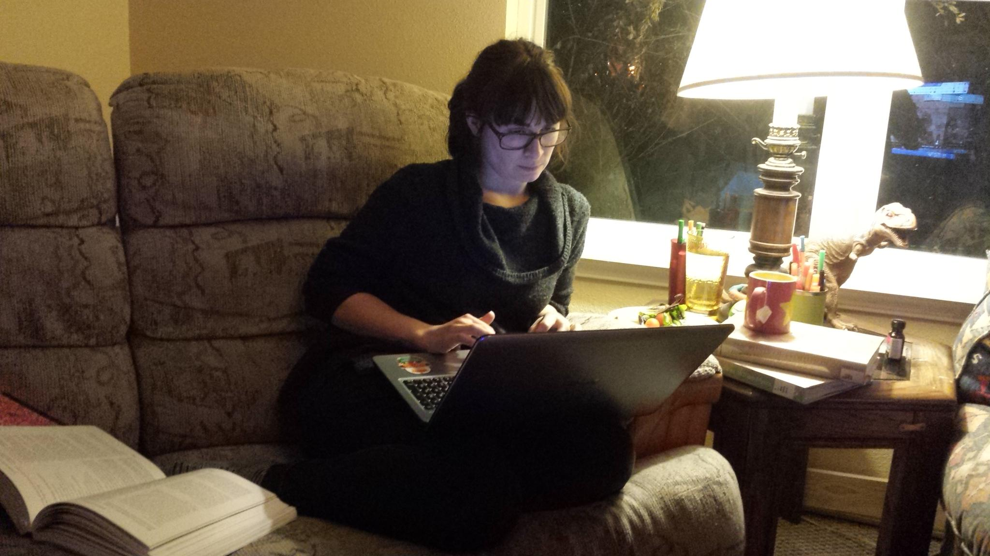
“The paper is about the evolution of tryptophane in Oyster mushrooms, and why it could be considered medicinal.”

Slide 16
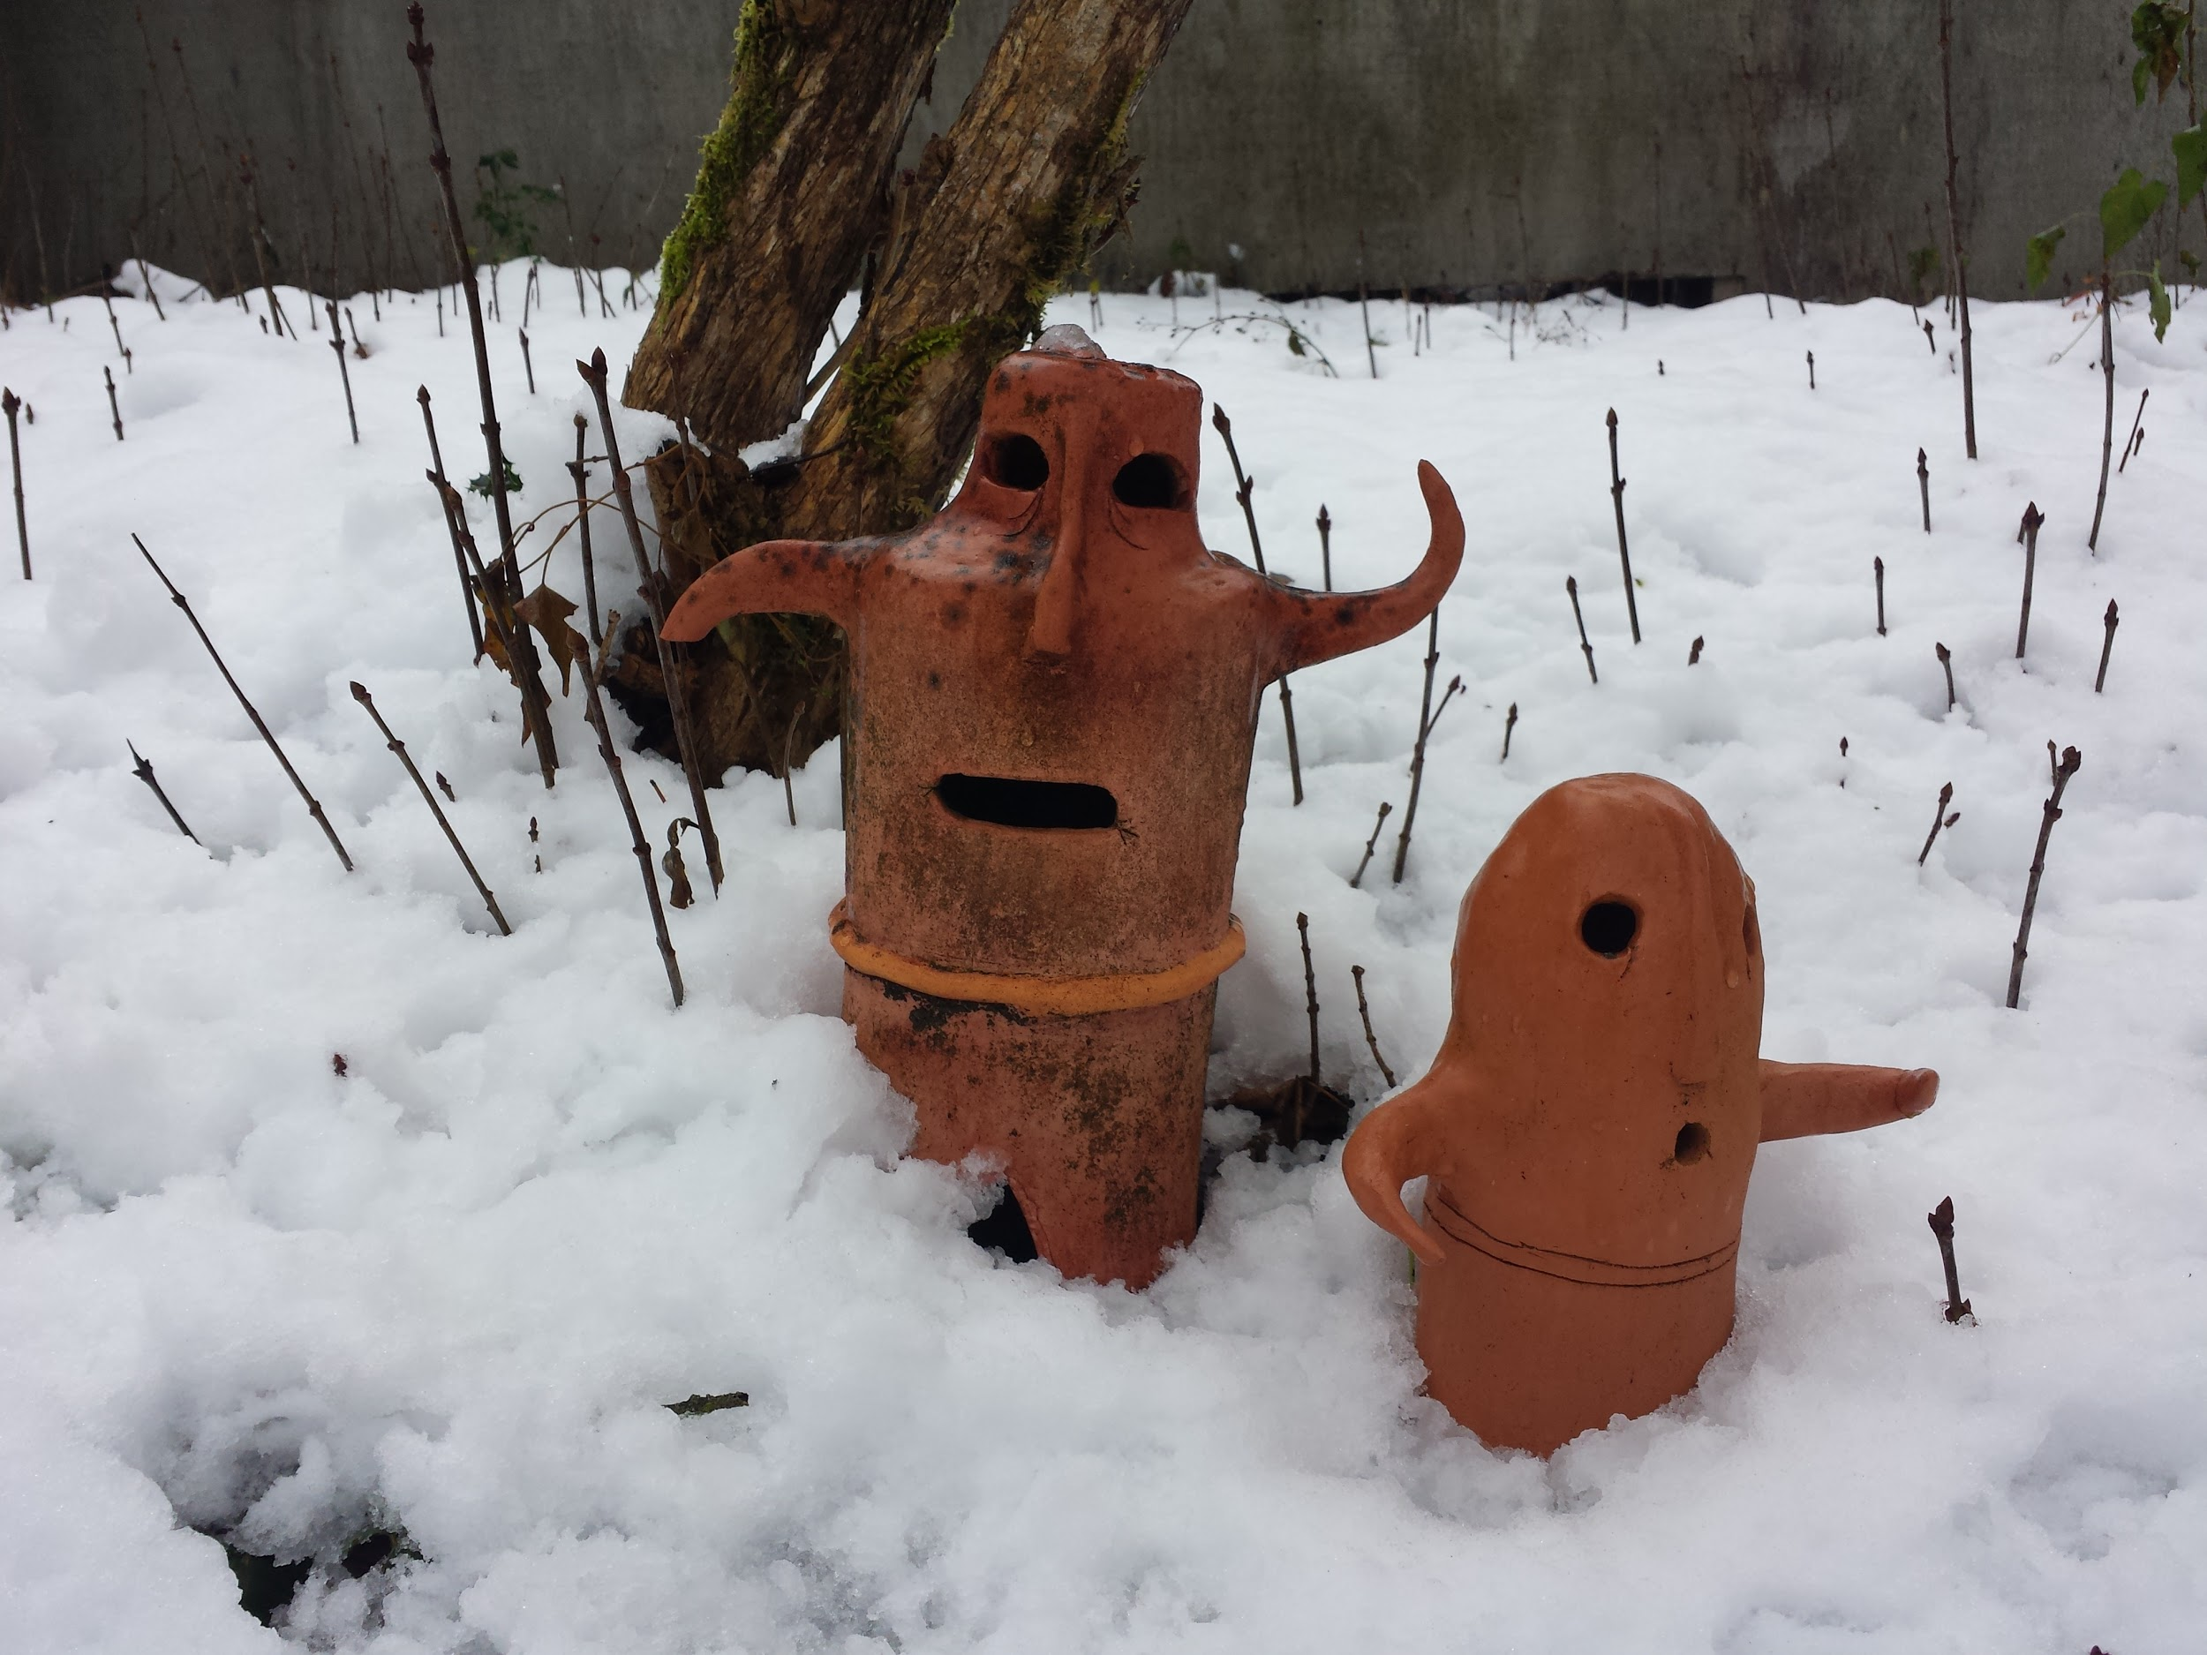
Thank
you!!
Thank you!

