Slide 1
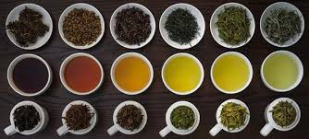
Tea: Chemistry and Social Ritual
Kotomi Yamamura
Final Presentation
SOS

Slide 2
ILC
I will read portions of the book, Tea: a symposium on the pharmacology and psychological effects of tea; therapeutic effects of tea; Chemistry and applications of green tea; caffeinated beverages: health benefits, physiological effects and chemistry. Plus any additional media, books, or peer reviewed research papers that will support my ability to synthesize my research.
I will write weekly e-journal posts to document my work, as well as, curate weekly tea tasting workshops where I will be able to share my research with my peers and faculty

Slide 3
Camellia sinensis Camellia sinensis variety sinensis “China Tea”

Slide 4
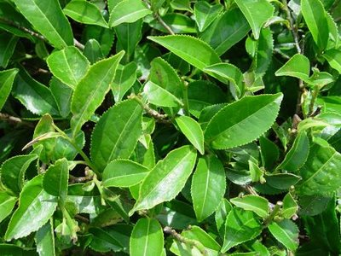
Camellia sinensis Camellia sinensis variety assamica “Assam Tea”

Slide 5
Categories of Tea
Un-oxidized
White and Green Tea
2. Semi-oxidized
Yellow and Oolong
3. Fully-oxidized
Red/Black Tea and Pu er
Only fermented tea is cooked Pu er

Slide 6
Tea Processing
Picking
Withering
Rolling
Drying
Sorting and Grading
Oxidation technique CTC (Cut Tear Curl)

Slide 7
Two general types of enzymatic transformation in tea
1. liberation of aroma molecules
2. Building of large molecules from small ones. The small molecules come from the tea leaf’s abundant supply of three-ring phenolic compounds.
Modifies, flavor, color, body, and physiological effects.

Slide 8
What is Oxidation
The chemical process in which atoms lose elections, as when the material combines with oxygen.
Oxidation of tea leaves

Slide 9
Enzymes, Polyphenol oxidase and peroxidase
Wither/roll>cells damaged>
Exposed to oxygen>
Polyphenols in cell leaf mix with peroxidase and then with polyphenol oxidase=chemical reaction.
Catechins are converted into flavanoids called theaflavins and thearubigins

Slide 10
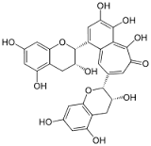
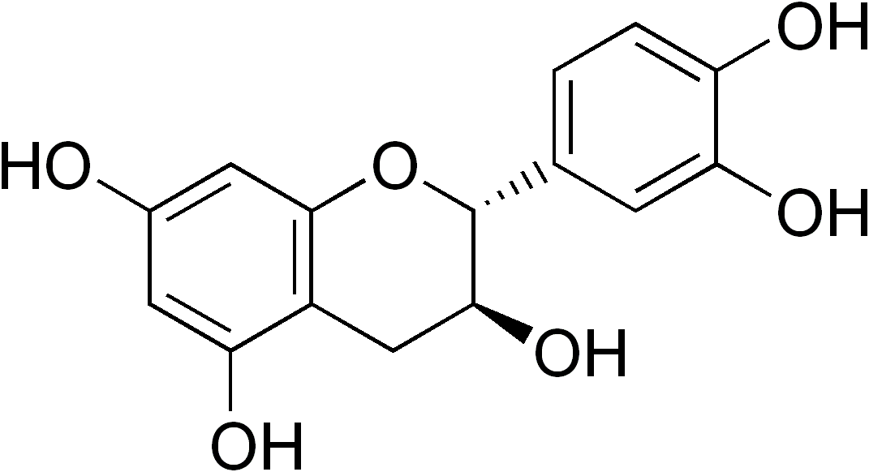
What is a polyphenol?
It is a compound containing more than one (poly)phenolic hydroxyl group

Slide 11
Theaflavin: Source of Yellow color in Yellow Tea and Oolong

Slide 12
Thearubigin: Source of red/brown color in Red/Black Tea and Pu er

Slide 16
“Man as a practice, supplements, the pharmacological stimuli he seeks in beverages by psychological and social stimuli, which reinforce and accentuate these pharmacological stimuli.” -Henry J.Klaunberg From, Tea: a symposium on the pharmacology and psychologic effects of tea

Slide 17
Related Art, Printmaking, and Wheel thrown pottery.

Slide 21
Bibliography
“31358_monkeypickedoolongrtea_a.jpg (638×638).” Accessed March 16, 2017. https://www.homenaturalcures.com/wp-content/uploads/31358_monkeypickedoolongrtea_a.jpg.
“32258_earlgreytea_Hol16.jpg (1000×1000).” Accessed March 16, 2017. http://demandware.edgesuite.net/sits_pod26/dw/image/v2/AAFV_PRD/on/demandware.static/-/Sites-Teavana_Master_Catalog/default/dw58701317/images/Product%20Images/Tea/32258_earlgreytea_Hol16.jpg?sw=1000&sh=1000.
“Assamteaplant.jpg (400×300).” Accessed March 16, 2017. http://www.assams.info/images/2008/05/assamteaplant.jpg.
“Camellia-Sinensis.jpg (1000×750).” Accessed March 16, 2017. http://www.plantsrescue.com/wp-content/uploads/2014/09/Camellia-sinensis.jpg.
“Catechin - Google Search.” Accessed March 16, 2017. https://www.google.com/search?q=catechin&source=lnms&tbm=isch&sa=X&sqi=2&ved=0ahUKEwit8Nytx9rSAhXGLmMKHRO9ACQQ_AUIBygC&biw=960&bih=525#imgrc=x8J8J1bgB0LrRM:
Klaunberg, Henry J. A Symposium on the Pharmacology and the Physiological and Physiological Effects of Tea. Biological Sciences Foundation, 1955.
“Polyphenol - Google Search.” Accessed March 16, 2017. https://www.google.com/search?q=polyphenol&source=lnms&tbm=isch&sa=X&ved=0ahUKEwie9uHOx9rSAhVC52MKHfyYDZ8Q_AUICCgD&biw=960&bih=525#imgrc=qN0yAyrEaObZ_M:
“Tea Polyphenols - Google Search.” Accessed March 16, 2017. https://www.google.com/search?q=the+phenolic+family&source=lnms&tbm=isch&sa=X&ved=0ahUKEwjg7Nr5yNrSAhUO8GMKHeT_Dz4Q_AUIBigB&biw=960&bih=525#tbm=isch&q=tea+polyphenols&*&imgrc=bi_ULSCWlBoPjM:
“Tea Processing and Its Effects on Polyphenol Content - Google Search.” Accessed March 16, 2017. https://www.google.com/search?q=tea+processing&source=lnms&tbm=isch&sa=X&sqi=2&ved=0ahUKEwjBsp2iydrSAhVQ_mMKHfY1D9sQ_AUIBigB&biw=1156&bih=595#tbm=isch&q=tea+processing+and+its+effects+on+polyphenol+content&*&imgrc=8qBfWex4lW_V7M:
“Theaflavin - Google Search.” Accessed March 16, 2017. https://www.google.com/search?q=catechin&source=lnms&tbm=isch&sa=X&sqi=2&ved=0ahUKEwit8Nytx9rSAhXGLmMKHRO9ACQQ_AUIBygC&biw=960&bih=525#tbm=isch&q=theaflavin&*&imgrc=fVl073tJv0TMuM:

