Slide 1
Addressing food insecurity on college campuses
At Evergreen and Beyond
Natasha Bynum
Winter 2017
SOS: ComAlt

Slide 2
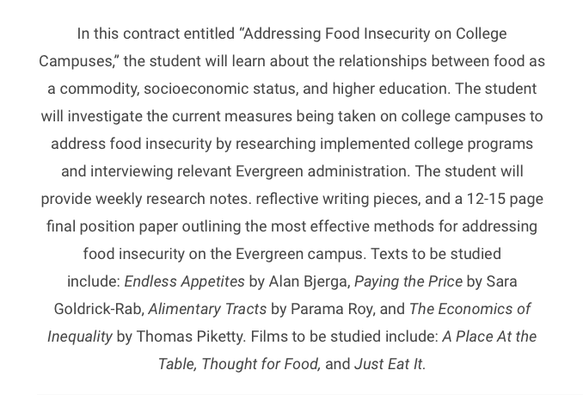
ILC Summary

Slide 3
TEXTs
Paying the Price by Sara Goldrick Rab: the most helpful in providing direct, relevant information
Alimentary Tracts and Endless Appetites
Economics of Inequality

Slide 4
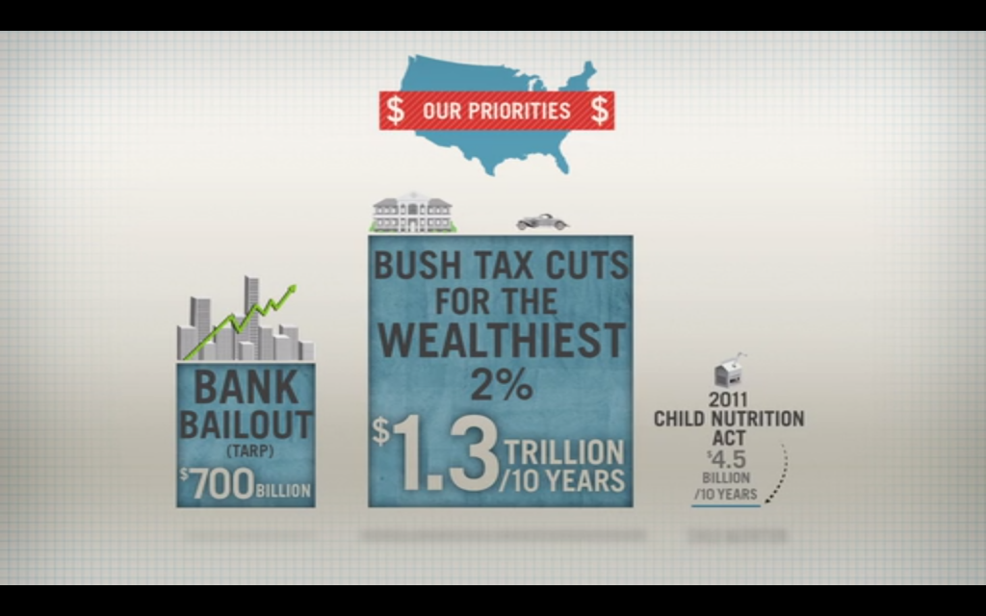
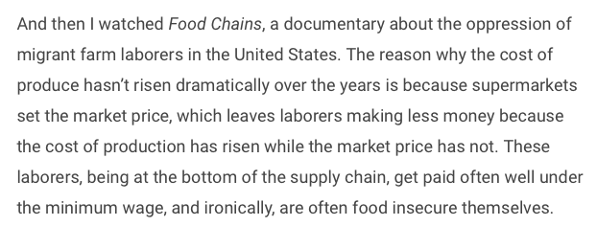
Documentaries
A Place at the Table: the most helpful in providing direct, relevant information
Food Chains, SEED: The Untold Story, Just Eat It

Slide 5
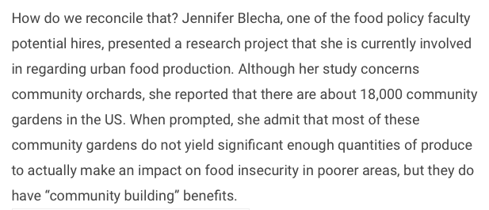
On campus: Food Faculty Candidates
Important to get to know future food policy faculty
Two of the three presented about community gardening

Slide 6
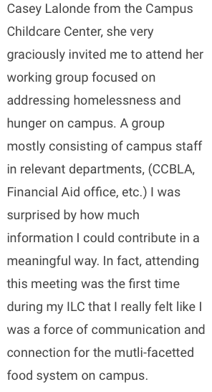
On campus: Human Services Working Group
Chaired by Casey Lalonde, Director of Campus Children’s Center
Bodies involved: CCBLA, Financial Aid, TRiO, Thurston County Food Bank, Police Services, and Food Systems Working Group (me)

Slide 7
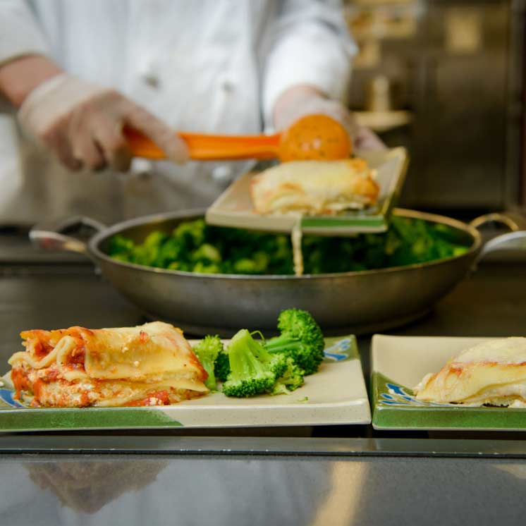
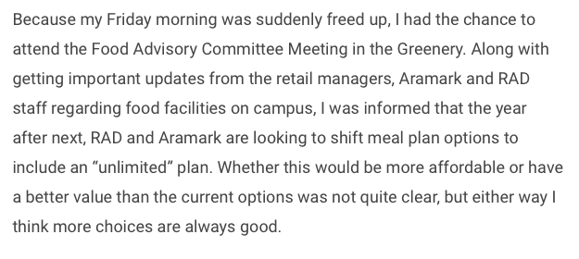
On campus: Food Advisory Committee
Bodies involved: RAD, Aramark, Retail Locations, Food Systems Working Group
Annual survey found students largest issue with campus food was affordability.

Slide 8
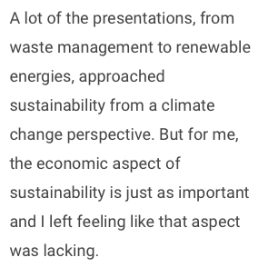
Off Campus:WAHESC

Slide 9
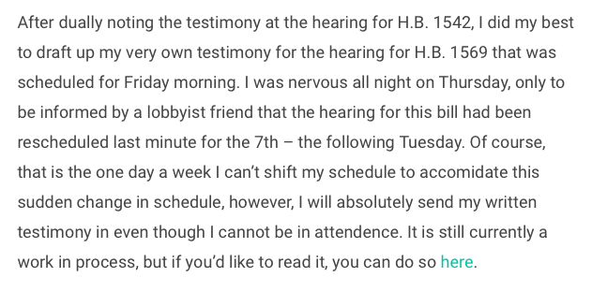
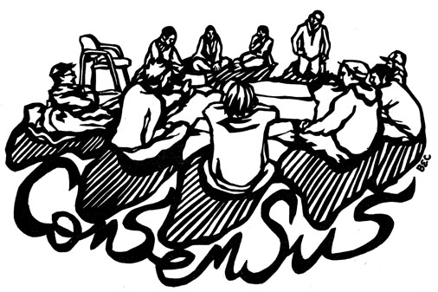
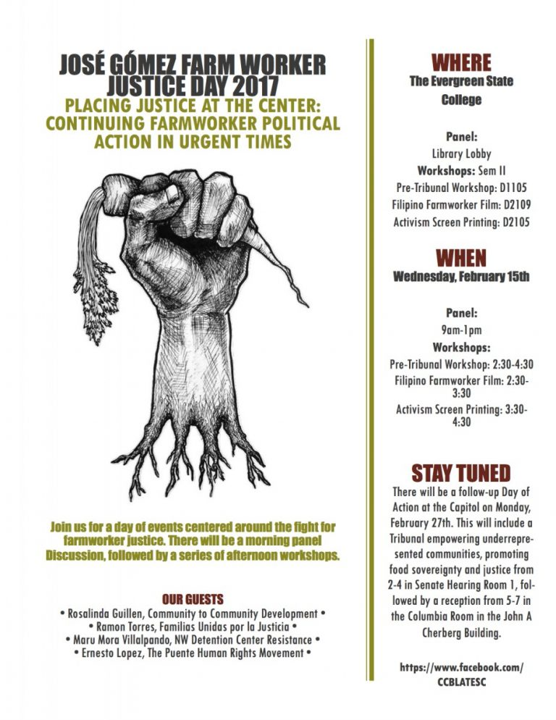
Off Campus: Policy
HB 1569 – died never having gone to committee
Farmworker Tribunal at the capitol

Slide 10
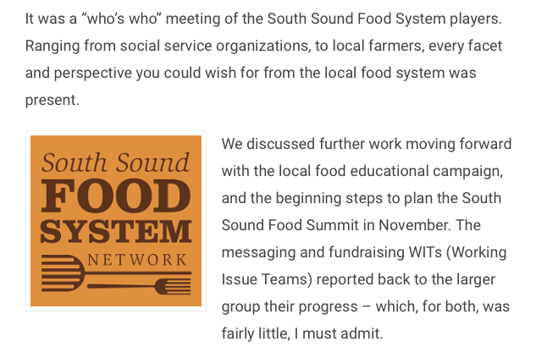
Off Campus: South Sound Food Systems Network
Food Summit Planning: Nov or Oct 2017
Intercept Survey for Marketing WIT

Slide 11
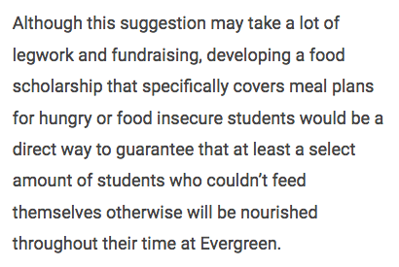
Potential Solutions
Human Services Working Group
Snack Shelves
Food Scholarships
Swipe Out Hunger

