Slide 1
Ecology Restoration and Foodbank Internship
Alana’s SOS – Spring 17

Slide 2
About my project
Completed two internships for the quarter
Ecology Restoration at Joint-Base Lewis McChord - Department of Fish and Wildlife
Thurston County Food Bank
Intern focusing on School Gardens Project
Notes:
Why I chose these internships: I initially was interested in both, wanting to do a different type of food service and hospitality work, which attracted me to the food bank. I also was unaware of all the extra components the food bank has to offer, but I took interest and wanted to learn and do as much as possible I also took interest in the ecology part of the project because I previously had studied botany, native plants, and worked within a field that allowed me to learn about these plants and the culture around them. Althought it was work on an organic farm, the work still overlapped and I was able to contribute my previous knowledge all while learning more about the environment in different ways

Slide 3
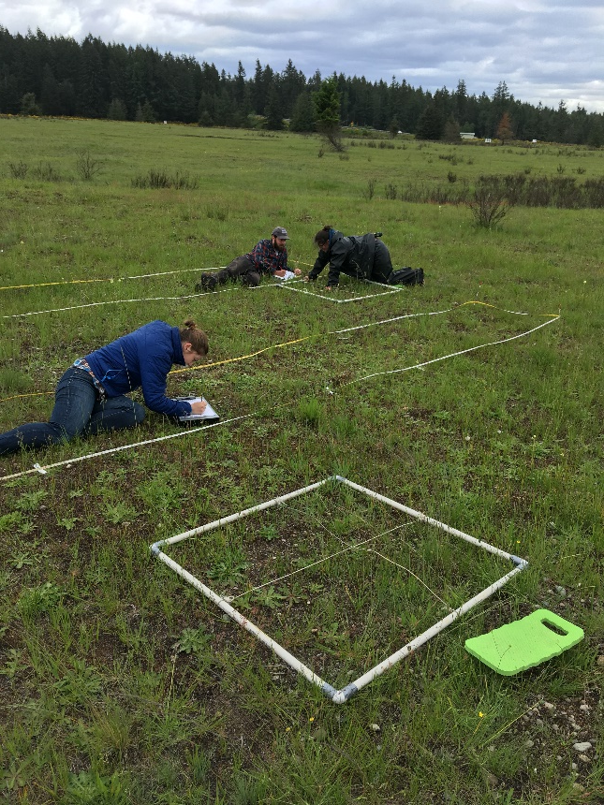
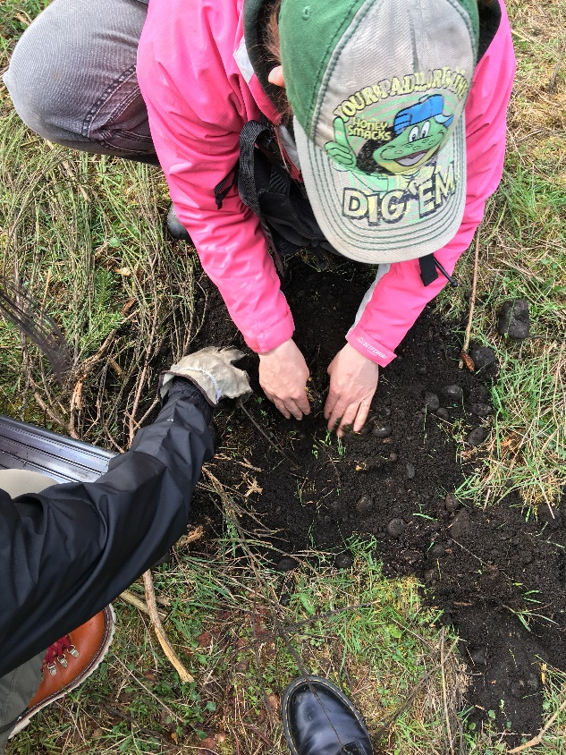
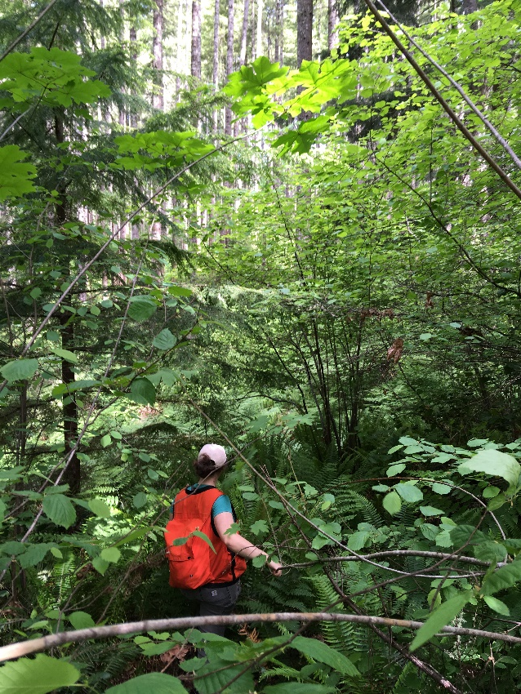
Ecology Restoration
Work included: - Wetland and Prairie restoration - Build different styles of bat boxes - Native Oak tree planting - Brush cutting, pre-burn prairie work
- Vegetative monitoring of native plants - Invasive plant tracking - Raptor Species Monitoring - Timber Sales

Slide 4
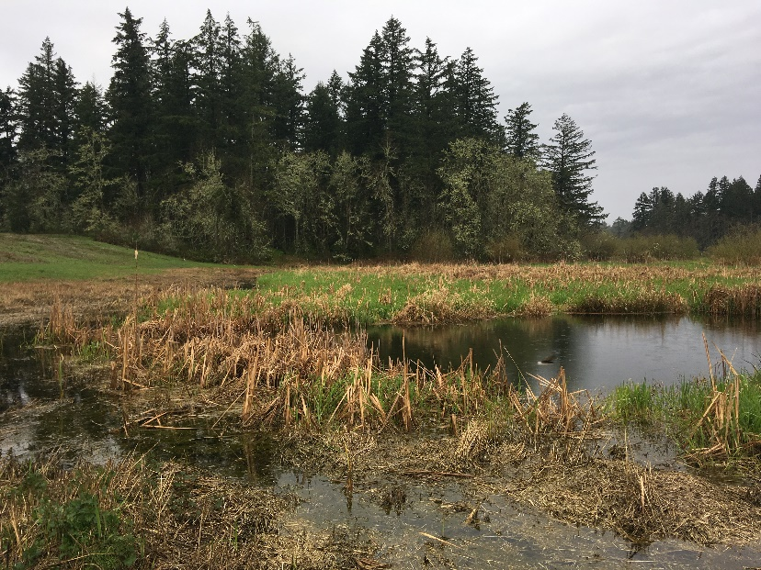
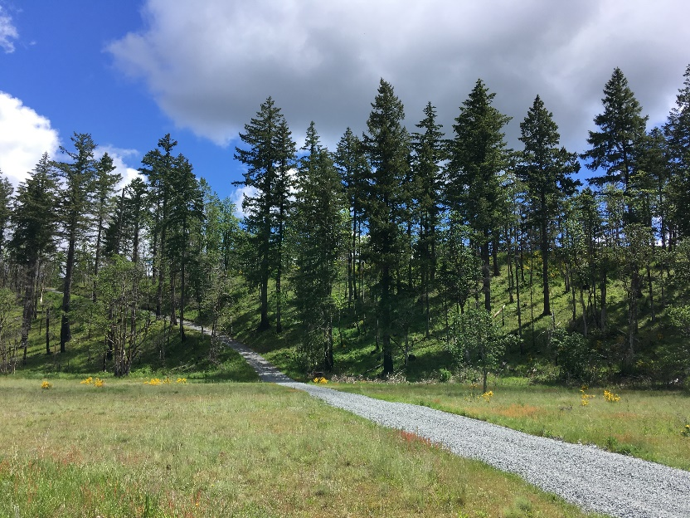
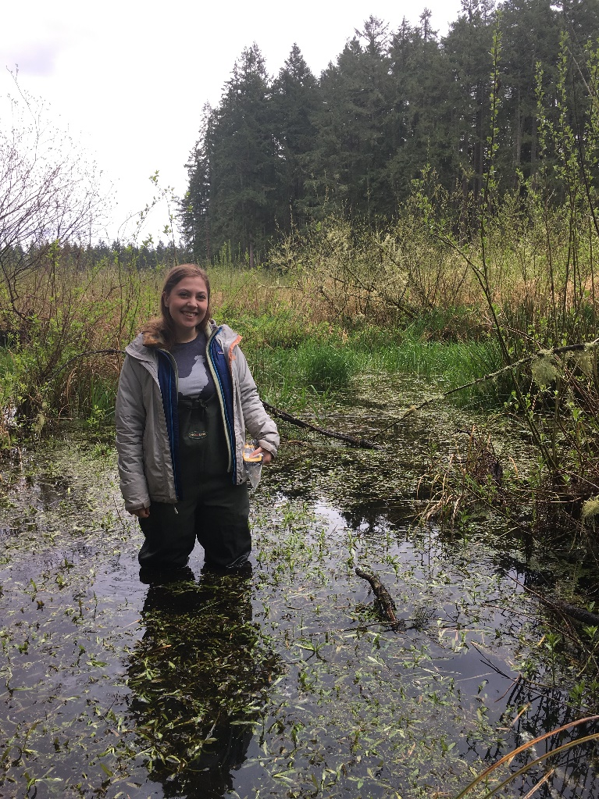
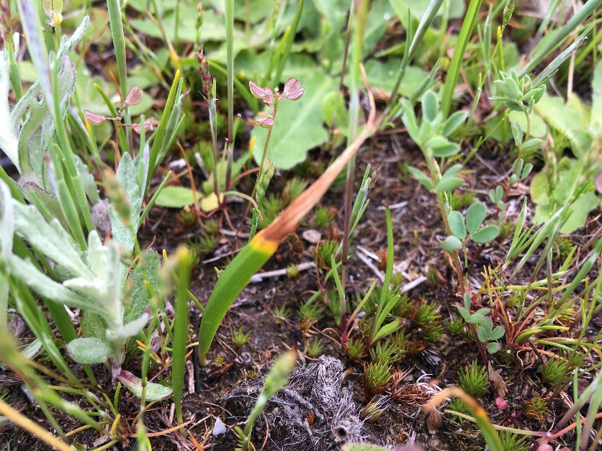
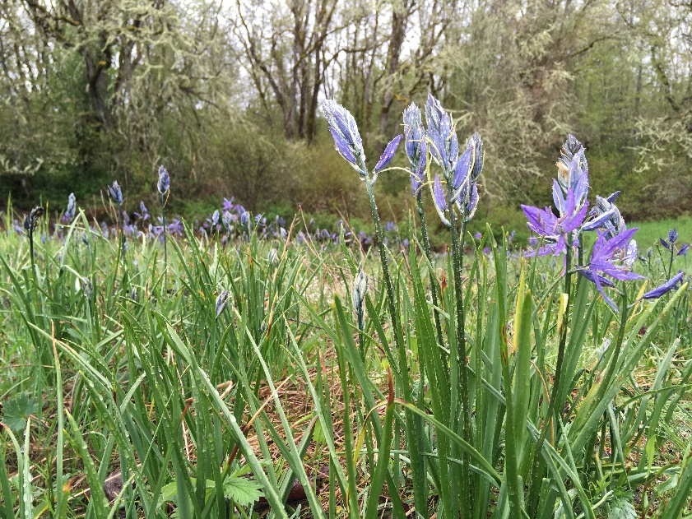
Prairies, Wetlands and Marshes

Slide 5
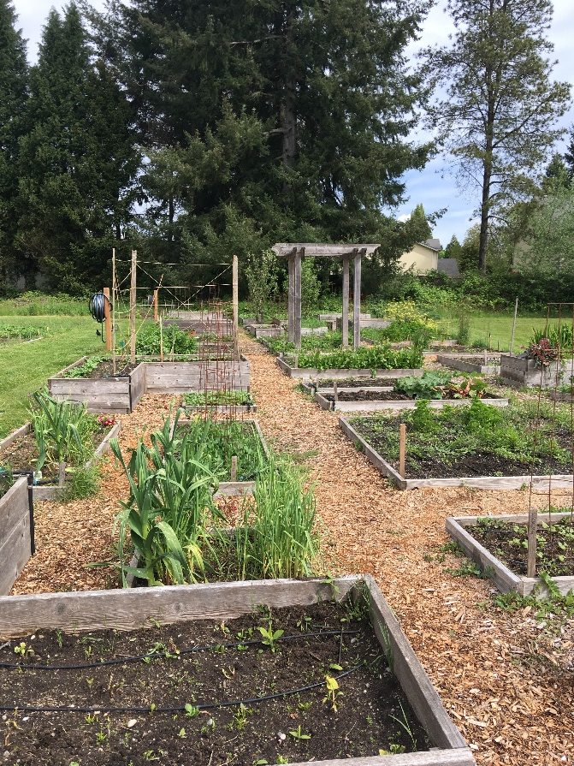
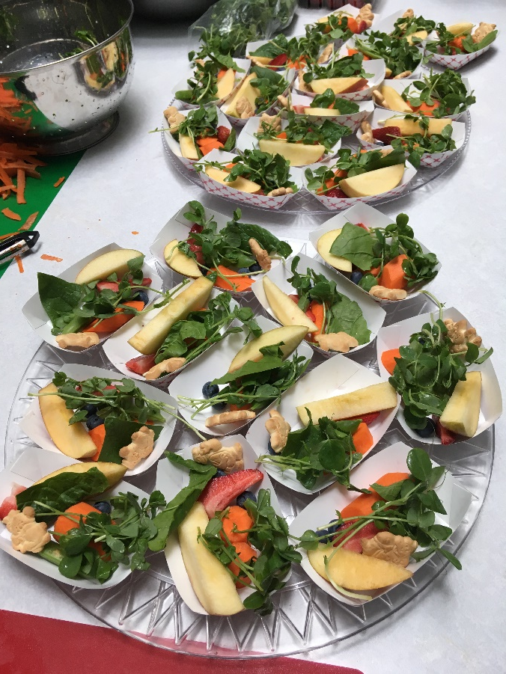
Food Bank Internship
Work Included: -Seed packet sorting -Thurston County school gardens work -Food Packaging and sorting -Field Trips with students grades 3rd – 5th

Slide 6
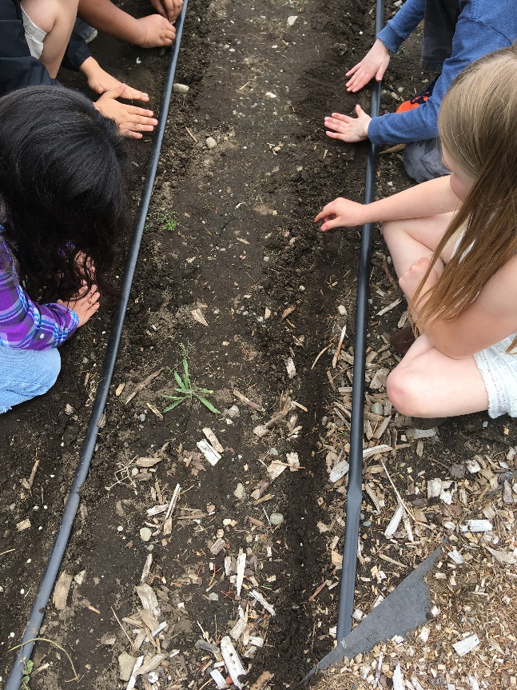
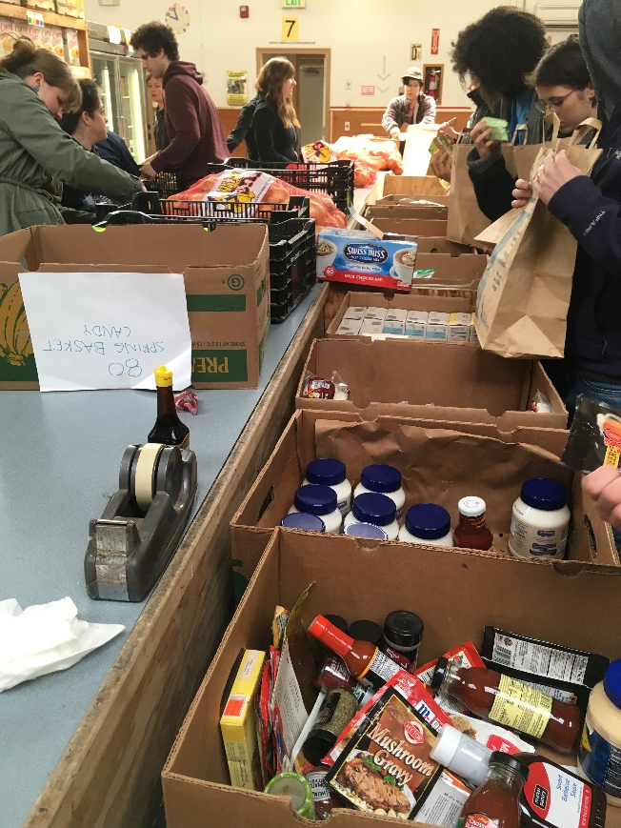
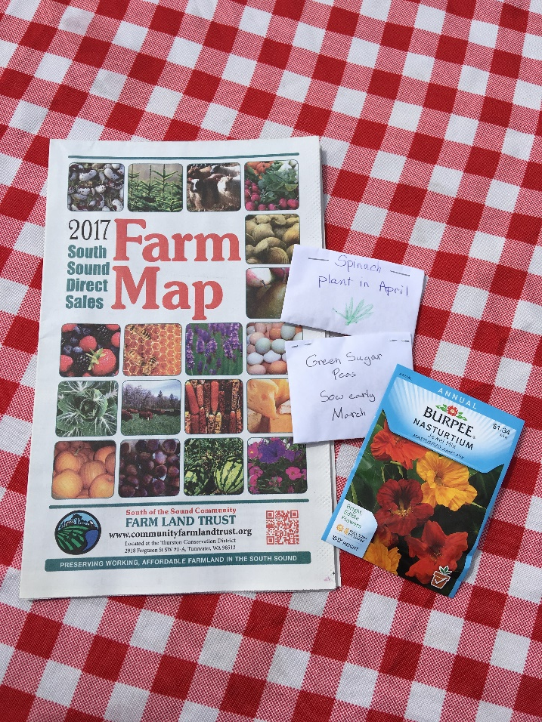
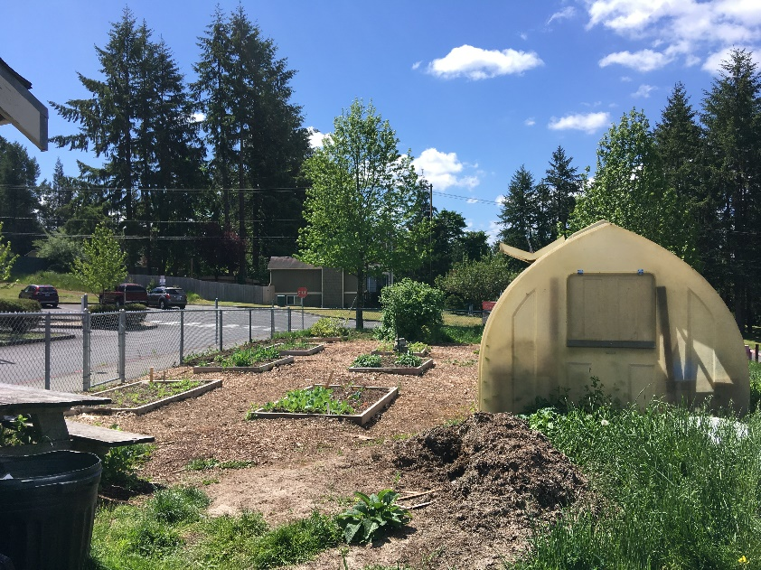
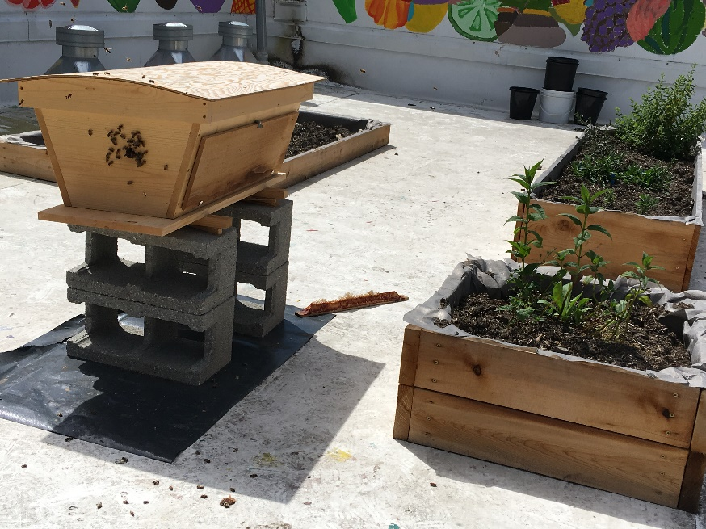
Different work sites through the food bank

Slide 7
Field Trips
Nearly all the field trips I went on were through my previous program, Food Health and Sustainability
- Overnight to Skagit Valley, April 27th – 28th (Steve Jones Bread Lab, NW Mills, Skagit Valley Malting, WSU Extension and Research Center in Mt. Vernon) -Day Trips Downtown Olympia Food Bank, The Bread Peddler, Fish Tail Brew Pub
Other Trips: Redmond: KIS Farm Seattle: Visit the MOHAI Portland: Cacao Luxury Chocolate Store

Slide 8
Locations of Sites Visited
Roughly 3 hours spent in travel time each week. (Not incl. overnight field trips)
This gave me time to listen to a LOT of podcasts while driving, to fill up required hours. http://blogs.evergreen.edu/comalt-spring-alana/map/
Notes:
-130 miles from TESC to The Bread Lab in Mt. Vernon - 60 ish miles from there to Redmond - 20 miles to DuPont transit, and more time traveling on to Base *Not shown on map: Lydia Hawk Elementary, Nisqually Middle School, St. Mark Lutheran Church (Where school garden work is held for Mountain View Elementary) Rainier during off sights work with JBLM, and Cacao – Shop in Portland A LOT of my project was spent commuting This was hard because so much of my time was spent on the road, and I couldn’t be doing as many posts as I wanted I didn’t actually calculate the total time I spent commuting every week, but it was something I had to take into consideration on top of my committed time for each week I spent roughly 3 hours a week driving. This time was usually sitting in traffic on the way to and from DuPont when I worked on Base, and traveling from Downtown Oly to Lacey on field trip days with schools Due to all the time commuting, I listened to a lot of podcasts during my travel times

Slide 9
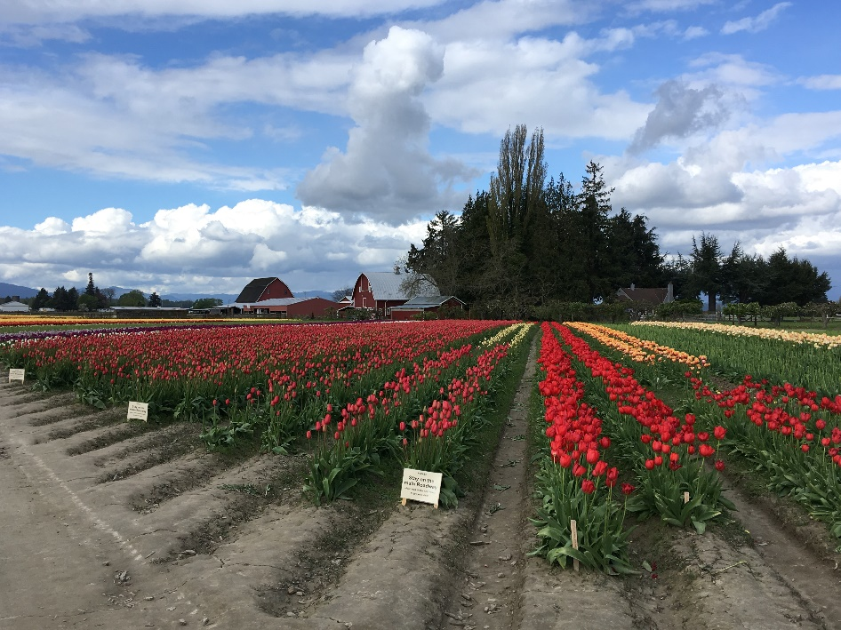
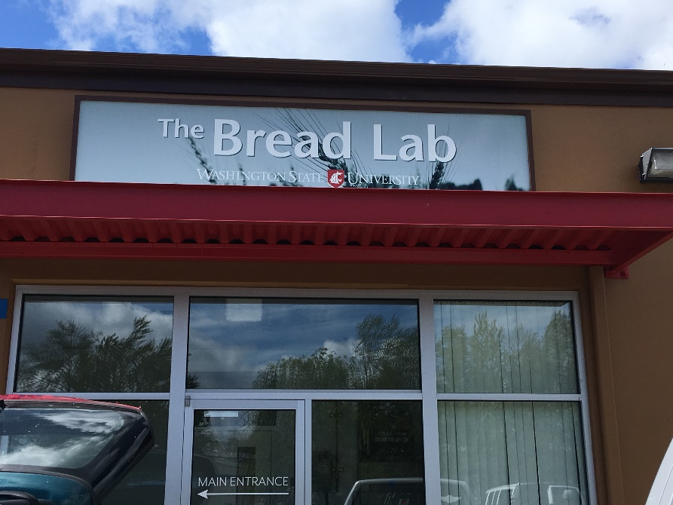
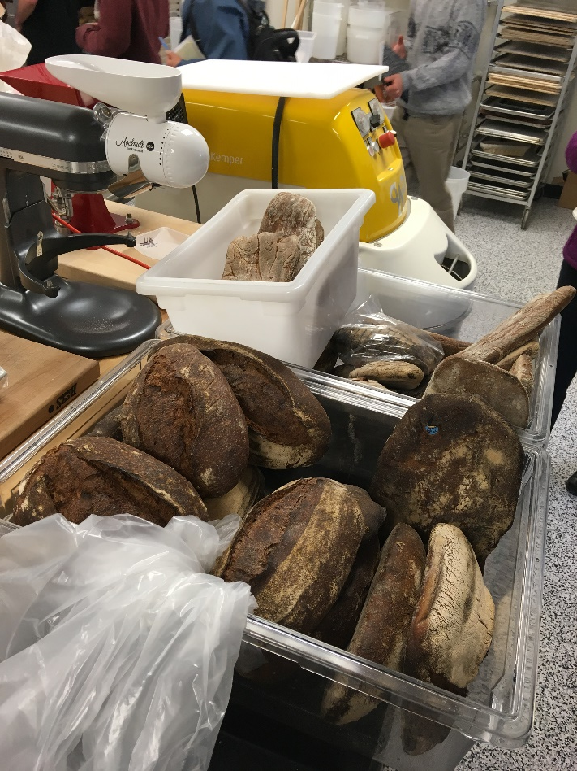
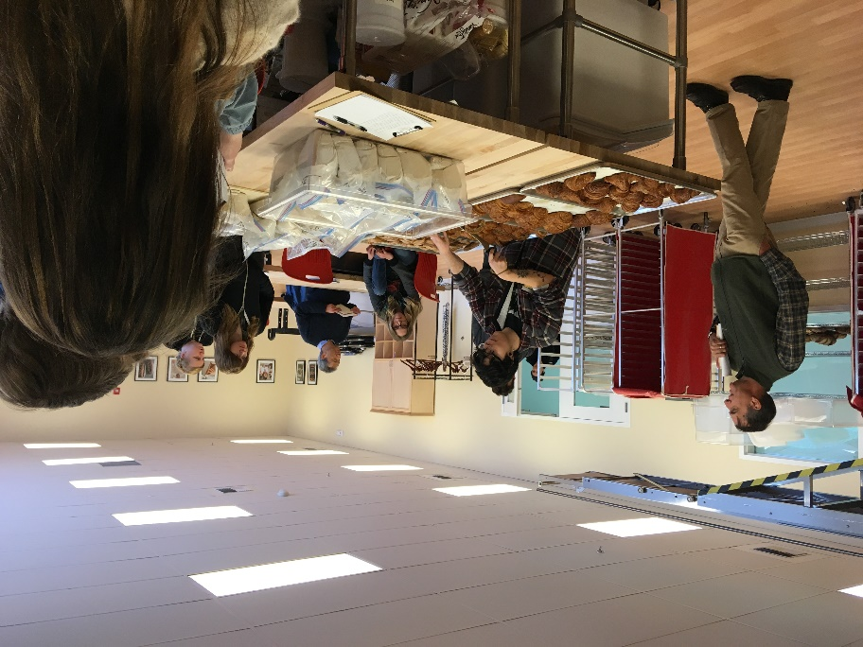
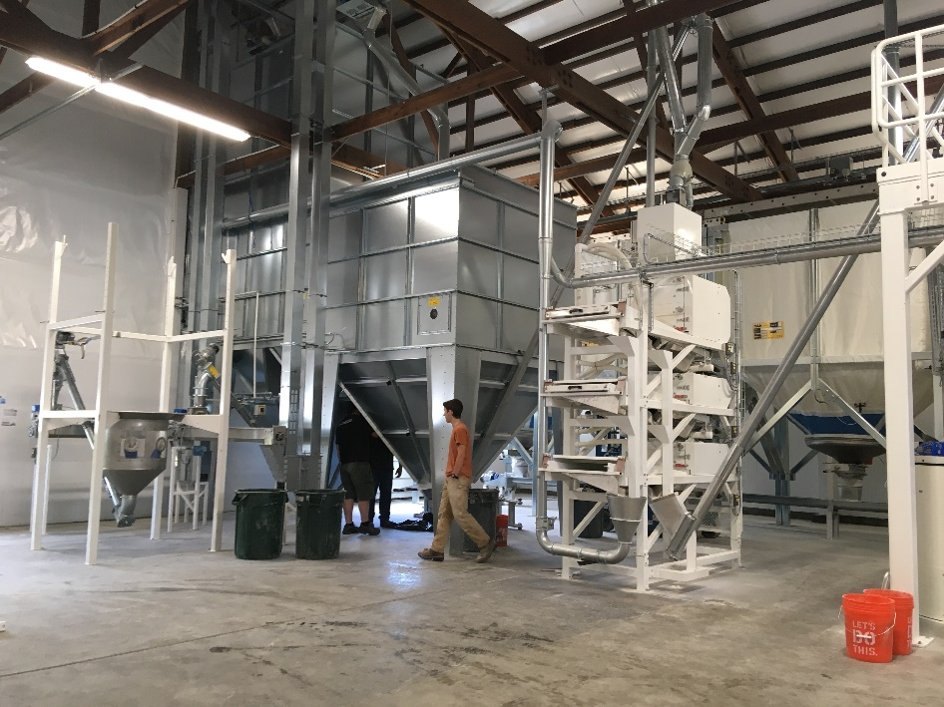
Two day field trip to Mt Vernon, WA and Skagit Valley

Slide 10
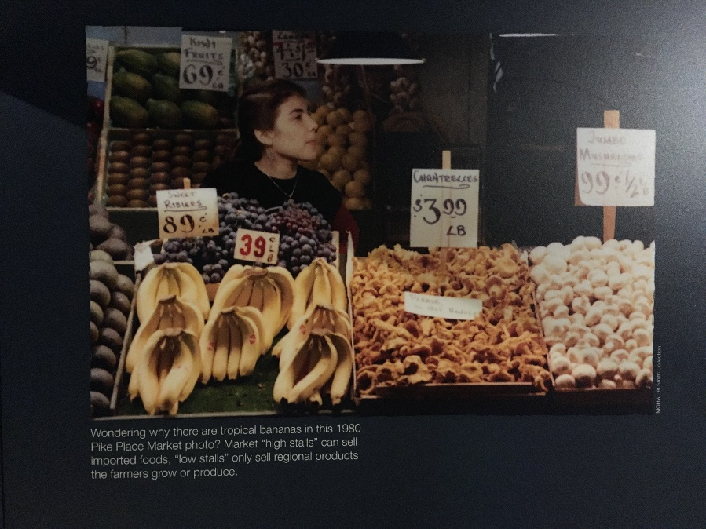
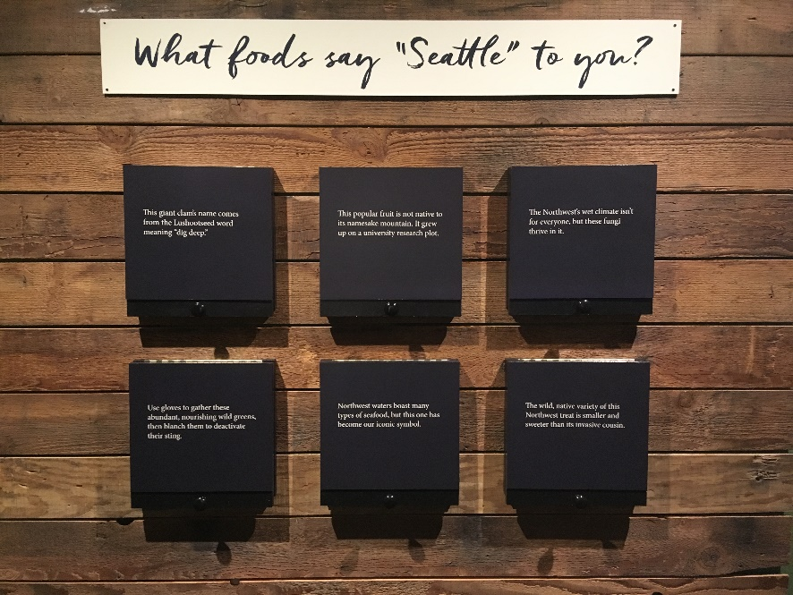
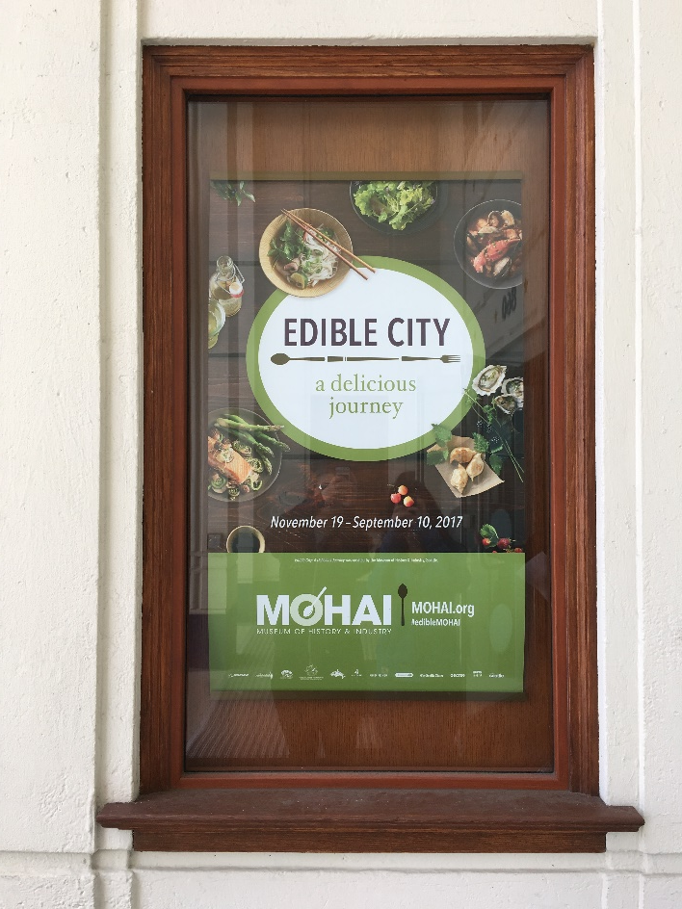
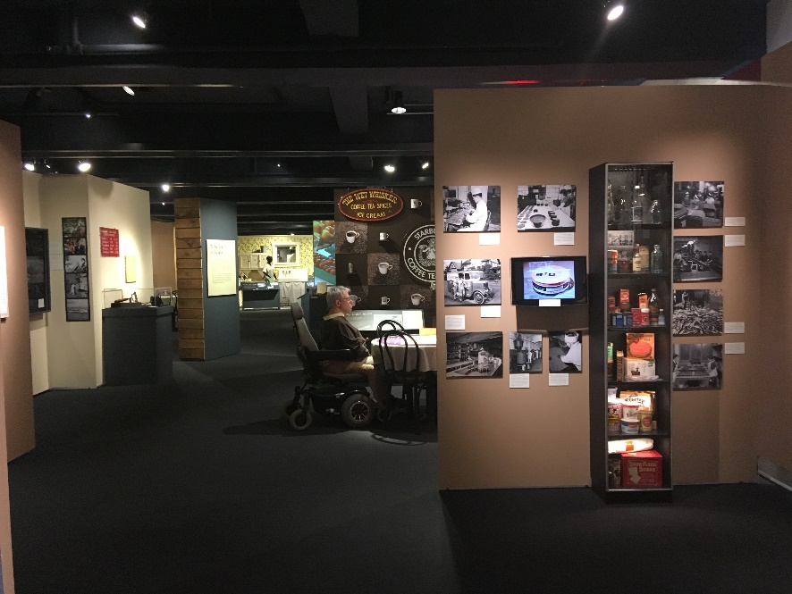
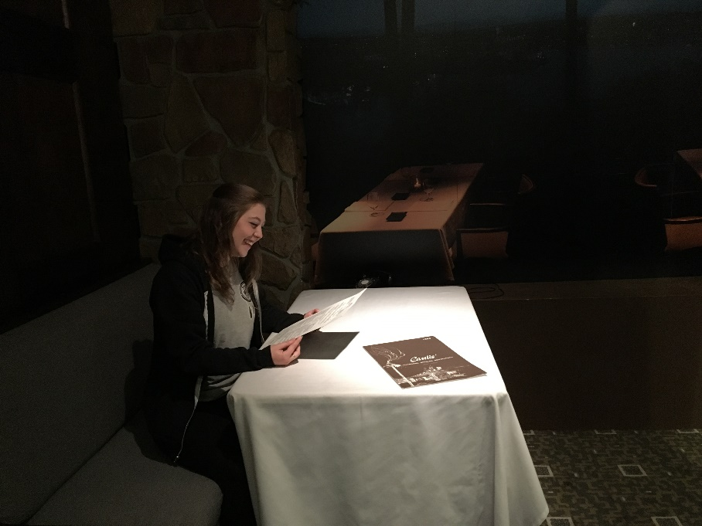
Edible City Exhibit at the MOHAI in Seattle

Slide 11
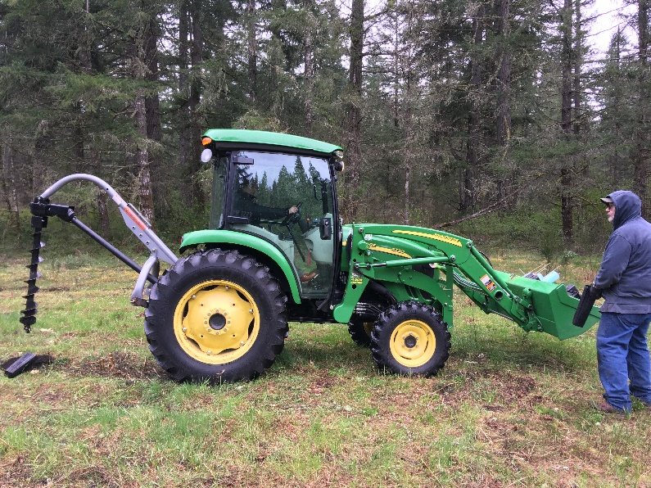
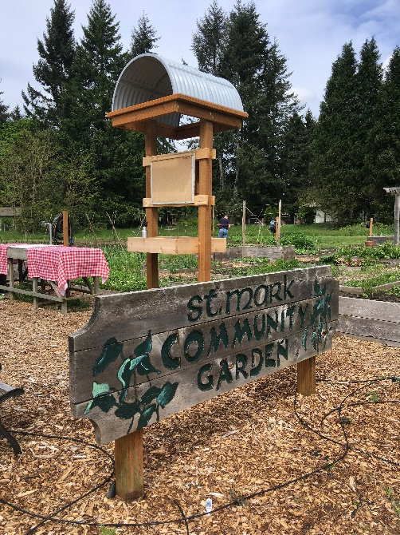
Challenges I faced…
Through the Food bank:
- Working with children - Accomplishing work in a timely manner - Making everything fun and seem interesting when working with kids to hold their attention and keep them involved
Through Ecology Restoration: - Learning new tools in the workshop - Tractor driving and setting up the trailer - Facing my fears (Walking in dark, deep water, bush whacking through nettles and black berry bushes, falling into holes in the woods and maybe never returning)
Notes:
Through all my challenges, I was seeing myself as a much braver and stronger person I wasn’t worried about injuries, or spiders getting in my hair while bush whacking deep in the woods I didn’t stress about working alone, and took it as a time for productivity I learned a lot about myself and my strength to keep going, regardless of how hard my challenge physically was I worked with a variety of people, and learned not to be intimidated about the work, and speak up with questions or concerns I had

Slide 12
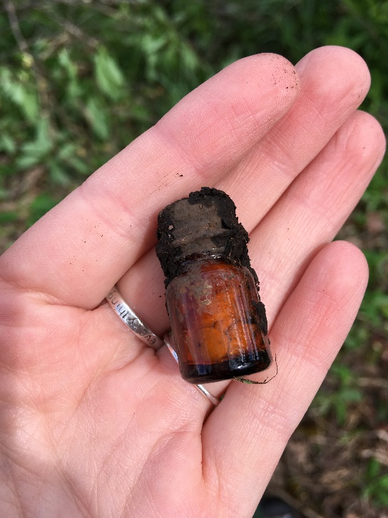
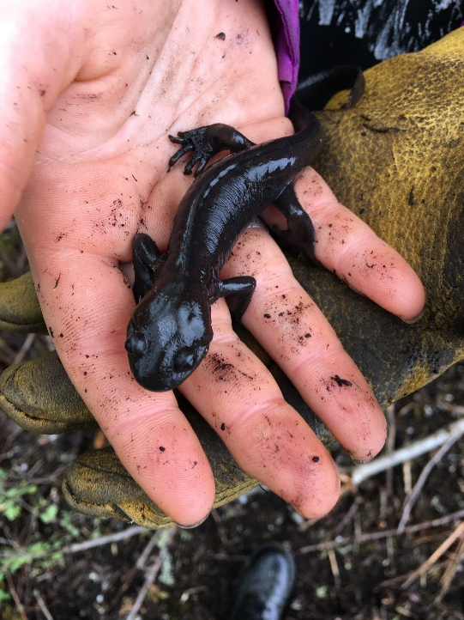
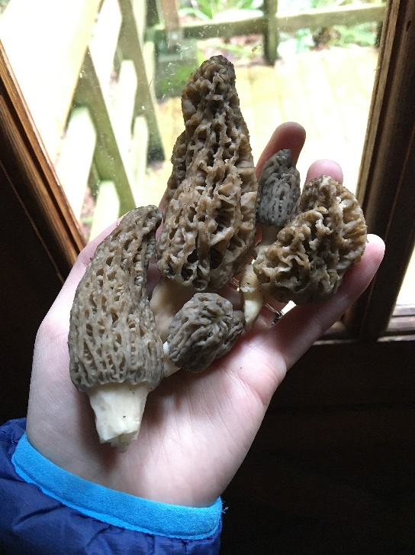
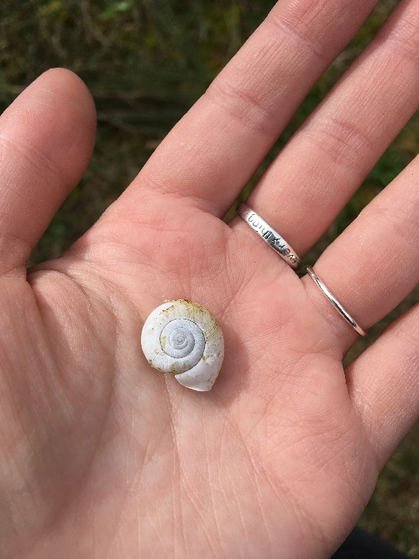
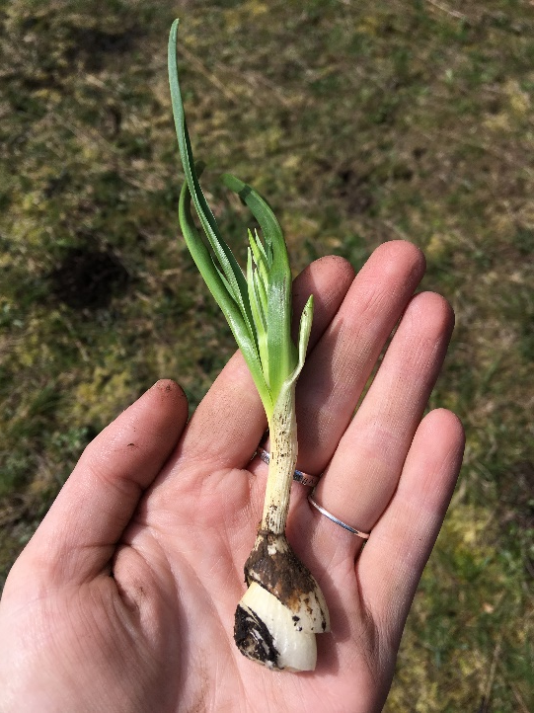
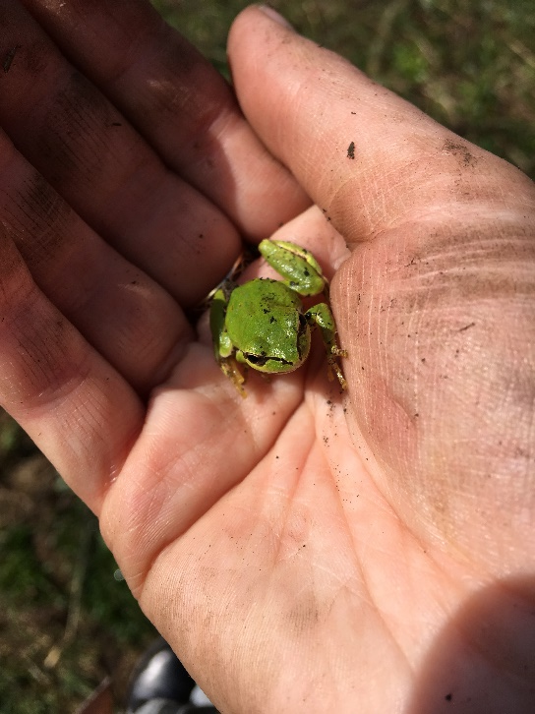
Fun discoveries

Slide 13
Bibliography
Palumbo, I. (2013). Chapter 14 - The Importance of Fire Ecology in Protected Areas Management. In D. O. O. and C. T. O. Paolo Paron (Ed.), Developments in Earth Surface Processes (Vol. 16, pp. 181–191). Elsevier. Retrieved from http://www.sciencedirect.com/science/article/pii/B9780444595591000141
K. M. (Krystyna M. ) Urbanska, N. R. (Nigel R. ) Webb, & Peter J. Edwards. (1997). Restoration ecology and sustainable development. Cambridge, U.K. ; New York: Cambridge University Press.
Coetzee, J. M. A. (1999). The Lives of Animals. Place of publication not identified: Princeton University Press.
Smart-Grosvenor, V. (1992). Vibration cooking, or, The travel notes of a Geechee girl (Ballantine Books trade ed.). New York: Ballantine Books.
Estabrook, B. (2011). Tomatoland: how modern industrial agriculture destroyed our most alluring fruit. Kansas City: Andrews McMeel Publishing.
Vandana Shiva, author. (2016). Who really feeds the world?: the failures of agribusiness and the promise of agroecology. Berkeley, California: North Atlantic Books.
Petrini, C. (2007). Slow food nation: why our food should be good, clean, and fair. New York: Rizzoli Ex Libris.
http://blogs.evergreen.edu/comalt-spring-alana/bibliography/ Photo credit for all photos: Alana Mousseau

