Slide 1
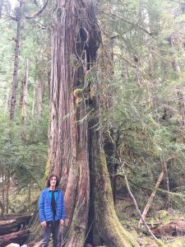
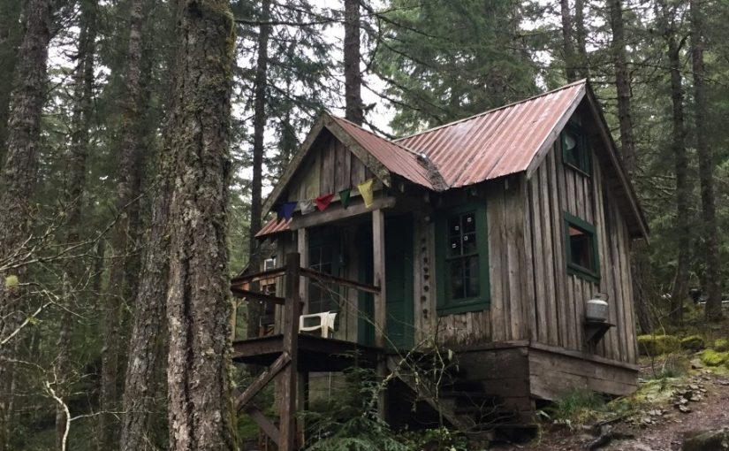
“You Can Drink The Water?!”
Learning in an uncut watershed

Slide 2
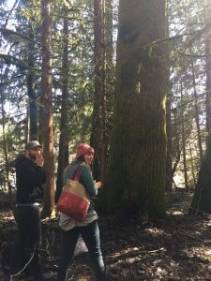
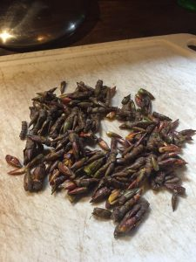
When you gather and prepare your own medicine, like food, you can know and monitor your impact on the environment and trust what you are ingesting.

Slide 3
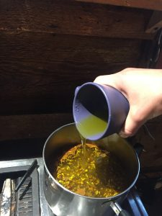
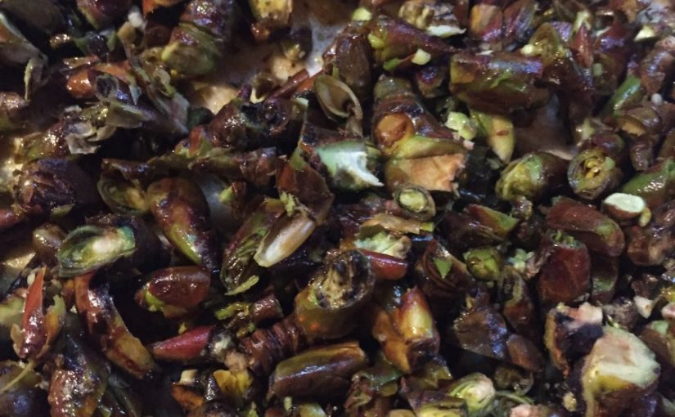
Preparing Black Cottonwood leaf buds into a muscle salve.
To extract the medicinal properties of the leaf buds into oil:
Crush or chop your leaf buds.
Mix 1 part leaf buds with 1 part Olive oil and 4 parts water. Simmer for one hour.
Filter the buds and decant the oil on top of the water.

Slide 4
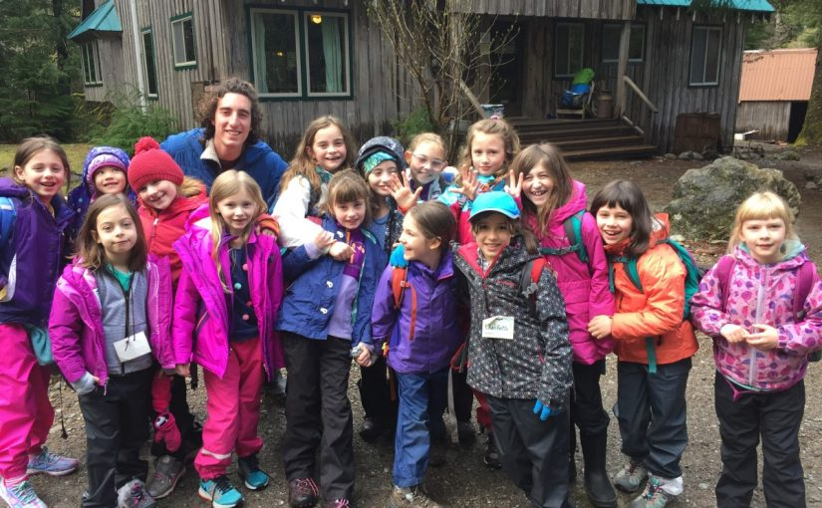
Learning and teaching hike hand in hand.

Slide 5
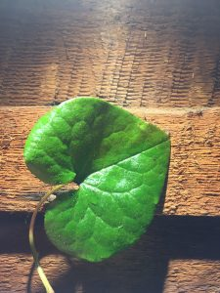
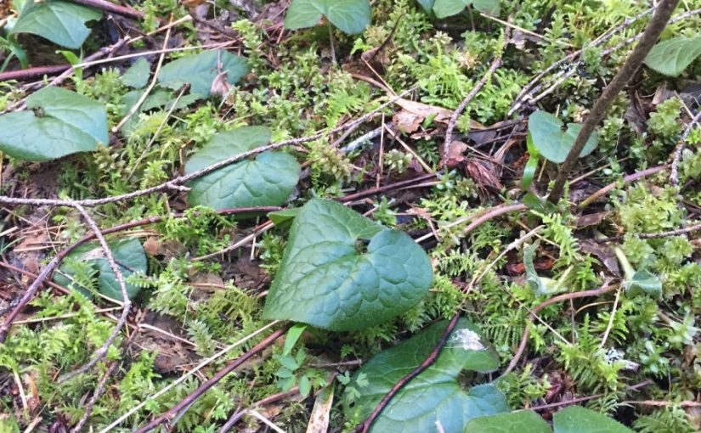
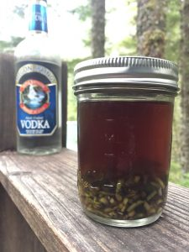
Wild Ginger is Wild Medicine

Slide 6
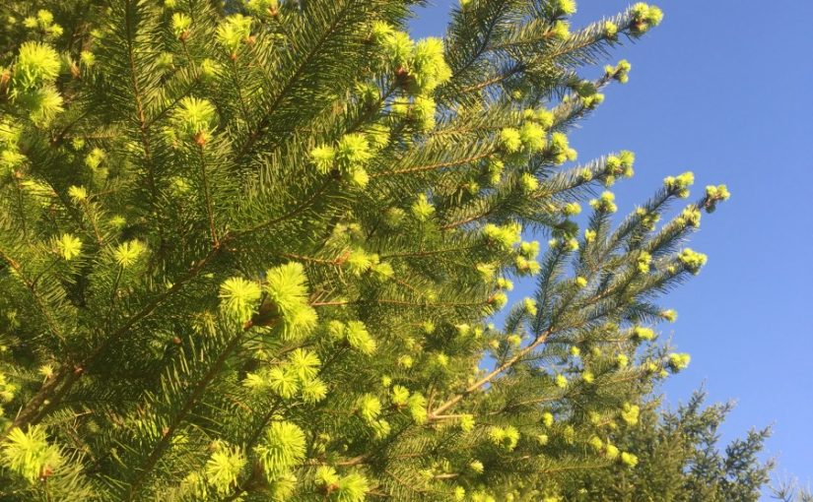
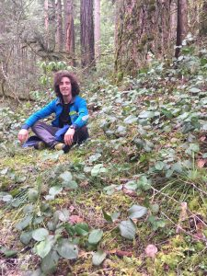
Why am I interested in wild plants? Because the wilderness is beautiful! It provides us with clean air, clean water, and a stable climate. Wild food in the Oregon wilderness is highly seasonal and can be scarce but it is highly nourishing to the human body and places us back into the native ecosystem.

Slide 7
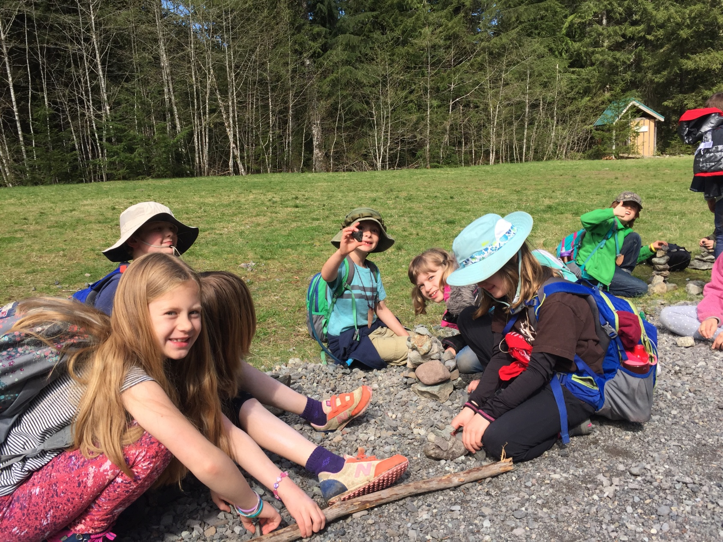
Tell the Children the Truth

Slide 8
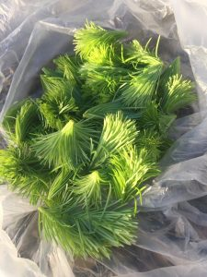
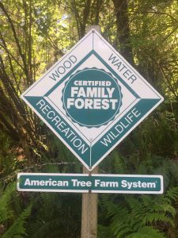
The soft needles of Douglas Fir taste like sour candy with the texture of thin rice noodles.
The Douglas fir is the favorite tree for farming in Oregon.

Slide 9
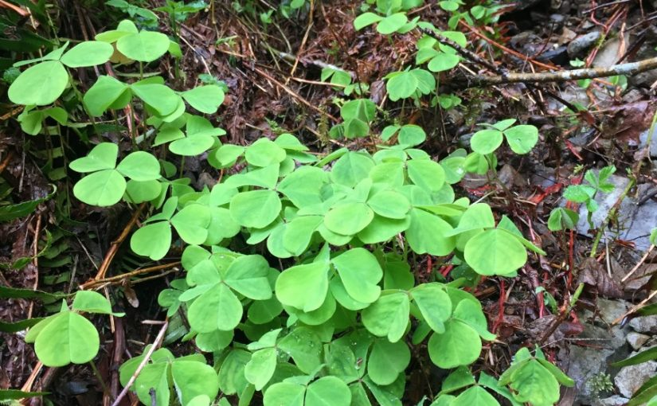
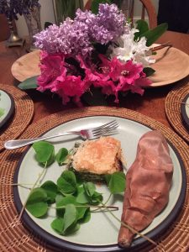
A great spring green to forage for or to be transplanted into home gardens.
Sorrel
Sorrel

Slide 10
-Bibliography -MacKinnon, A., Pojar, J., & Alaback, P. B. (2004). Plants of the Pacific Northwest Coast. Edmonton: Lone Pine Pub. -Kelly, D., & Braasch, G. (1990). Secrets of the Old Growth Forest. Salt Lake City: Peregrine Smith Books. -Ancient Forests: Rage Over Trees [Motion picture]. (1989). USA: National Audubon Society. -Port of Olympia. (n.d.). Retrieved April 20, 2017, from http://www.portolympia.com/352/What-is-a-Port -Stettler, R. F. (2009). Cottonwood and the River of Time on Trees, Evolution, and Society. Seattle: University of Washington Press. -Moore, M. (2001). Medicinal Plants of the Pacific West. Santa Fe: Red Crane Books. -Deur, Douglas. Pacific Northwest Foraging: 120 wild and flavorful edibles from Alaska blueberries to wild hazelnuts. Portland, Or.: Timber Press, 2014. -“Associated Oregon Loggers, Inc.” Associated Oregon Loggers, Inc.N.p., n.d. Web. 27 May 2017. -Cook, S.F., The Epidemic of 1830-33 in California and Oregon, University of California Publications in American Archaeology and Ethnology 43(3):303-326, 1955 -Mackey, Harold. The Kalapuyans: a sourcebook on the Indians of the Willamette Valley. Salem, Or.: Mission Mill Museum Association, 2004. Print.

