Slide 1
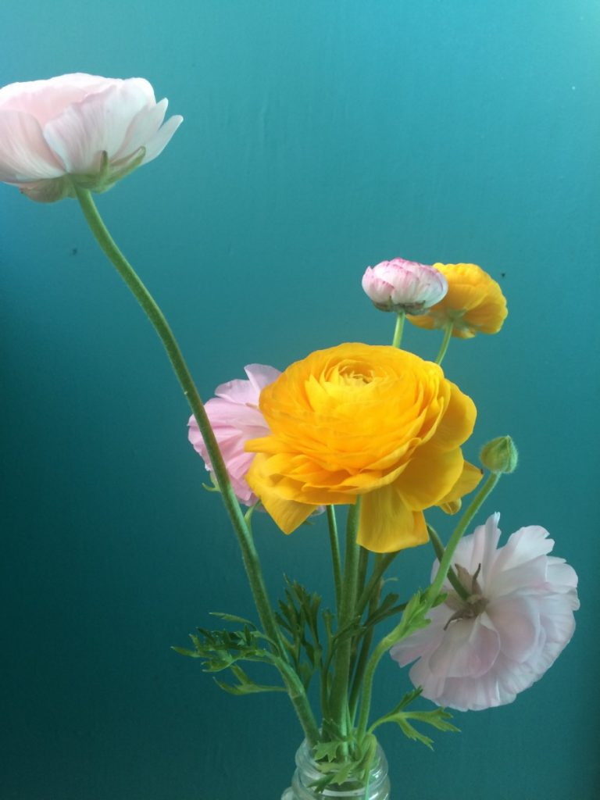
Cut Flowers: Cultivation, Marketing and Culture
Jessica Herrera
SOS:ComAlt Spring 2017

Slide 2
Independent Learning Contract
Description:
In this quarter long internship, Cut Flowers: Cultivation, Marketing and Culture, the student will work closely with a small-scale, sustainability-minded cut flower farm to gain skills in growing, harvesting and preparing cut flowers for sale. The student will explore agricultural concepts through on-farm experiences and through various texts. Academic learning will also focus on the cultural significance of flowers in various times and places. The student will submit weekly reflection writings, a 5 page synthesis paper at the end of the quarter and give a final presentation.

Slide 3
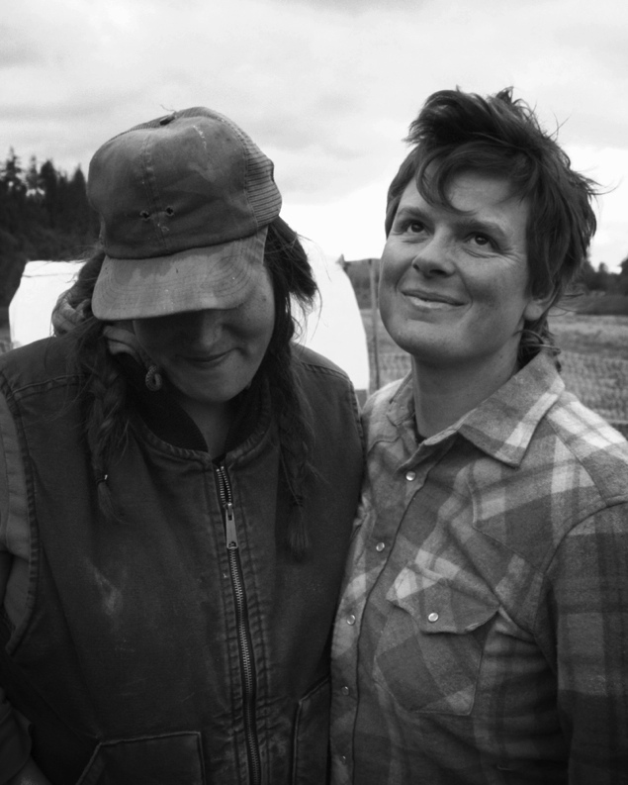
August Farm
A small livestock and cut flower farm owned and operated by Marianne Copene and Liza Judge in Rochester, Washington.
Animals (chickens, sheep, pigs) are pasture-raised with a diet of grass/local, organic feed
Flowers are grown without use of chemicals
Not certified organic
1 acre in flower production (double from last year)
Sites: August Farm & The scatter creek conservatory land trust
Markets: CSA (30-50 shares), Olympia Farmers Market, Portland Flower Market, Bar Francis Pop up, Milk Glass Mrkt Weddings, (seattle??)
Photo from august-farm.com with permission

Slide 4
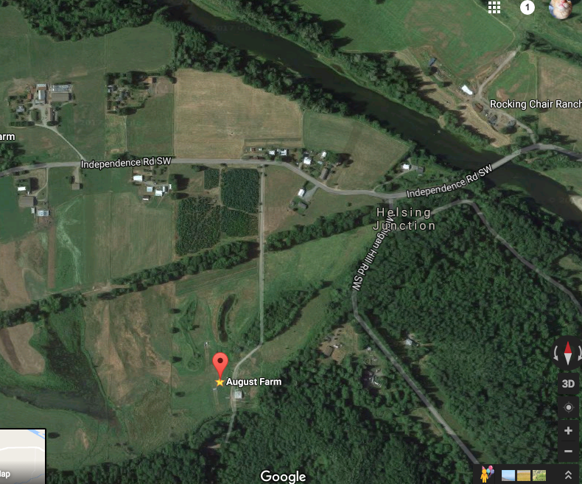
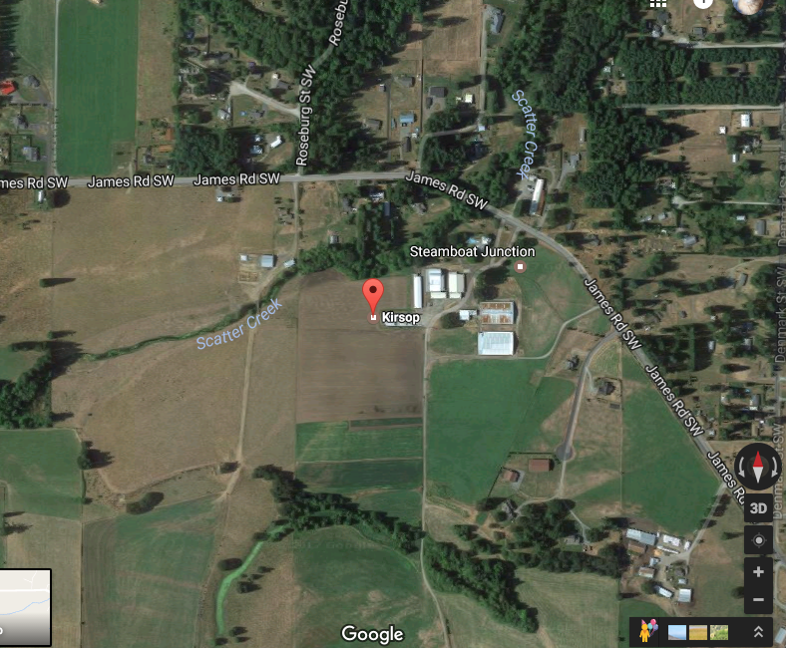

Slide 5
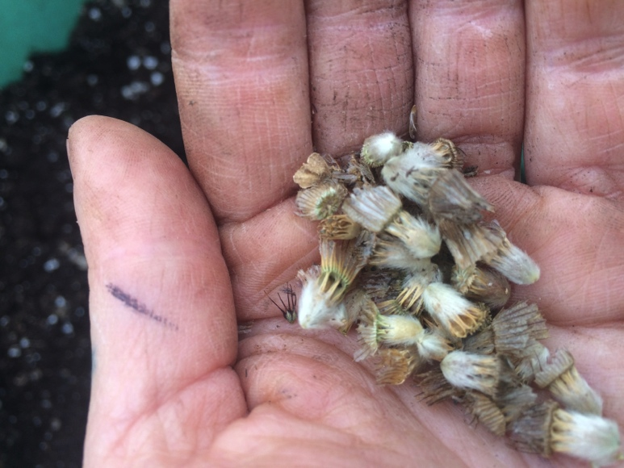
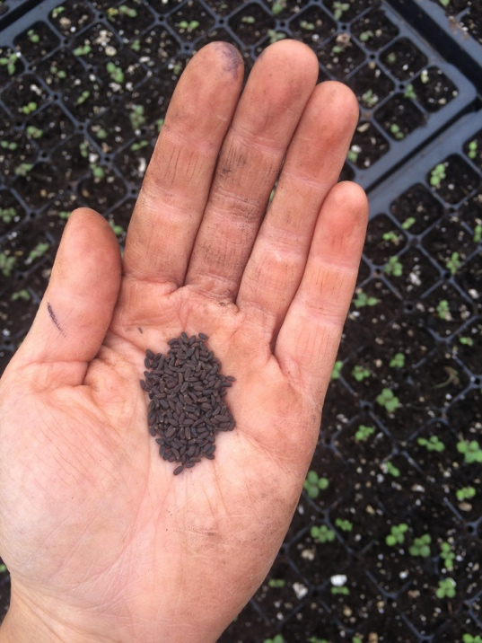
Project Posts
Week 1:
“Mar shared a bit about her journey of feeling validation in doing what they do and about using privilege and not getting stuck in an apologetic mindset. …How to make a ‘luxury item more accessible?’”
“I snipped and collected large armfuls of zinnias and sunflowers and put them in buckets. I learned that the smell from the center of sunflowers transports me to some unknown childhood memory. There was a debate between members of the farm crew about the importance growing flowers on the farm. Some argued it was arbitrary and tedious – they didn’t want anything to do with them. Flowers don’t serve a real purpose, they’d say. You can’t be nourished from flowers in the same way as vegetables. At the time I didn’t have a good counter argument – but I did know that I loved working with flowers.”

Slide 6
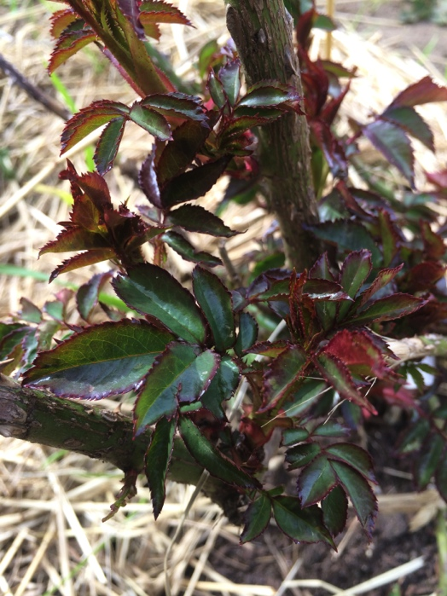
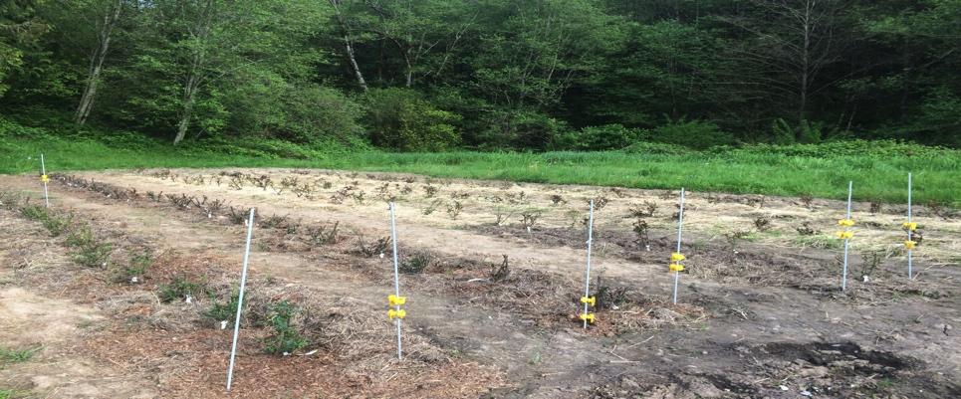
Project Posts
Week 3 - Roses!
The Process:
125 rose bushes – 5 varieties
Each plant gets it’s own 2X2X2 (approximate) hole, variations as needed.
Roots should not be bent.
Graft union should be at ground level.
Build cone out of earth for roots to rest on.
Tack down, add amendments (worm meal, compost, fish meal), fill in the rest of the way, sprinkle with more amendments.
Thoughts:
How do I pay attention to different tasks? With something more permanent such as a perennial rose garden, it’s important to remember every little step affects the end result and the end result will be around longer than annual crops. In this way, digging hole after hole, building little cones of earth, placing the roots down into the soil in just the right way… these things all become mediation and practice of having awareness of the moment.

Slide 7
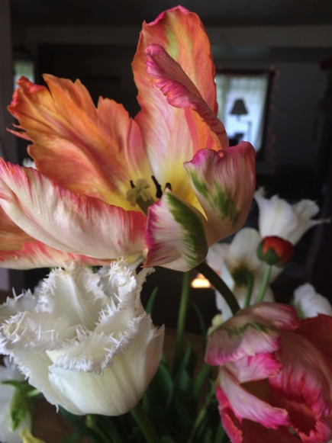
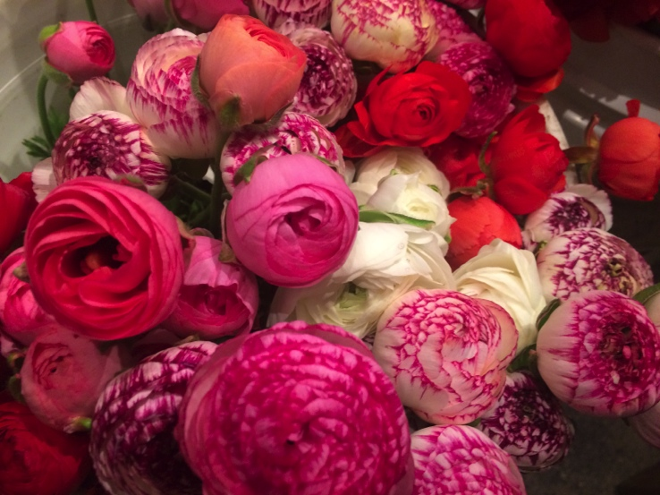
Project Posts
Week 7
Things to think about:
land: location, resources available, types of infrastructure possible, community, etc.
partner/s / co-owner
employees/interns
what do we grow? what works well in this area AND what will sell?
who are our customers? community partners?
what is your style?
how can I use the platform of farmer/florist to actively participate in making positive change
"Flowers are unlike other frequently studied commodities such as food and clothing, because they are not necessary to life: they have no utilitarian function. For those who consume them, the function of fresh-cut flower is always to express cultural or social meaning. Fresh flower laid on a grave, for example, demonstrate the cultural importance of honoring the dead. When people decorate spaces - whether church or ballroom-with extravagant displays of flowers, they signal aspects of identity and social status." (Ziegler 2007:7)

Slide 8
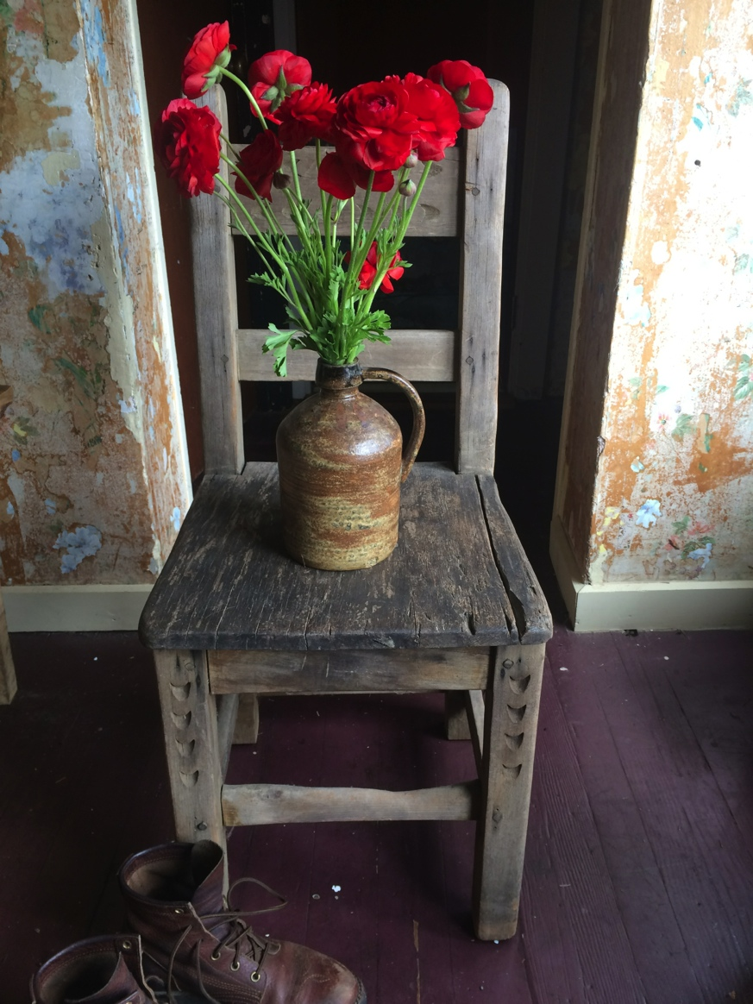
Project Posts
Week 8
“One reason I enjoy farm work so much is because I have time to reflect on life and the natural world while I am feeling fully in my body, molding the natural world as though an art medium. I have realized that I am drawn to working with flowers because, in some ways, it marries the worlds of art and farming. The practical, task-at-hand, physical-labor-loving part of myself and the artistic, creative, fine-detail sides of myself are both exercised through the growing and arranging of flowers.”

Slide 9
Peonies
This morning the green fists of the peonies are getting ready
to break my heart
as the sun rises,
as the sun strokes them with his old, buttery fingers
and they open–
pools of lace,
white and pink–
and all day the black ants climb over them,
boring their deep and mysterious holes
into the curls,
craving the sweet sap,
taking it away
to their dark, underground cities–
and all day
under the shifty wind,
as in a dance to the great wedding,
the flowers bend their bright bodies,
and tip their fragrance to the air,
and rise,
their red stems holding
all that dampness and recklessness
gladly and lightly,
and there it is again–
beauty and brave, the exemplary,
blazing open.
Do you love this world?
Do you cherish your humble and and silky life?
Do you adore the green grass, with its terror beneath?
Do you also hurry, half-dressed and barefoot, into the garden,
and softly,
and exclaiming of their dearness,
fill your arms with the white and pink flowers,
with their honeyed heaviness, their lush trembling,
their eagerness
to be wild and perfect for a moment, before they are
nothing, forever?
– Mary Oliver

Slide 10
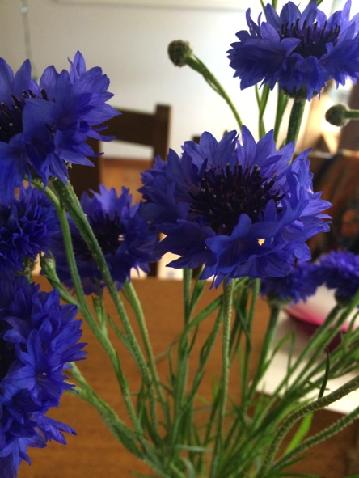
Tasting Labs
From Week 2:
“While eating the salad and thinking about what it means to be a locavore, I was reminded of a paper written by Brandon Born and Mark Purcell, Avoiding the Local Trap. The local trap is the assumption that the local scale is inherently good (or bad). What is local? Is it down the road, within city limit, regional? Scale is fluid, fixed and relational to other kinds of scale. The paper argues that scale is a strategy and not necessarily a goal. ‘Therefore, it is social justice (or sustainability or democracy, etc.), not localization or globalization, that must remain the focus for those planners who seek to change the current structure of food systems.’ ”

Slide 11
Seminar
Week 8
News Media:
“Well, why not? After all, America is an open society, in which everyone is free to make his or her own choices about where to work and how to live. Everyone, that is, except the 30 million workers now covered by noncompete agreements , who may find themselves all but unemployable if they quit their current jobs; the 52 million Americans with pre-existing conditions who will be effectively unable to buy individual health insurance, and hence stuck with their current employers, if the Freedom Caucus gets its way; and the millions of Americans burdened down by heavy student and other debt.”
Response:
“…at the myth that the United States is supposedly a place where all of its citizens have the freedom to choose things such as their job and their surroundings. This one particular trap – noncompete agreements – acts as a metaphor or a template for the other ways in which the freedoms touted are not an accessible reality for so many people.”
https://www.nytimes.com/2017/05/22/opinion/american-workers-noncompete-agreements.html?ref=opinion

Slide 12
Seminar
Week 9
Passage from Vibration Cooking:
“ People here act like it’s going to a lot of trouble just to give you a glass of water and whenever those vibrations hit me, I remember how Aunt Carrie with no electricity, no running water, no gas, no refrigerator, not even an ice box got us a beautiful supper with love.” (Smart-Grosvenor 2011: 147)
Response:
Vertamae has a way of telling it how it is. She speaks of intention and providing love regardless of resources. Where are these habits and ways of life learned? Why is value divided the way it is? There need to be more Aunt Carries in the world.

Slide 13
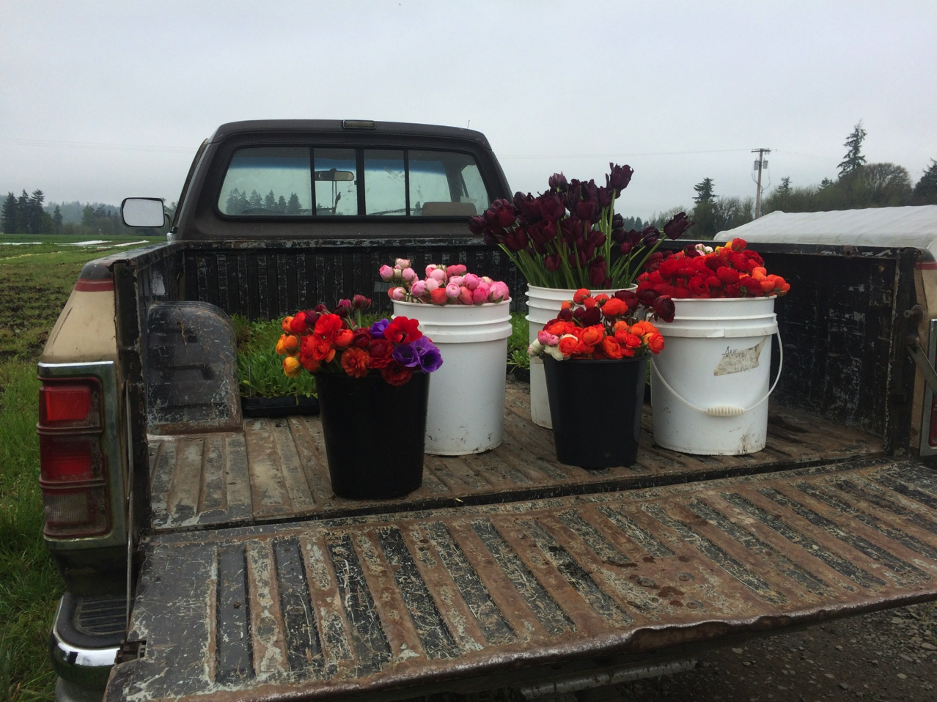
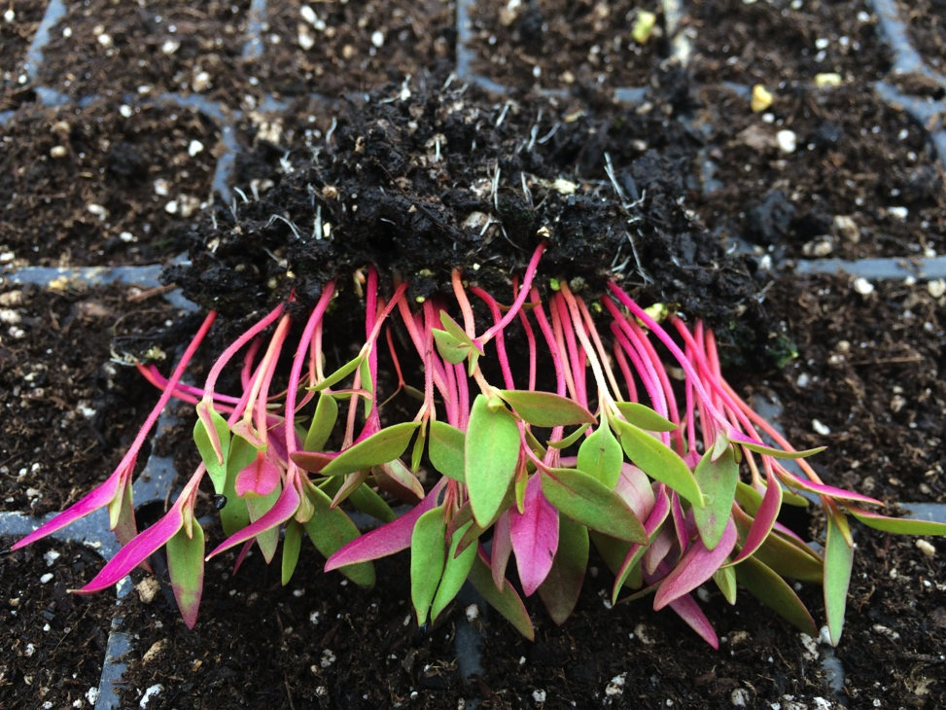
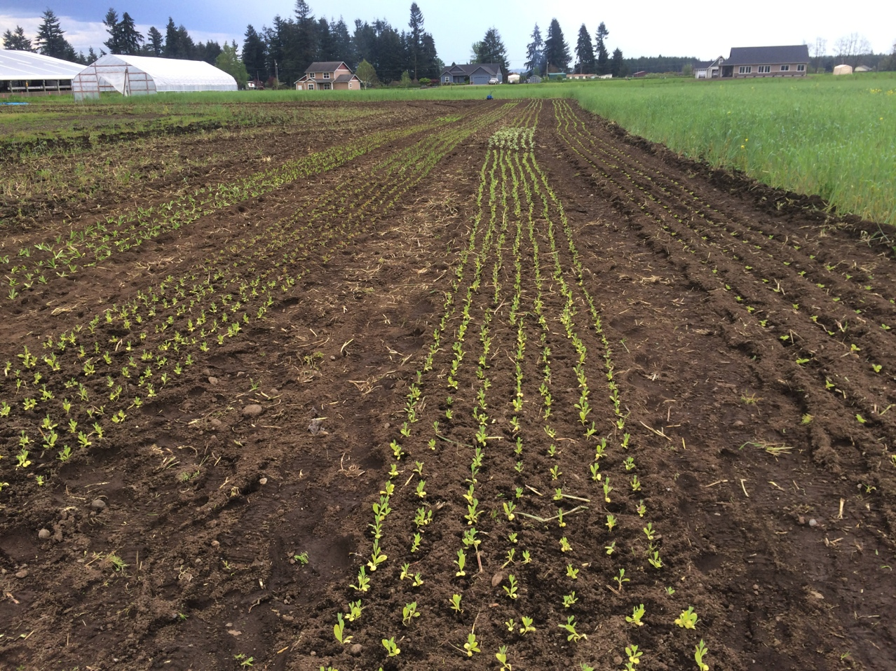
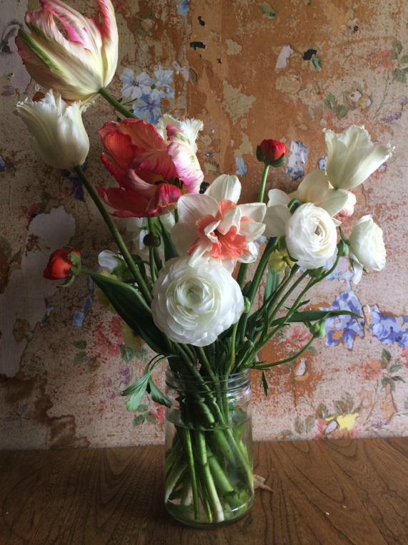
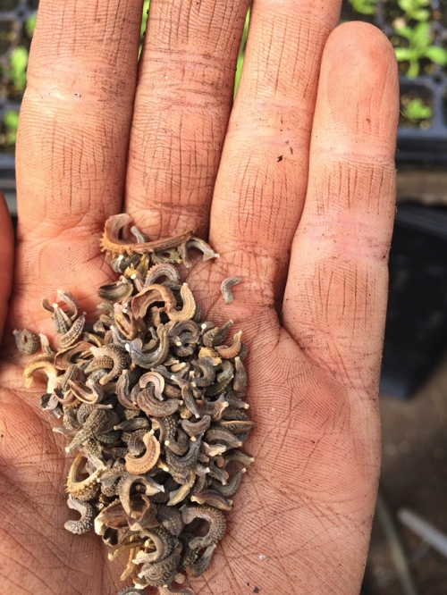

Slide 14
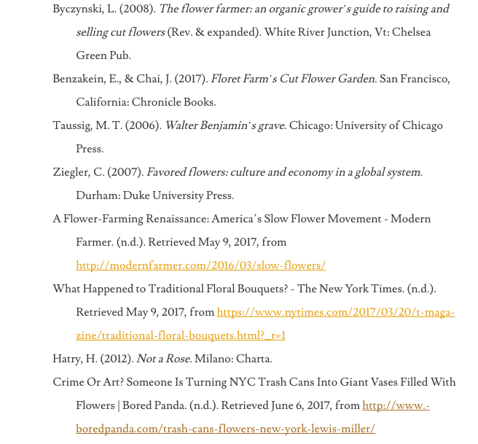
Bibliography

