Slide 1
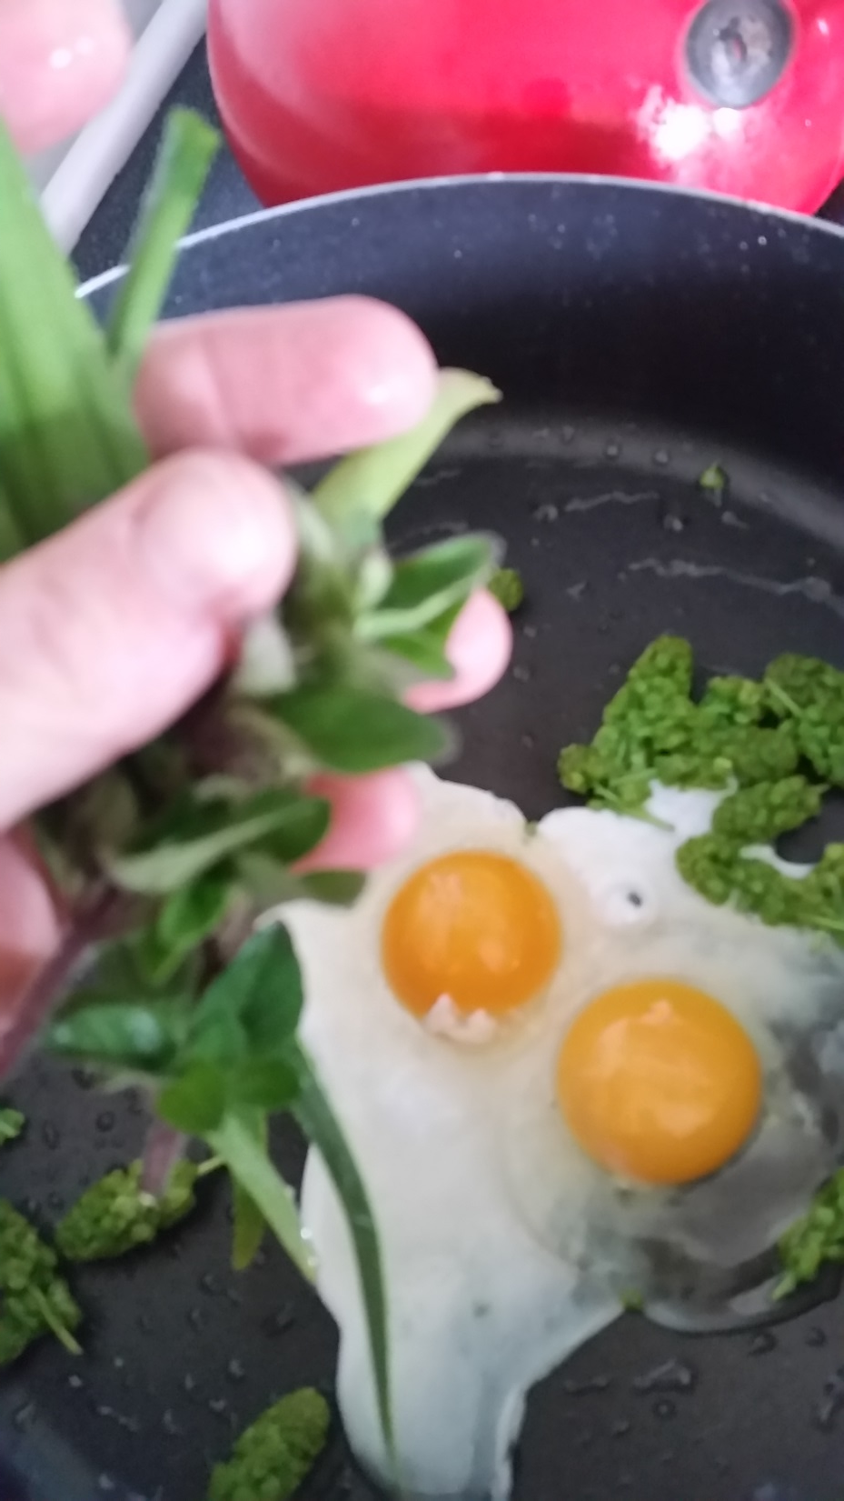
Food Sovereignty
A partnership with Cascadia Cares

Slide 2
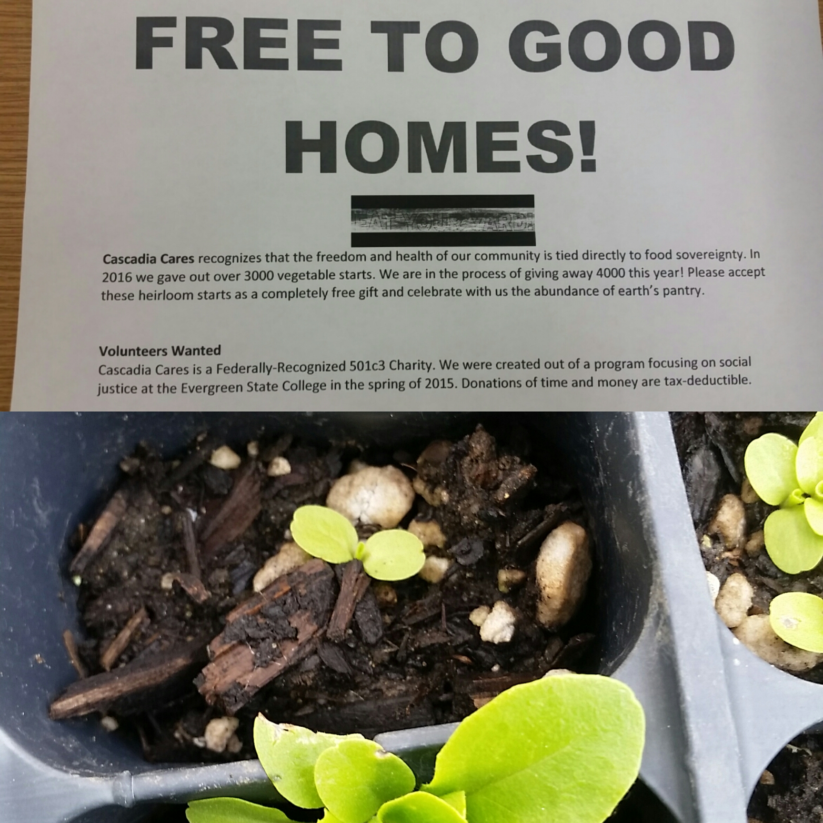
Planting Seeds of Change

Slide 3
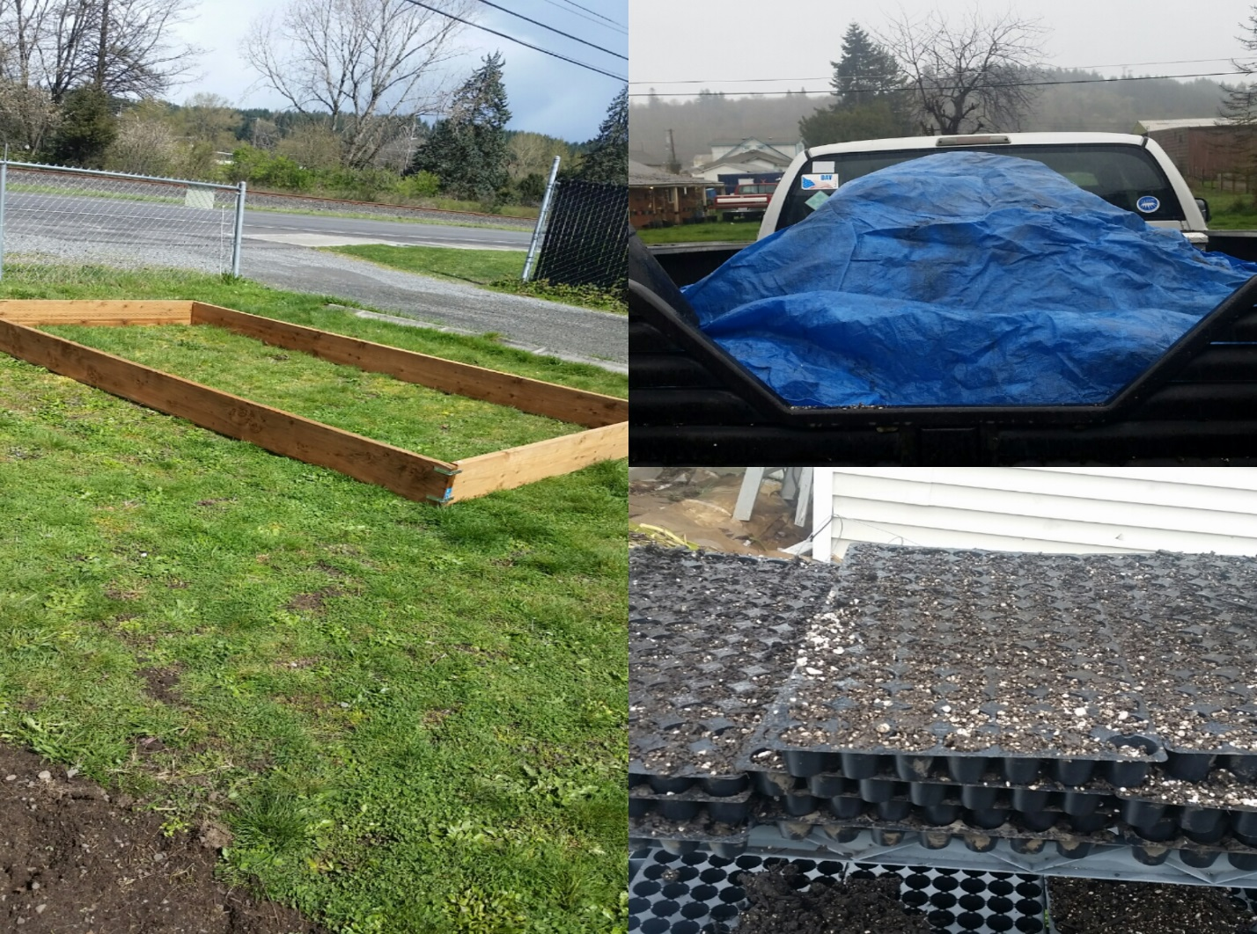
Growing Commuinty
The garden is going strong now! We are already harvesting lettuce and berries!
Garden Creation at The Serenity House

Slide 4
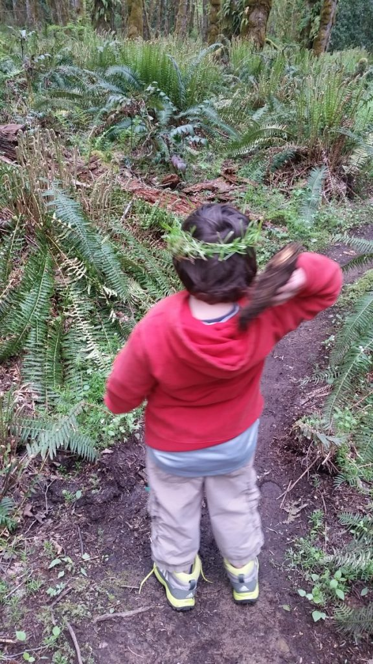
Helping Families
Helping families access free and healthy food feels good. Through wildcrafting walks, free garden help, and donating free starts to DSHS sponsored support groups I worked to make real food accessible in a real way!

Slide 5
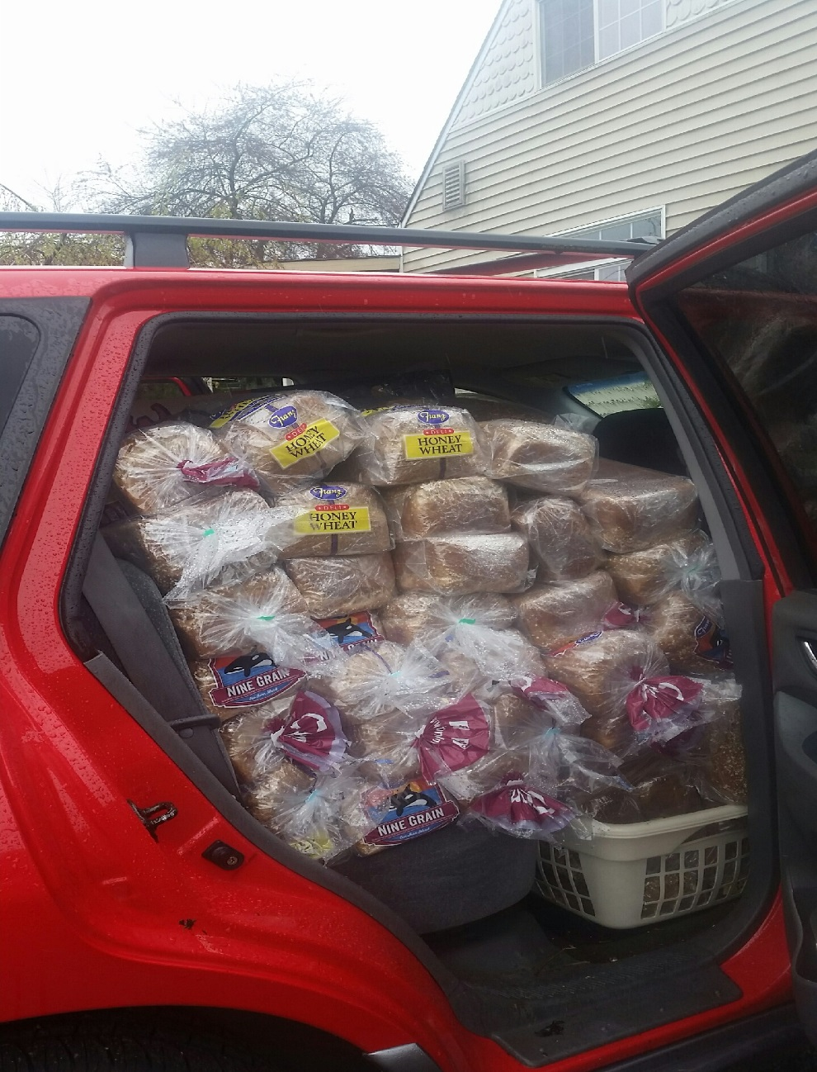
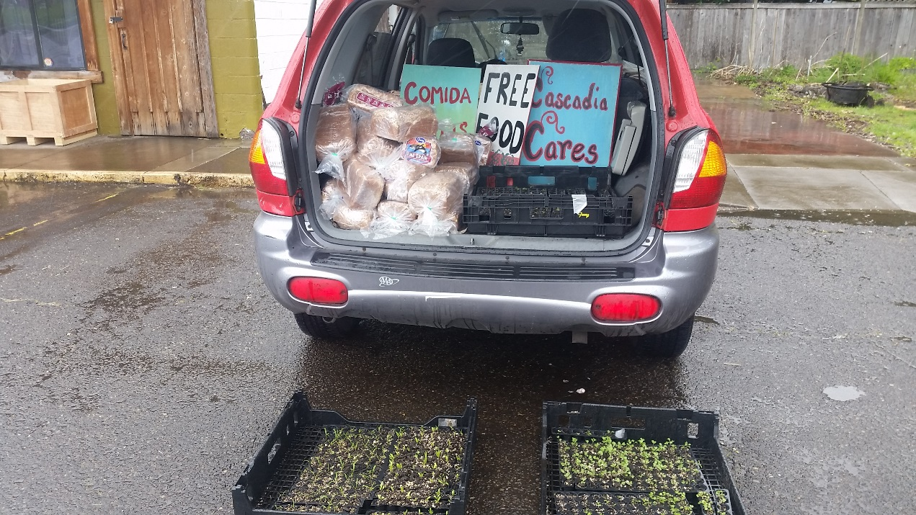
Connecting Needs and Resources

Slide 6
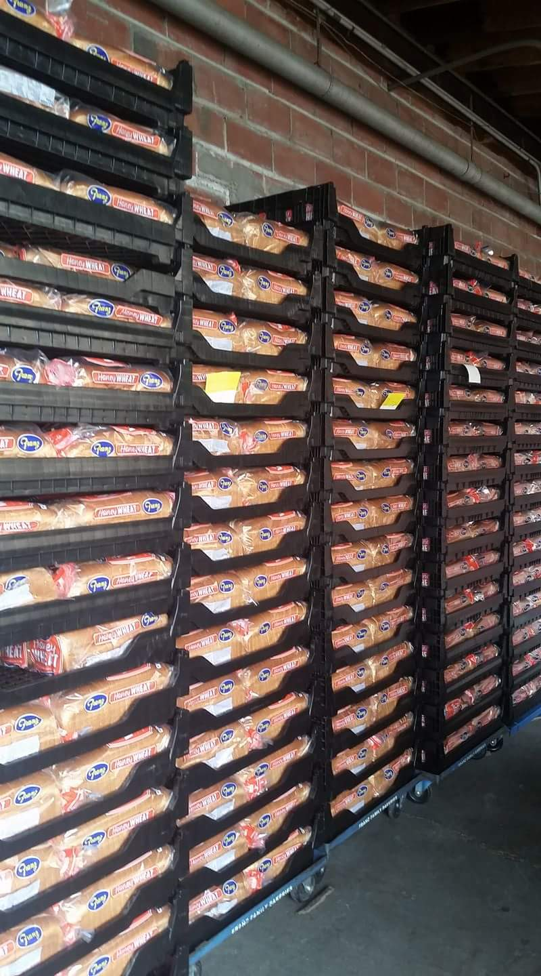
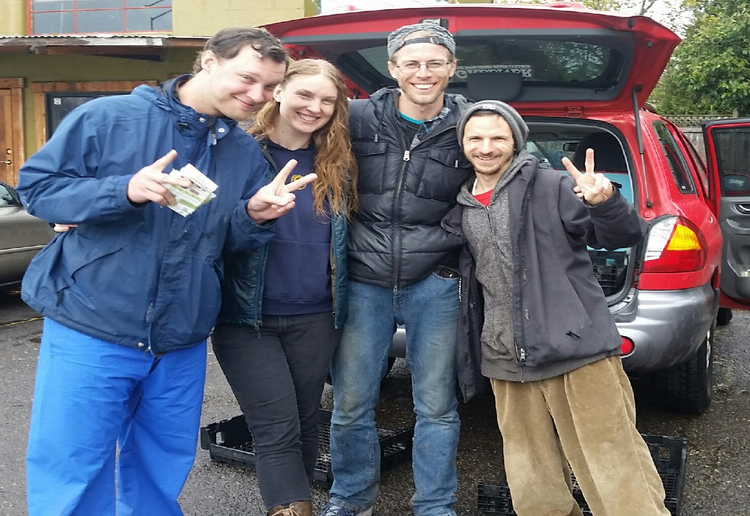
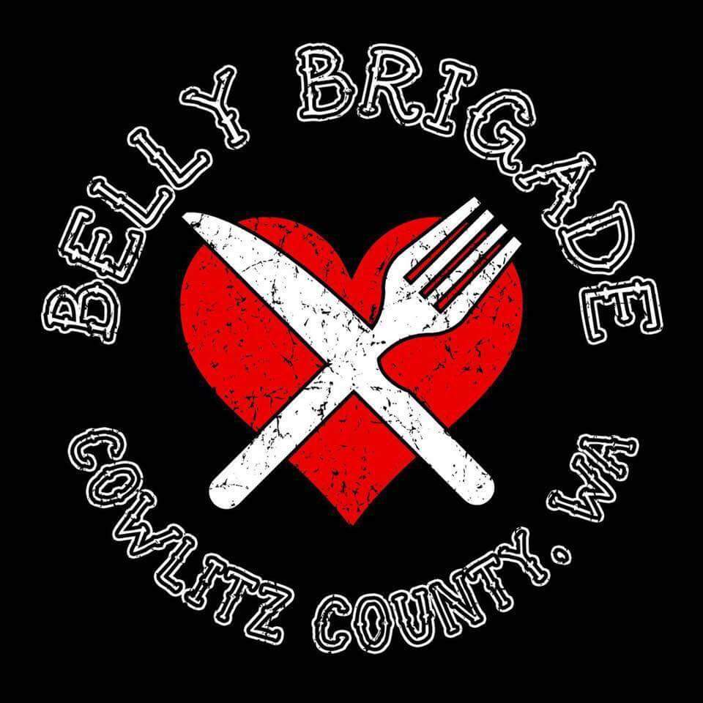
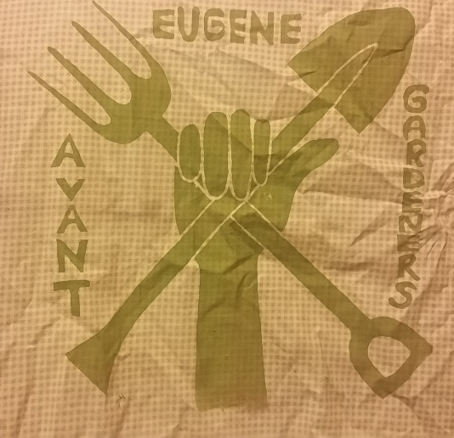
Supporting Outreach Groups

Slide 7
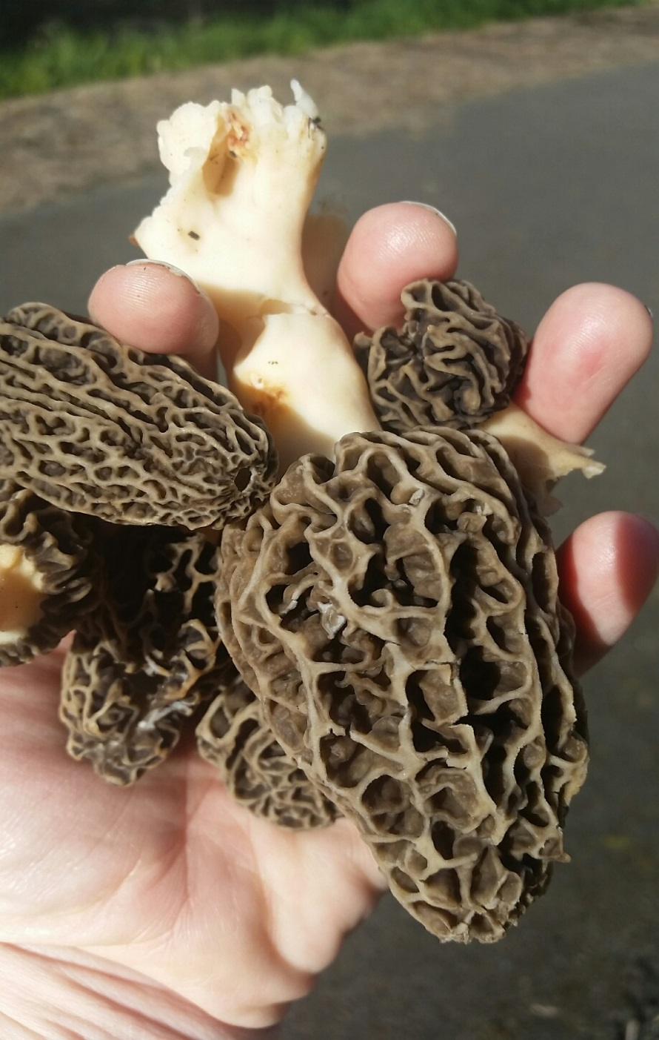
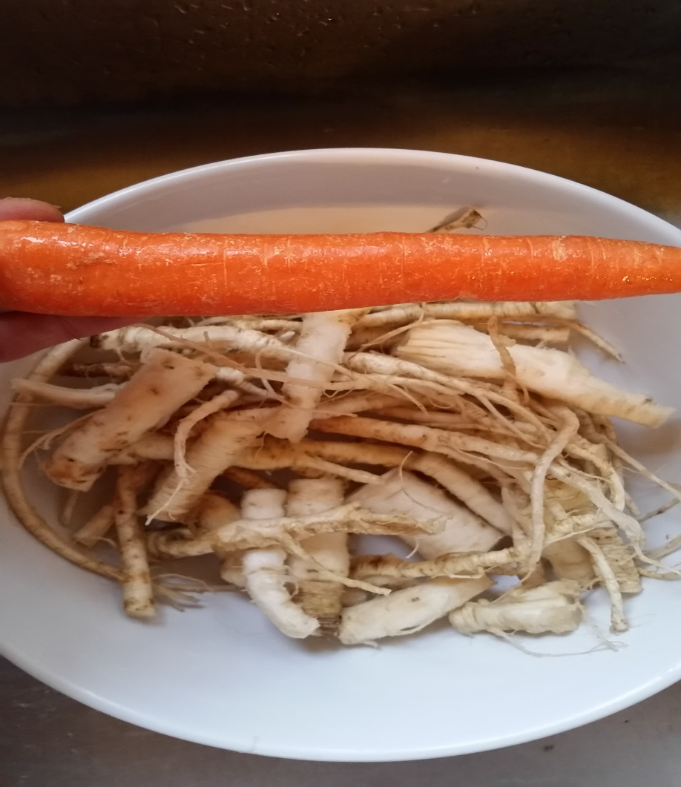
Teaching Others About Wild Foods
Queen Anne has hairy legs!
It is good to have hollow morels!

Slide 8
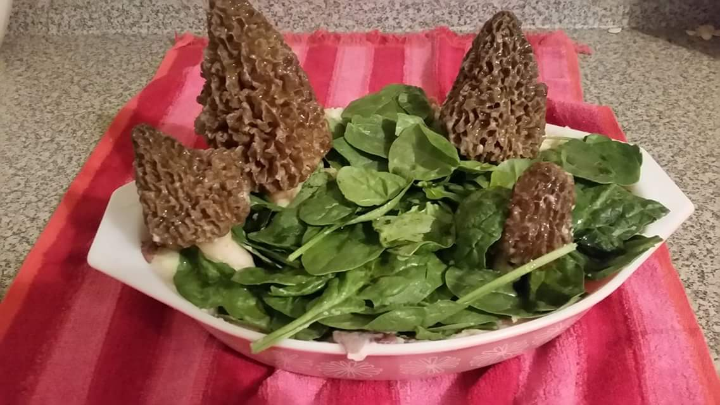
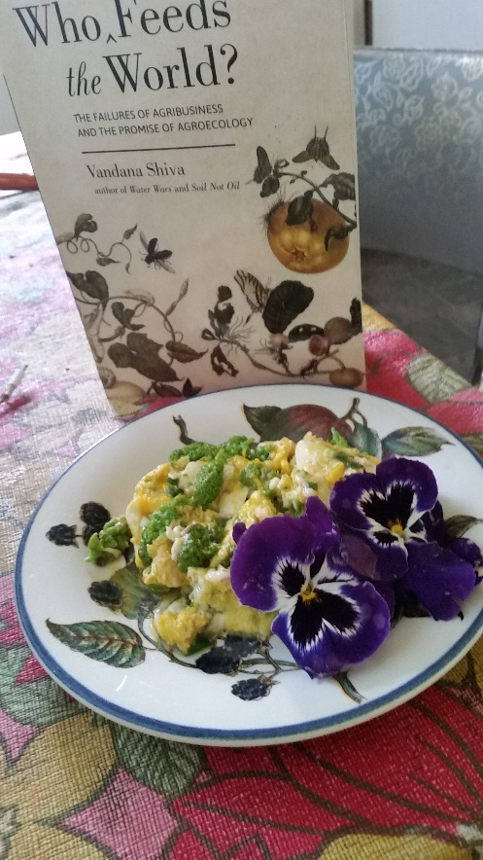
Learning Ways to Normalize and Utilize Wild Foods

Slide 9
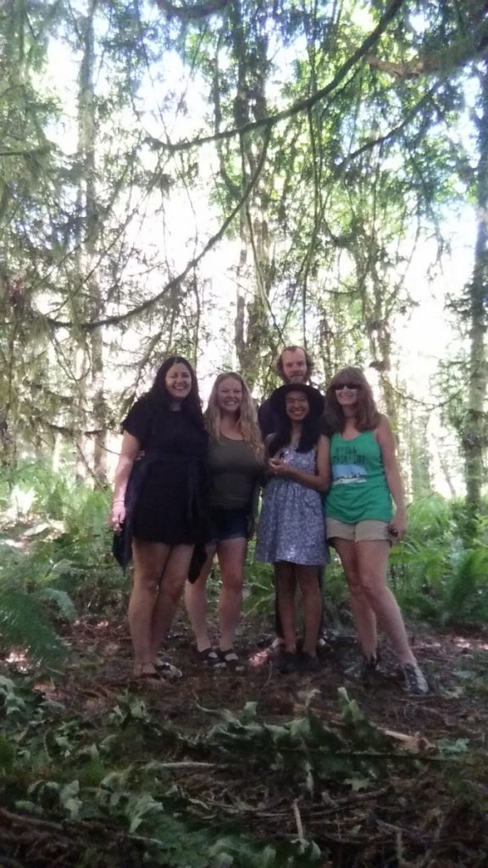
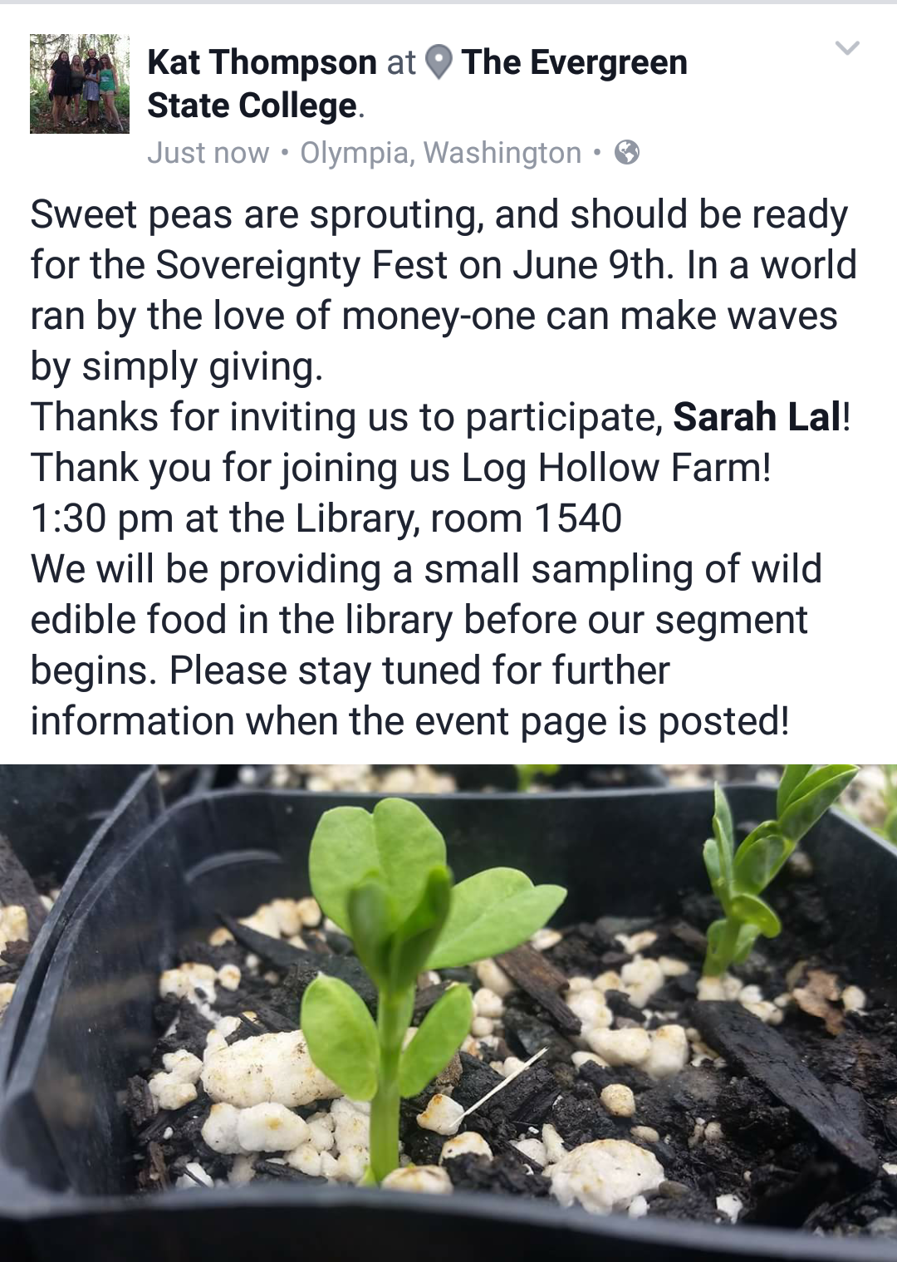
Connecting with Kindred Spirits
Please join us this
Friday, June 9th to
meet Rohn and Amy
and hear how
Log Hollow Farms
was Born!
Cascadia Cares was invited
to use the space at
Log Hollow Farms for a fundraiser!

Slide 10
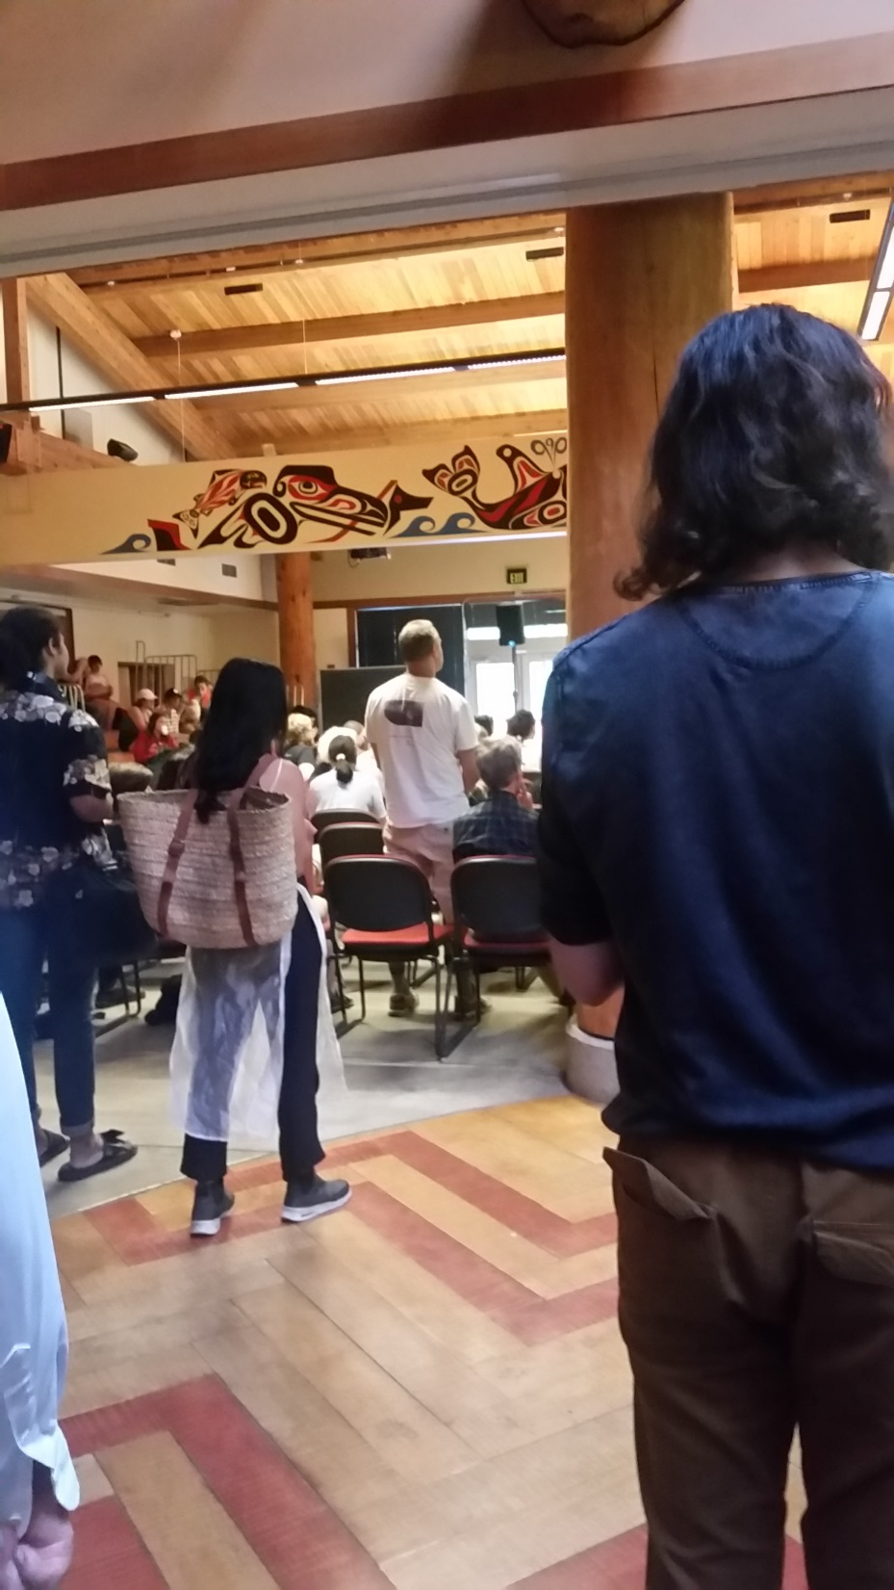
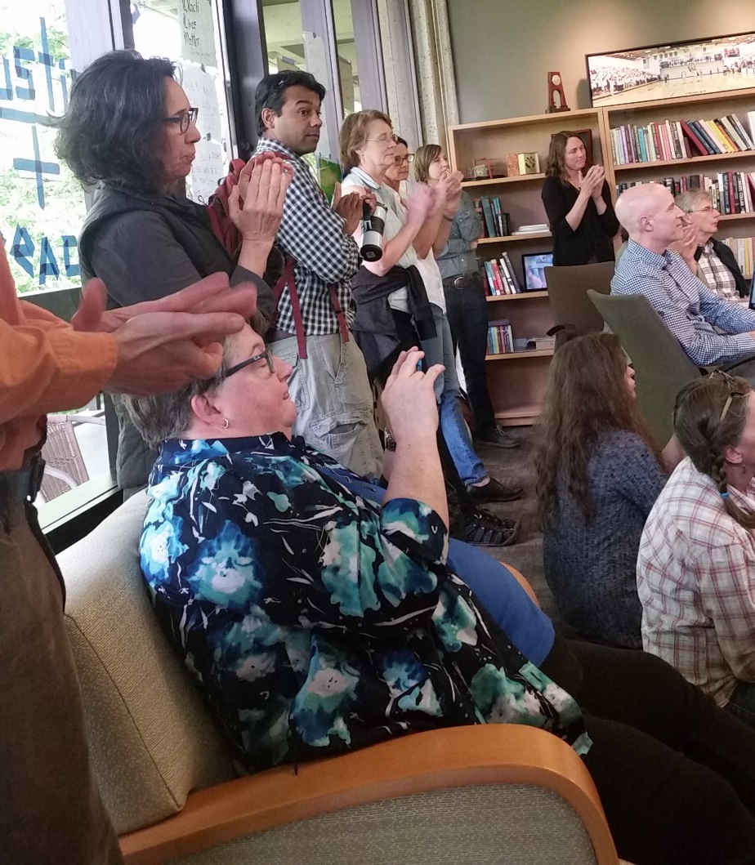
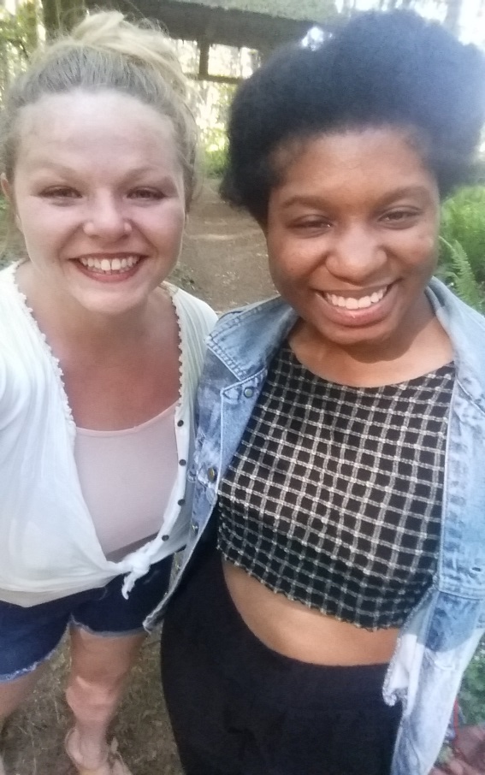
Connecting Skills and Knowledge to the Greater Community
Waylon and Persephone in solidarity with OMPJ
I attended the meeting with my friend (and TESC Alumnus)Jenna. She works as a case manager advocating for people who lack homes/resources. Of course we are kindred spirits!
It was great to see Sarah standing for equity. Thank you for the strong example of civic leadership!

