Slide 1
Animism in the Anthropocene
Kirsten Evenson, Spring 2017

Slide 2
ILC Contract
For this ILC, the students will explore the role of animistic thought in shaping philosophical, political, and poetic ways of understanding our place in the living world. The students will challenge the outdated concept that considers animism a “primitive” way of viewing the world. Using The Handbook of Contemporary Animism and texts from Donna Haraway, David Abram, Timothy Morton, as well as somatic explorations, the students will develop an original body of writing that seeks to present a theory of connection and kinship, that stands in opposition to the idea that human and economic concerns outweigh the rights of all life on Earth. The students will seek to deepen their understanding of non-human forms of communication in an attempt to broaden their own bodily knowledge.

Slide 3
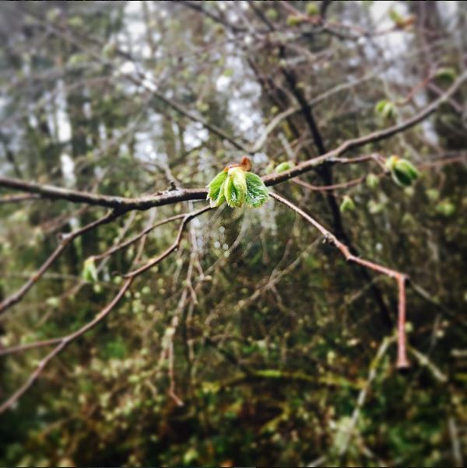
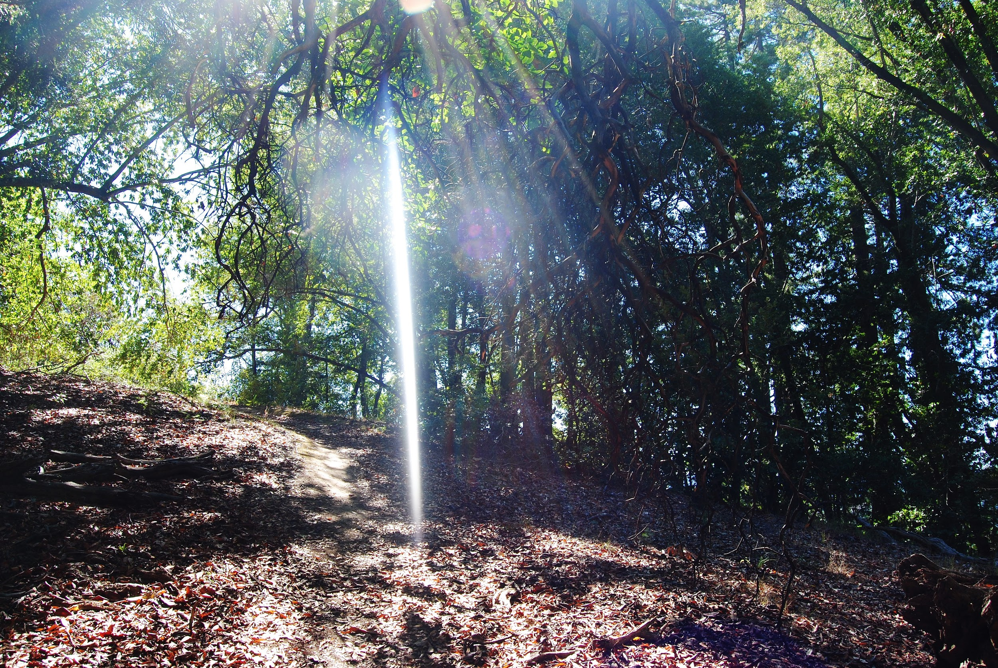
As I’ve been trying to explain to people over the past weeks what exactly it is I’m going to be doing this quarter, I find myself opening my mouth to explain these terms and coming up blank, overwhelmed by questions and confusion, and instead of words I simply breathe out: air. Air that is actually carbon dioxide, which I expel before I breathe in oxygen that is dispelled by trees and other creatures that survive from photosynthesis. I am, every breath, taking in molecules that another being didn’t need, and in an exchange of subconscious generosity, giving what I do not need in return. The answers to my questions seem more easily answered with silence, but we humans communicate with language, and so I start my journey on this question of breath, and the interchange of chemicals that forms the basis of life. What is the importance of consciousness in this exchange? Does it matter that my rational mind does not acknowledge and agree to this giving of gifts, does that make it less an act of relationship, or less important? What is the role of our ability to think rationally in our relationship to the world?

Slide 4
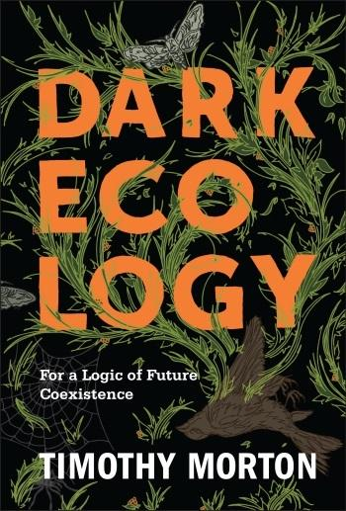
One of the central themes in the book is the prominence in dominant human culture of agrilogistics; “a technical, planned, and perfectly logical approach to built space” (42) that arose when our ancestors figured out a way to assure their future food supply- agriculture. Agrilogistics by necessity caused humans to shift their way of looking at the world from one of fear, wonderment and magic to one of rational, linear organization and control.
Morton refers to a “possibility space that flickers continually within, around, beneath and to the side of” (80) agrilogistics as the arche-lithic. The arche-lithic is the timeless, magical, boundless state of existence that we can imagine other species and non-agrilogistic humans exist(ed) within. It is also the scary, creepy, uncanny, terrifying reality that we are very small creatures on a large planet, and there are things that want to eat us. We aren’t in charge.

Slide 5
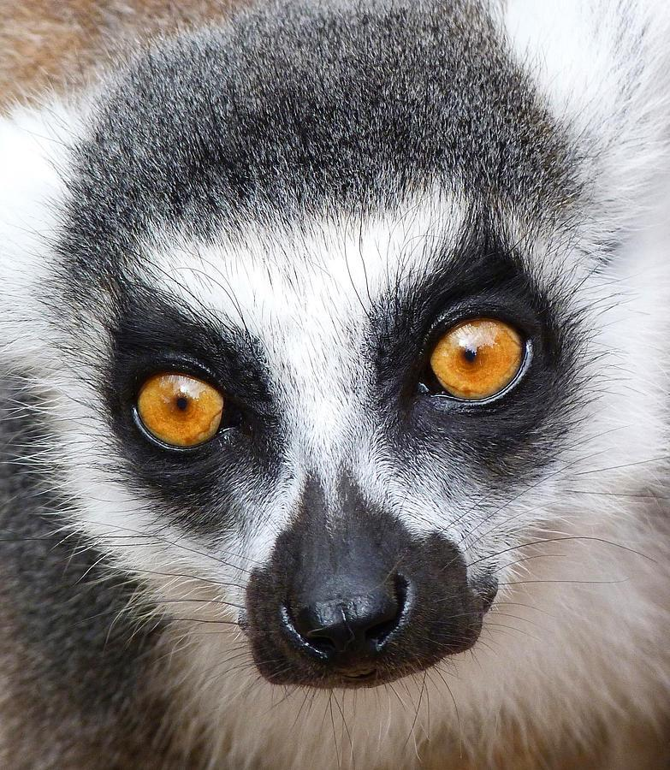
Somatic Exploration: Point Defiance Zoo
Let yourself get lost in golden eyes, deep river of time, timeless. There is a place that exists, around and within us, lost worlds lost only to our ability to see them. We know they are there, they bubble up from all the places where we hold our hands tight to the wound. Remember all those tales about other lands, falling asleep under a tree and waking up in a different world? Two hundred years passing while you feasted with the fairy queen. The world holds unending multitudes of time. Time is but the breath, the breath and the body. The nameless is the great backstage on which the one dimensional fantasy of anthropocentric order plays out. It is not a place separate from here but one beat to the side of the rhythms we’ve learned to speak, it flashes and giggles just out of sight and sound. The wounded ones know there is something deeper. You can only get there out of the corner of your eye or with a stutter step, change of breath, through deja vu or the way standing up too fast can make the world turn upside down. Or maybe you can get there through the eyes of another.

Slide 6
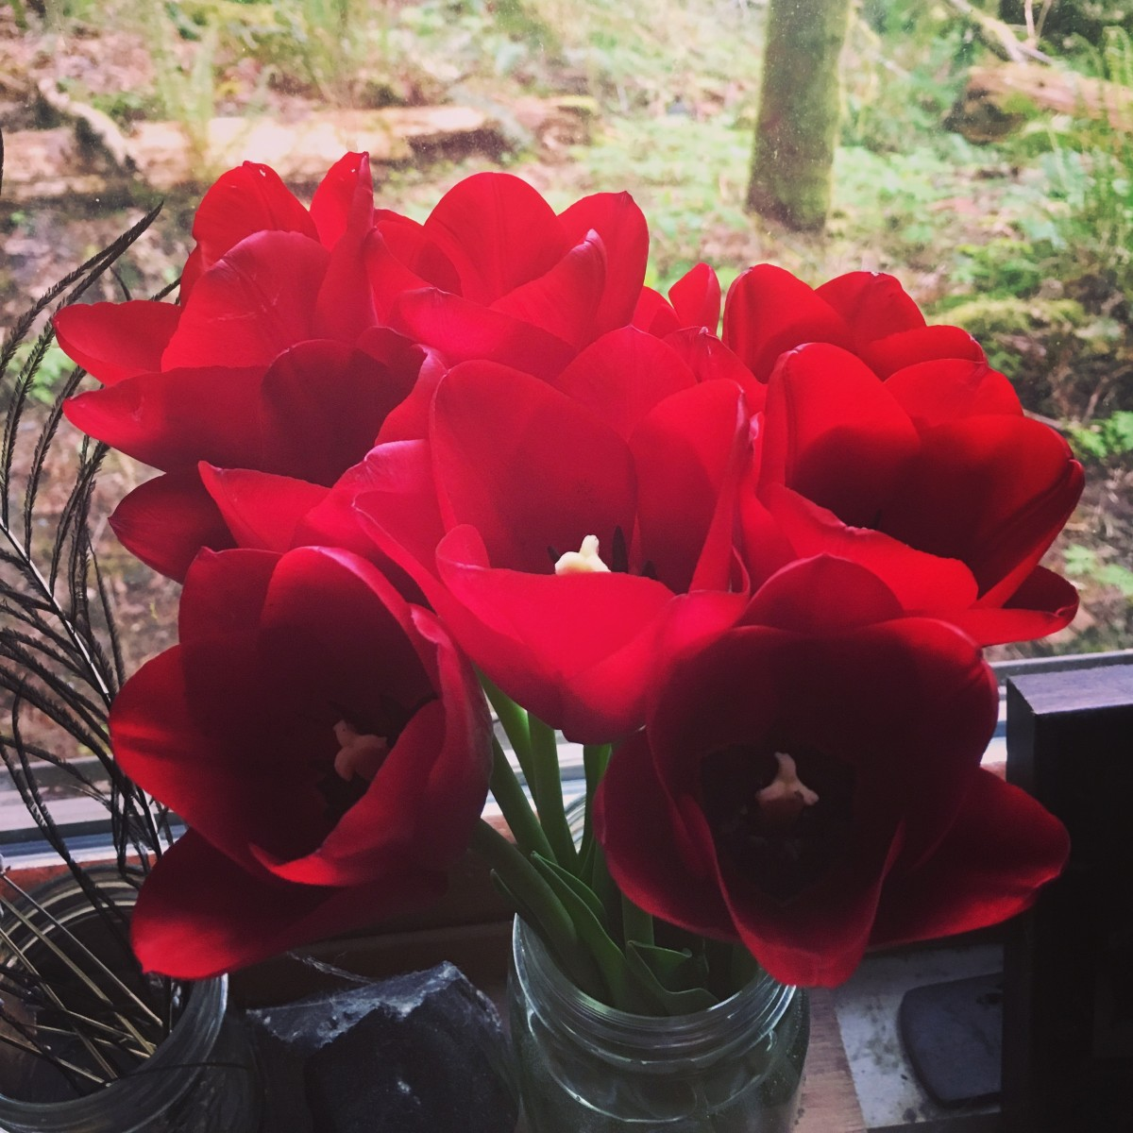
Even In the Gloom, We Bloom
This project is becoming entwined in some kind of weird, uncomfortable but rewarding feedback loop with the psychological/emotional work I’m doing in my personal life. As discussed in my self evaluations, after being at conventional colleges for years I have a deeply ingrained belief that our academic work should be separate from spiritual/emotional/psychological selves. If I’m trying to articulate anything in this project, it’s that no parts of ourselves are separate from the other, and that the messier parts of our beings should be more integrated into our public selves… so I guess that’s what is happening!

Slide 7
Handbook of Contemporary Animism
In reading The Handbook of Contemporary Animism, I was struck by the constant references to the ways that animistic indigenous cultures considered themselves as members of kin groups that included both human and more-than-human members. These kin groups were highly specific to the bioregion in which each culture arose; not a generic ‘love the earth’ messaging but a deeply felt, specific and practical relationship with the species around then upon whom they were dependent for survival.
Another theme in the HCA was that of the permeability of self that exists in many animistic indigenous cultures. ‘Self’ is not a clearly delineated territory of property, with strong boundaries between the property (body) and the world, but something inhabited for a time within the matter that makes up all of life.
I am Kirsten, for now, because the matter that has come together in my form has also developed the consciousness that exists as myself, but in the end this matter will go on to be food for something else, just as all the pigs, salmon, broccoli and potatoes that I eat in this form have become a part of me.

Slide 8
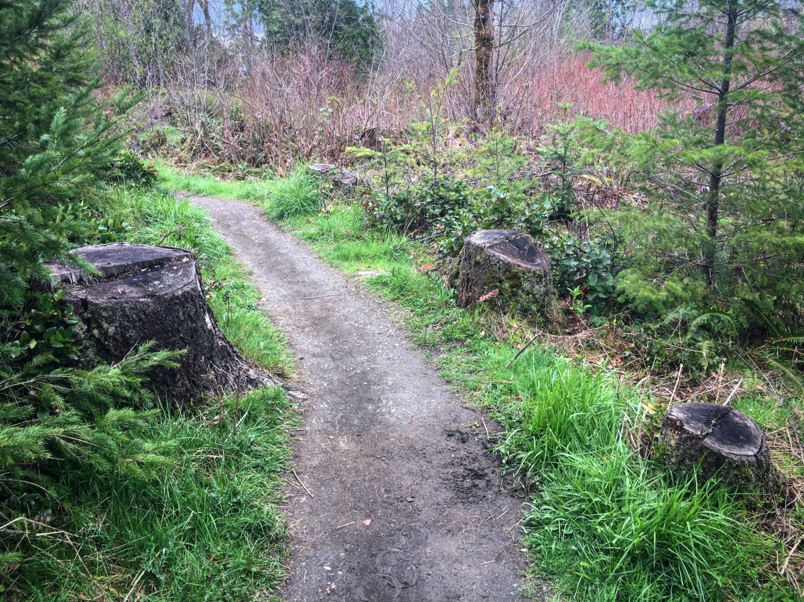
Somatic Exploration: Capitol Forest
Sitting there with the three stumps, it was as if I could feel the ghost of the forest that had stood before, or maybe the ghost of the forest that was to come, the one that was growing. It was something I could sense in the air. Like an eagerness and a sad remembering at once. I considered the fact that, at least in English, we don’t have any word for ‘death’ that doesn’t imply a complete end to existence. We would say that the tree whose stump I was sitting on died and in doing so we would be saying that that tree had ceased existing. All the more so to speak of the death of a more sentient (as far as we know or accept) creature such as a dog or a human. This conception of death leaves out the fact that while our consciousness might (probably, we can’t actually know) cease existing, all of the matter that made up our physical bodies goes on to become something else. For this tree maybe it was a house or paper, eventually to decompose into something else. For my body when I go, maybe parts of me will become plankton in the sea, or a spider, or grains of sand, or an eagle.

Slide 9
The (...)
In The primacy of the body, not the primacy of perception, E. T. Gendlin discusses the way the body interacts with the world with an intuitive, felt instinct that goes beyond any of the five senses or the intellect. In musing, “isn’t it odd that no word or phrase in our language as yet says this?” (3) he defines this indefinable thing with an ellipses: (…). It is powerful to read this paper and keep running into the … Every time I saw it, the … in myself cried out with recognition. Yes, that! It is the part of myself that is at odds with my rational intellect, which wants to be linear and controlled. It is odd to even call it a “part” of myself, because really my intellect is a “part” of … We developed our intellects as a tool for survival but the deeper … that is really in charge is the body and the felt sense of the world that we might call intuition or spirit. It is both incredibly present and physical, and it is the intangible thing that is connected to the … in each other and other creatures. It is the thing that reacts first to intuitively felt situations. It is our life force and it is the thing that is connected to the life force of everything else. It’s the umbilical cord that keeps us rooted in our bodies to the wild, present world and it is the thing we keep trying to cut off, because it doesn’t make ‘sense’.

Slide 10
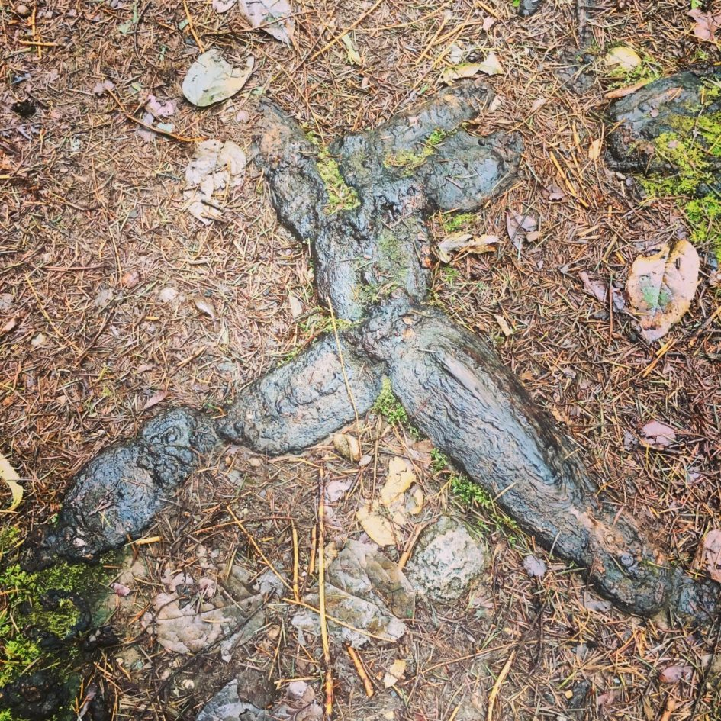
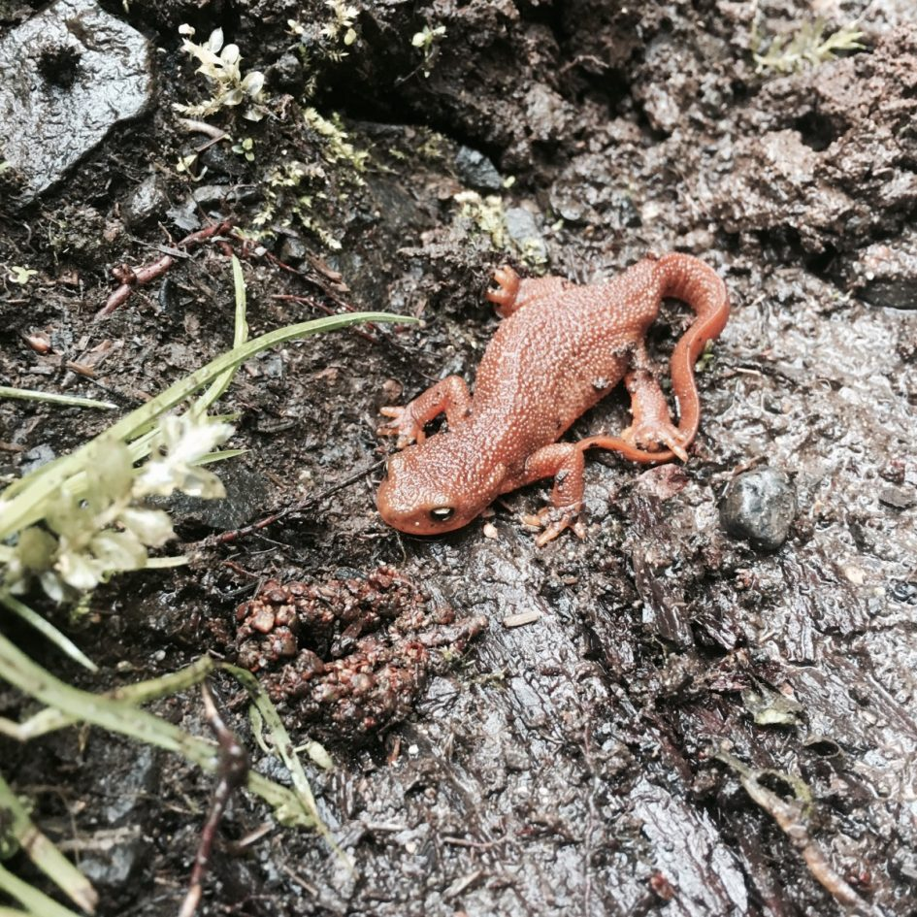

Slide 11
The Personal is... Ecological?
“The exit route [from agrilogistics/the anthropocene] looks like a regression. The arche-lithic appears as decadence and so is ignored.”
Earlier in that section Morton says that the urge to DO something about the anthropocene can be in itself an anthropocentric urge to order our way out of the order that caused the problem in the first place. This is not to say that we shouldn’t be ‘doing’ something. But what is doing? Can doing mean walking through the woods, looking into the eyes of lemurs at the zoo, writing poetry, working in deep intimacy with others to undo the anthropocentric training and attendant trauma we’ve all experienced, showing each other the ‘irreducible gap between who you are and who you think you are’ in vulnerability and humor, sitting in silence, BEING in our bodies in ways that we are trained out of from birth?
I keep finding myself ready to go ‘do schoolwork’ like I would go to the laundromat, just another chore, and realizing that whatever strange spell I started with this project is working on me all the time. The real work is in these strange moments when I find there are parts of my psycho/emotional/spiritual being that are entirely opposed to anything like animism and all of this work is exposing them to the light and they are falling away, pieces of myself I thought bedrock becoming small and weightless. Who am I underneath all of that? Do I even need an I anymore?

Slide 12
Sitting in the quiet of my house, evening forest hush outside, no birds singing this late, too early for the barn owl that calls out every night from the tree just outside the open skylight. I am reading and have just come across a factoid; 35,000 generations of humans lived in the time before agriculture, agrilogistics. 35,000 generations of humans living as animals on this world that we come from. I look up, imagination dazzled, and see my reflection in the dark glass- sleepy, tousle-haired, smudged glasses- and feel a visceral tug of grief in my gut that I am here now; late stage capitalism, neoliberalism, mass extinctions, climate change, industrialization and almost universal human detachment from the embodied world. But that is more linear thinking- A to B except in this case we’re going backwards. B, the now. A, the place we want to get back to.
I am here now, as I was there, then, in a different form. I will be here, after. The mystery is only that there is no mystery. Only everything, laid out before us in the timeless moment, offering itself up to our knowing- and it is us, and we are it.

Slide 13
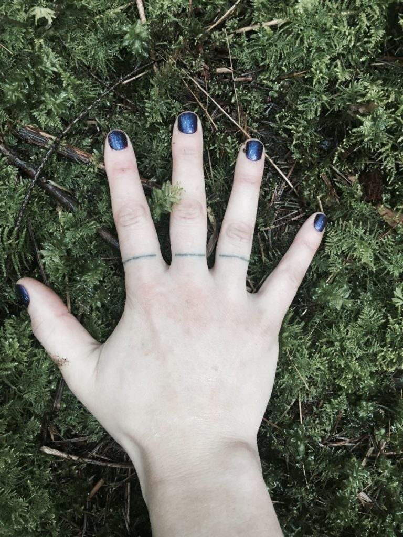

Slide 14
Bibliography
Abram, D. (2011). Becoming Animal: An Earthly Cosmology. New York: Vintage.
Cortazar, Julio.Axolotl. Retrieved May 11, 2017, from http://southerncrossreview.org/73/axolotl.html
Coetzee, J. M., Garber, M., Singer, P., Doniger, W., & Smuts, B. (2001). The Lives of Animals. (A. Gutmann, Ed.). Princeton, N.J Chichester: Princeton University Press.
Derrida, J., & Wills, D. (2002). The animal that therefore I am (more to follow). Critical Inquiry, 28(2), 369–418. Retrieved from http://www.journals.uchicago.edu/doi/pdfplus/10.1086/449046
Gendlin, E.T. (1992). The primacy of the body, not the primacy of perception [Excerpt from pages 343-353, slightly revised]. Man and World, 25(3-4), 341-353. From http://www.focusing.org/gendlin/docs/gol_2162.html
Glendinning, C. (1994). My Name is Chellis and I’m in Recovery from Western Civilization (1st edition). Boston : New York: Shambhala.
Godfrey-Smith, P. (2016). Other Minds: The Octopus, the Sea, and the Deep Origins of Consciousness. New York: Farrar, Straus and Giroux.
Haraway, D. J. (2016). Staying with the Trouble: Making Kin in the Chthulucene. Duke University Press Books.
Lingis, A. (2009). The voices of things. The Senses and Society, 4(3), 273–281. Retrieved from http://www.tandfonline.com/doi/abs/10.2752/174589209X12464528171815

Slide 15
Morton, T. (2016). Dark Ecology: For a Logic of Future Coexistence. Columbia University Press.
Johnson, Don Hanlon. Sitting, Writing, Listening, Speaking, Yearning: Reflections on Scholar-Shaping Techniques. Body Movements: PEdagogy, Politics, and Social Change. Hampton Press. 2002 Retrieved May 11, 2017, from http://www.donhanlonjohnson.com/articles/sittingwriting.html
Reclaiming Animism - Journal #36 July 2012 - e-flux. (n.d.). Retrieved May 11, 2017, from http://www.e-flux.com/journal/36/61245/reclaiming-animism/
Salmon, E. (2000). Kincentric ecology: indigenous perceptions of the human–nature relationship. Ecological Applications, 10(5), 1327–1332. Retrieved from http://onlinelibrary.wiley.com/doi/10.1890/1051-0761(2000)010[1327:KEIPOT]2.0.CO;2/full
Shaw, M., & Abram, D. (2016). Scatterlings: Getting Claimed in the Age of Amnesia. Ashland, Oregon: White Cloud Press.
Smuts, B. (2001). Encounters with animal minds. Journal of Consciousness Studies, 8(5-6), 293–309. Retrieved from http://www.ingentaconnect.com/content/imp/jcs/2001/00000008/f0030005/1213
Sonic Acts. (n.d.). Retrieved May 12, 2017, from http://www.sonicacts.com/portal/dark-ecology-interview-tim-morton
Wohlleben, P., & Flannery, T. (2016). The Hidden Life of Trees: What They Feel, How They Communicate—Discoveries from a Secret World. Greystone Books.

