Slide 1
Localizing Olympia’s Food System
Natasha Bynum: ComAlt Spring 2017

Slide 2
Original ILC

Slide 3
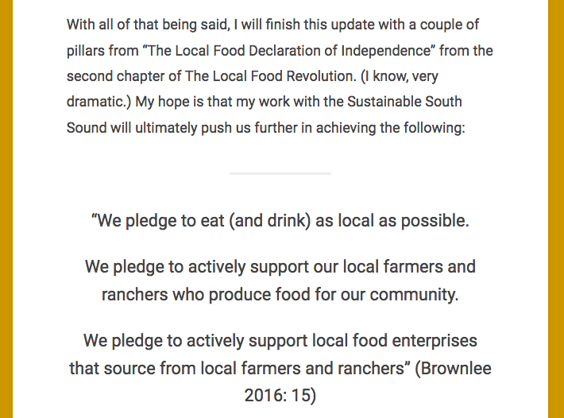
The Local Food Revolution
by Michael Brownlee

Slide 4
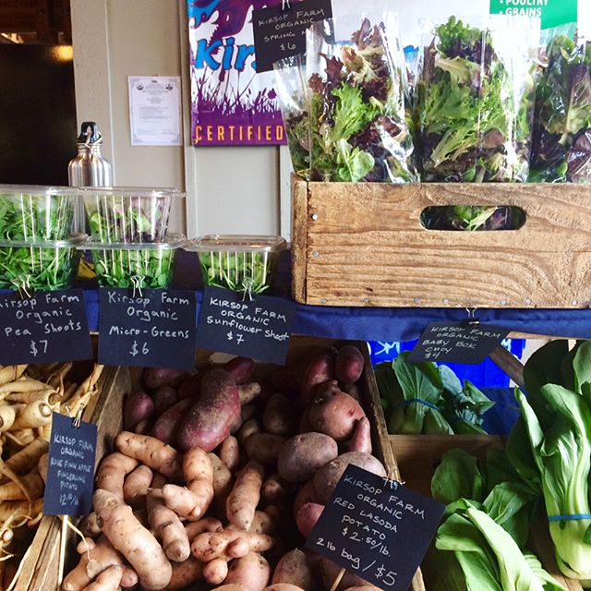
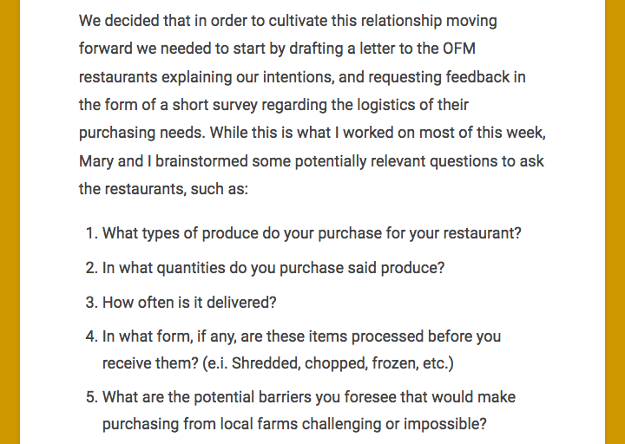
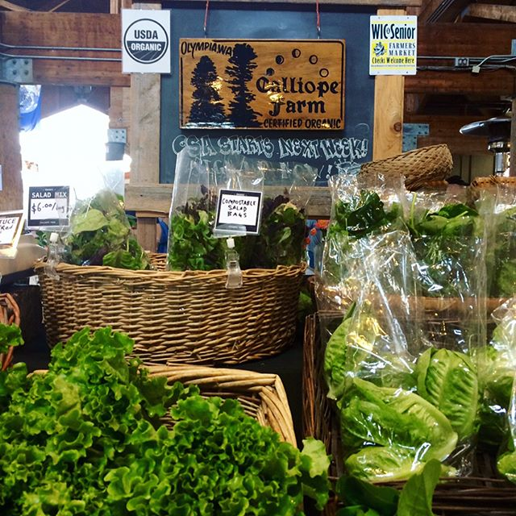
SSS: OFM Farms and Restaurants

Slide 5
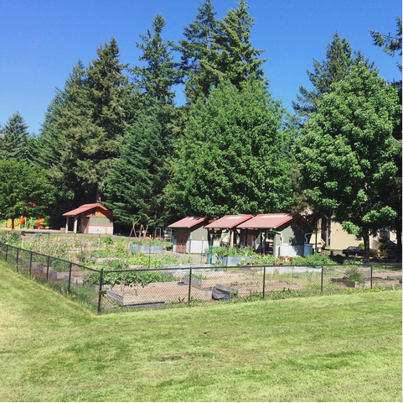
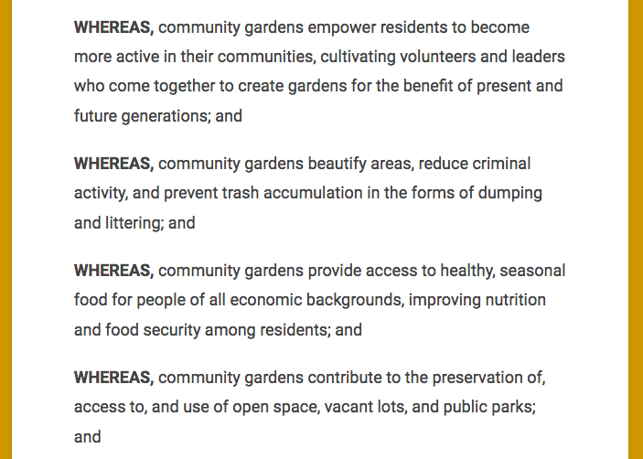
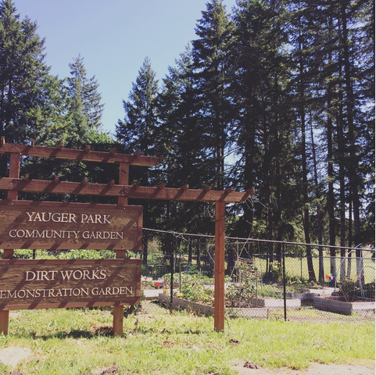
SSS: Community Garden Resolution

Slide 6
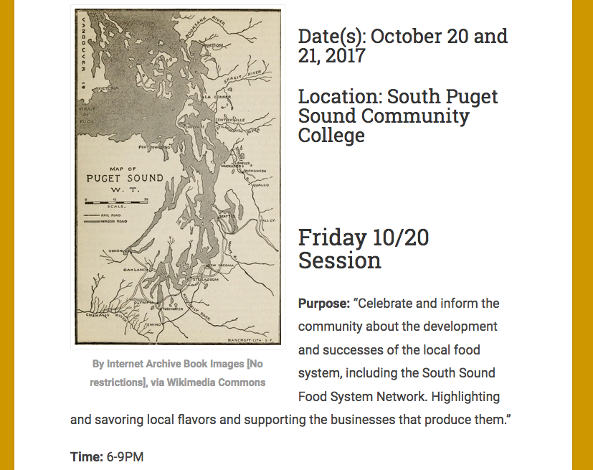
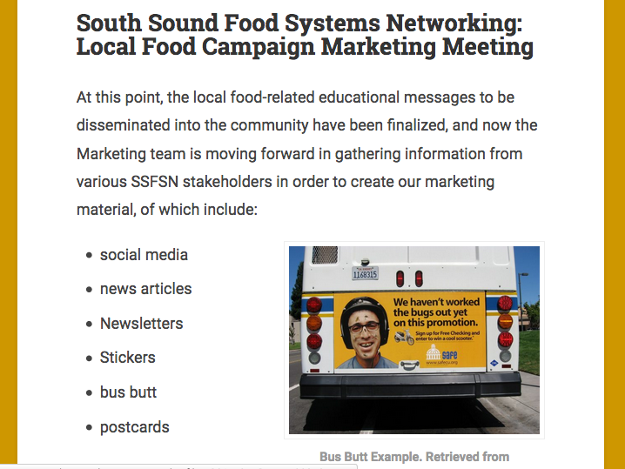
SSFSN: Food Summit
SSFSN: Food Campaign

Slide 7
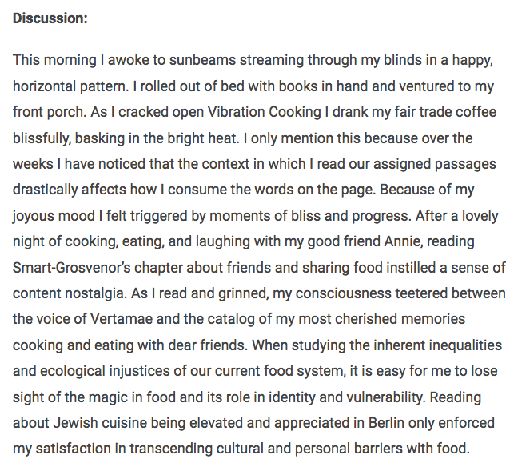
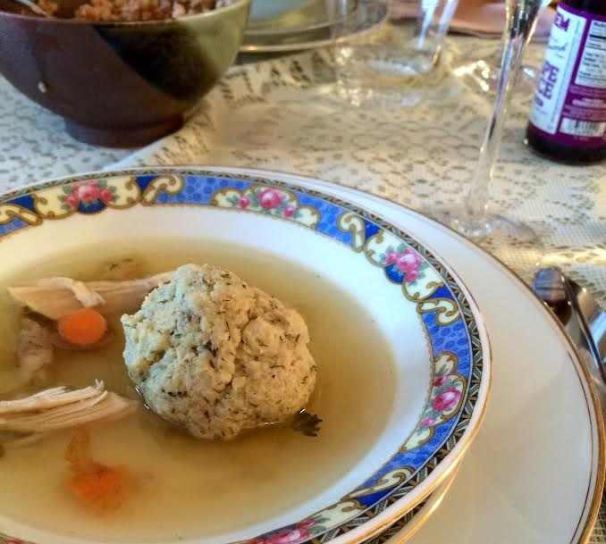
Seminar

Slide 8
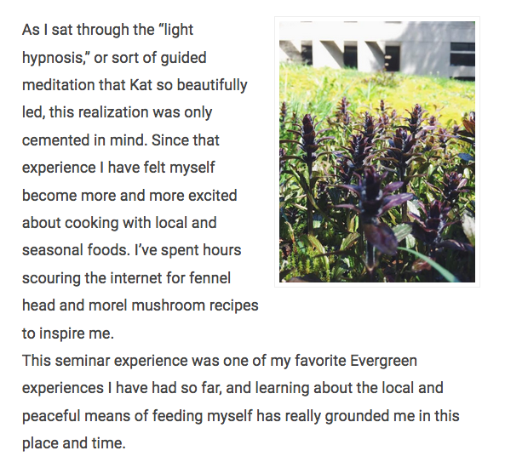
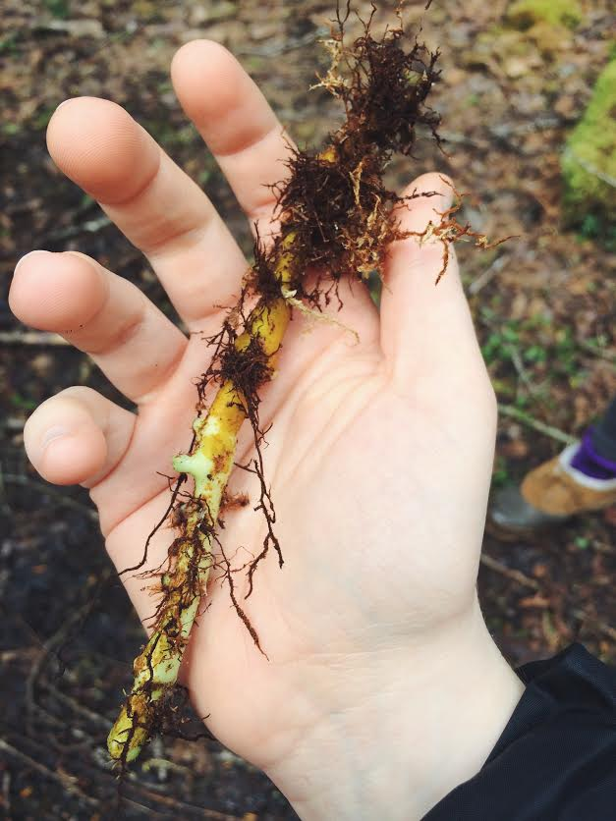
Tasting Labs

Slide 9
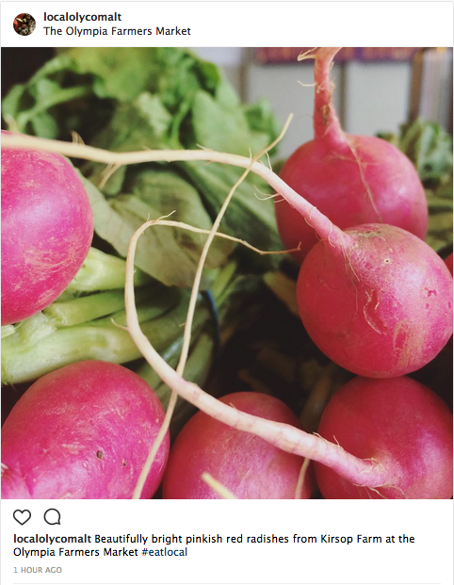
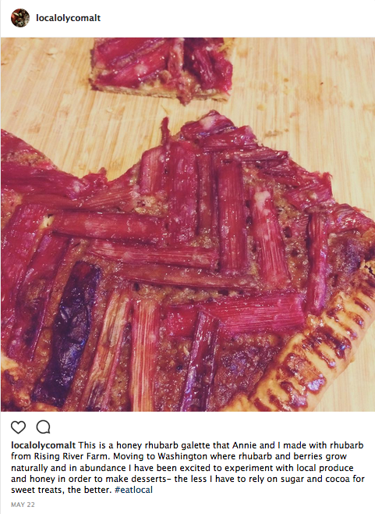
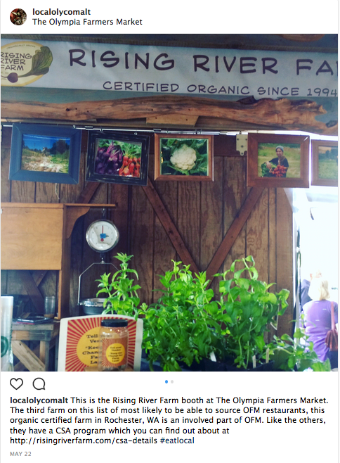
Image Gallery: Instagram

Slide 10
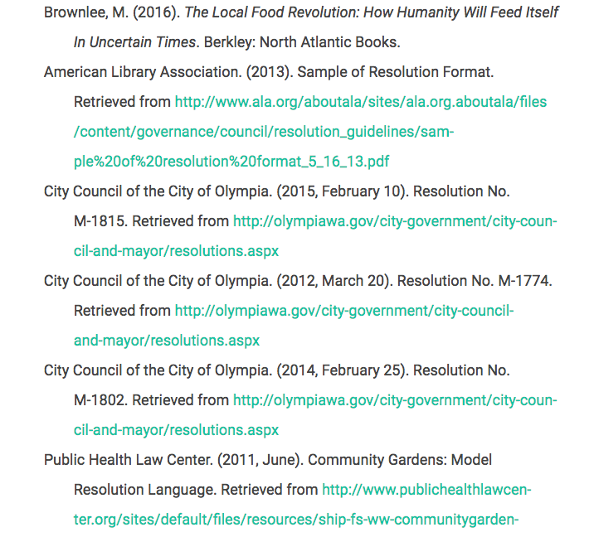
Bibliography

Slide 11
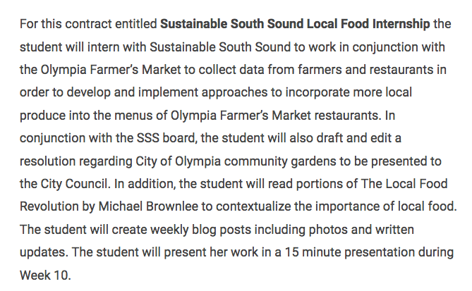
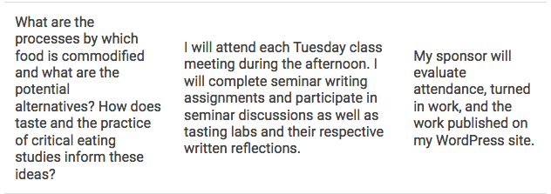
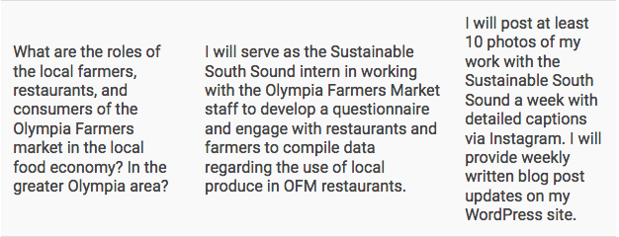
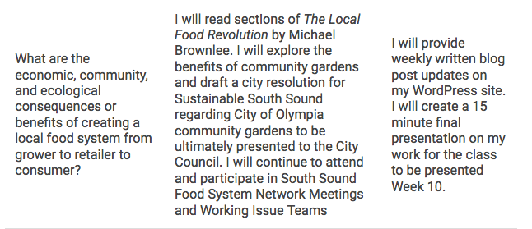
ILC: Transformed

Slide 12
Photo Citations
The Local Food Revolution Cover retrieved fromhttp://www.penguinrandomhouse.com/books/252877/the-local-food-revolution-by-michael-brownlee/9781623170004/
https://ssfoodsystemnetwork.org

