Slide 1
Queer Studies: Projects in Comprehensive Sex Education
This in-program ILC titled “Queer Studies: Projects in Comprehensive Sex Education” will study the connections between comprehensive, inclusive sex education and social justice issues by blending elements of experiential research, fiction creation, and hands-on leadership and program coordination experience to give the student a broad perspective that is connected to real world applications. The student will carry out an internship with the Trans and Queer Center at The Evergreen State College to gain practical experience with program and event planning in a LGBTQIA+ space. In addition the student will carry out an independent experiential research project on the importance of comprehensive sex education as a social justice tool, and the student will create several pieces of short fiction including elements of the social justice, identity, and diversity issues being addressed over the quarter. Texts to be utilized in whole or in part include: “Octavia’s Brood” edited by Adrienne Maree Brown and Walidah Imarisha; “Not Your Mother’s Meatloaf” edited by Saiya Miller and Liza Bley; and “LGBTQ Comedic Monologues That Are Actually Funny” edited by Alisha Gaddis.
Deliverables:
Experiential Research Paper.
Event Leadership Experience.
Fiction Shorts and Reflection.

Slide 2
Fiction:
Dumpster Roses Kept (Rose Series 2)
Subtle Rebellion
It was a huge bunch, and we decided they were the most beautiful things in the world.
Some of the petals were dented, and some of the flowers were small, the stems were uneven, and broken in place. They were the most beautiful things in the world because they were dented and bruised, because they had been thrown away and still shone deep rich pigment and glorious grace.
Because we’d skinned our knees and covered ourselves in tiny scars. We’d broken bones and cut our own hair in the mirrors. Our crooked layers and lopsided ponytails were the roses proof, the roses were our proof.
The rebellion is subtle. Maybe no one on the outside will notice. Likely the administrators won’t notice, or won’t notice the pattern until they’re looking at the pictures that make up the day. It will irritate them when they notice, they will worry that people on the outside will notice and wonder or retaliate.
The rebellion is progress of ideal tucked gently under the edge of someone’s cuff or hidden quietly between the folds of a robe, waiting for the time it can be flown and exposed so proudly.
It’s slow so they won’t notice till it’s taken over, until it’s too late.
Rebellion is subtle.

Slide 3
Trans and Queer Center Internship
Tasks:
Being Present in the Center
Be Welcoming, Keep the Space Clean, Keep a tally of Visitor Numbers
Help Where Needed
Plan an Event (Let’s Talk About Sex/Gown Decoration Party)

Slide 4
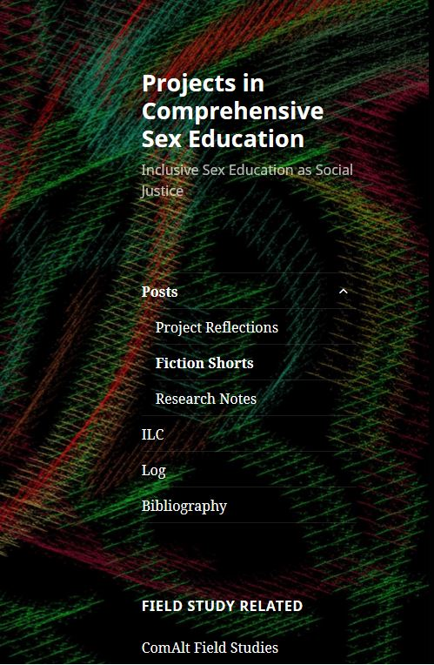
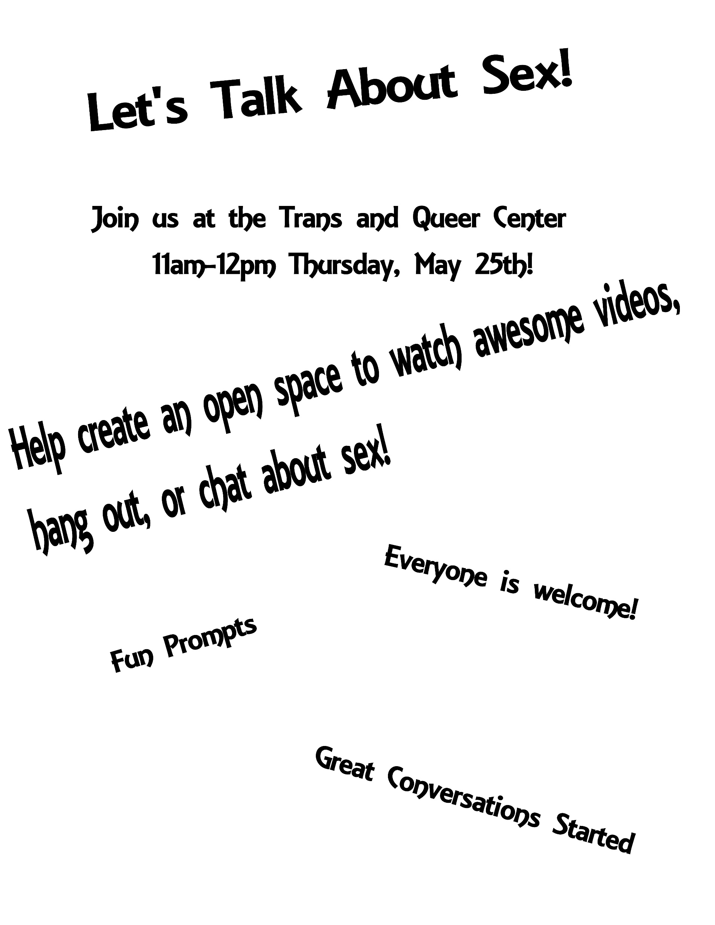
Flyer, Images

Slide 5
Comprehensive Sex Education’s Connections to Social Justice Work: Experiential Research Paper
Sex education is not just a curriculum that should be taught for a semester in an arbitrary age group. It is a community building experience. Talking about personal experiences and having an open space to share that experience is important to community health, because it's important to be able to continue learning and finding new information in an environment that won't stigmatize discussion of subjects that are pretty fundamental to our lives and the systems we live within. As long as no one is forced to speak about what they do not want to, and everyone is consenting to be part of that conversation and everyone is making sure that conversation is taking the form it needs to to make sure everyone is getting what they want or need out of that conversation, then there shouldn't be anything in the way of having more of these kinds of conversations.

Slide 6
Bibliography Hours Log
A week by week collection of the material I am reading, watching, studying, or just considering for further study in my research.
Hours Log: As of Wk 9 Total Hours: 379

