Slide 1
Internship with Elliott Bay Brewing Company
Social Media Marketing Manager

Slide 2
Duties:
Take and edit photos
Post content across socials
Employee Spotlights
Market analysis
  Hashtag optimization
  Research, strategy development
  Attending & photographing events

Slide 3
Typical Week
Travelling to each location to shoot
Interviewing employees
Special events
Editing photos at coffee shops, at the brewpubs, or at home
Posting to all socials at least once a day

Slide 4
Objective 1:
Research what content and frequency of posts similar businesses were successful in doing, in order to develop a strategy to implement based on best practices.
  Forbes
  Sprout Social
  Beerlatta
    https://www.instagram.com/allagashbrewing/?hl=en
    https://www.instagram.com/elysianbrewing/?hl=en
    https://www.instagram.com/pfriembeer/?hl=en

Slide 5
Objective 2:
Create fresh, new, interesting content for Elliott Bay Brewing Company’s social media outlets (majority of my internship)
  Photography
    my camera (canon rebel t6)
    YouTube
    Photoshop
  Employee Spotlights
  Travel
  Events

Slide 6
Objective 3:
Tracking data through Social Report
  What I’ve learned about the audience
  What posts perform the best

Slide 7
Objective Revisions
WA Beer Association Sustainability tool

Slide 8
Accounts I manage:
https://www.instagram.com/elliottbaybrewingco/
https://www.instagram.com/brotherbarrel/
https://twitter.com/elliottbay_beer
https://twitter.com/brotherbarrel
https://www.facebook.com/ElliottBayBrewingCompany/
https://www.facebook.com/BrotherBarrel/

Slide 9
Things I Did Not Expect
Independence, mentorship
Time commitment (& how it changed over time)
Lifestyle change (love it!)

Slide 10
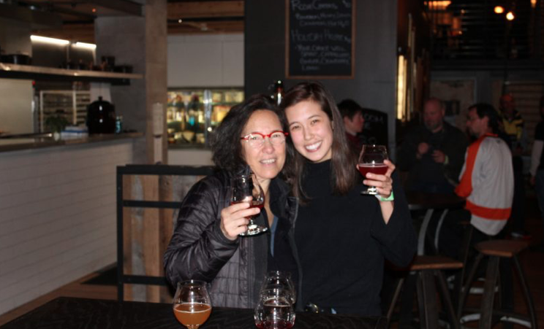
Barrel Aged Invitational

Slide 11
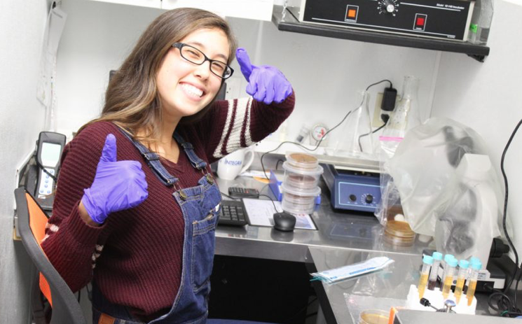
Fermentation Project

Slide 12
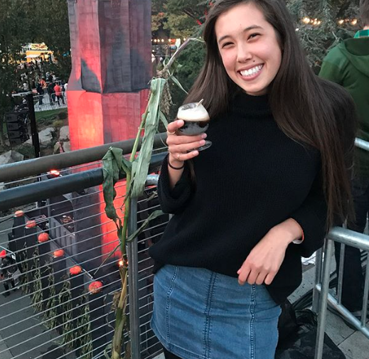
Elysian Pumpkin Beer Fest

Slide 13
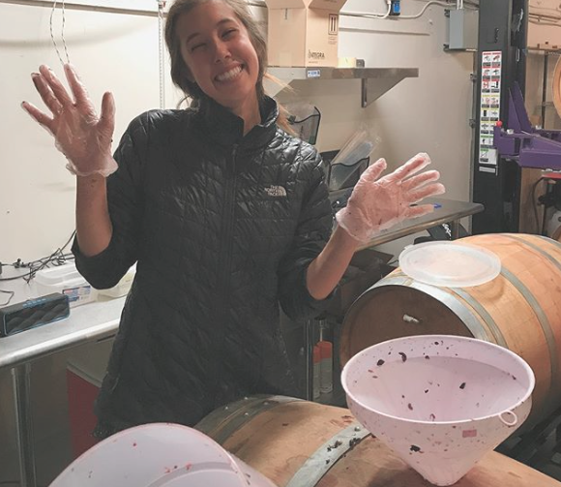
Brew Day

