Slide 1
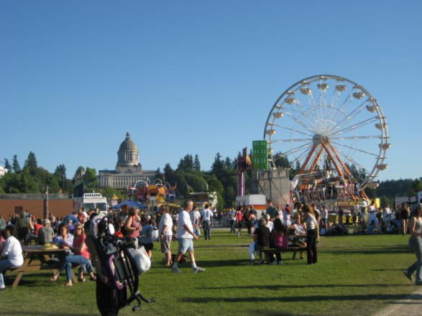
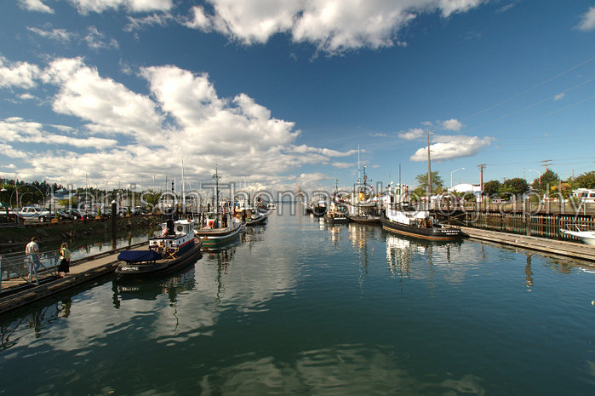
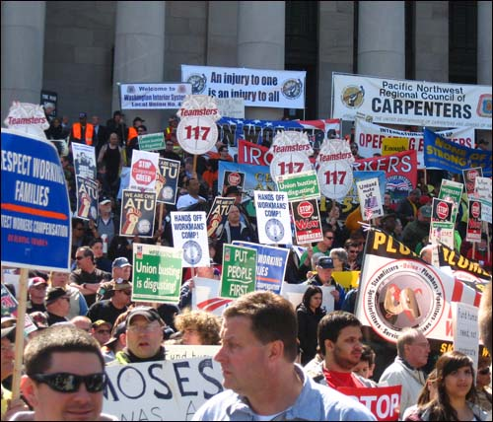
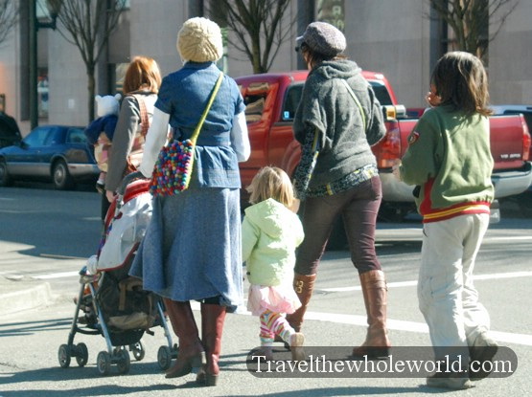
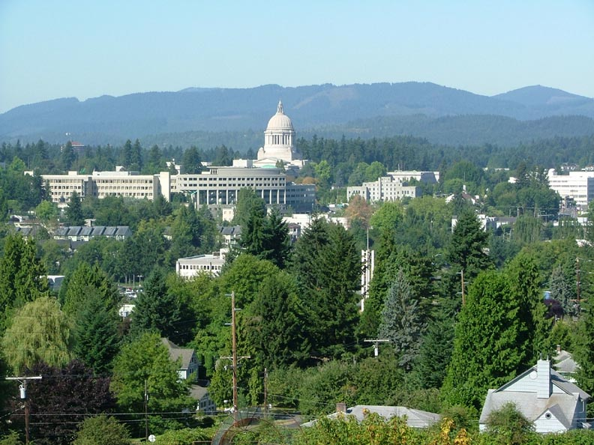
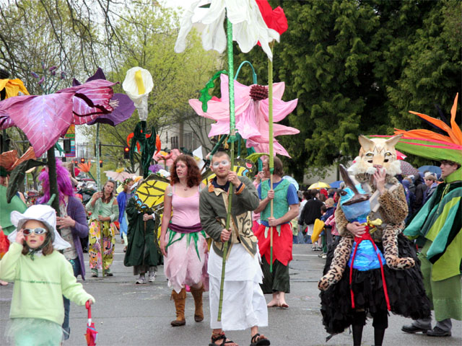
The Six Olympias…

Slide 2
Original Six Americas results

Slide 3
The Six Olympias

Slide 4
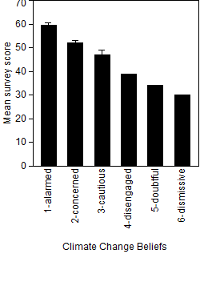
Olympia Survey Scores by Category

Slide 5
Organize panels by total score?
name | score | sum | Code | TYPE | name
bush | alarmed | 55 | 7 | alarmed | bush
perez | alarmed | 55 | 19 | alarmed | perez
narog | alarmed | 56 | 29 | alarmed | narog
gallagher | alarmed | 58 | 3 | alarmed | gallagher
beaman | alarmed | 59 | 24 | alarmed | unk2
andrusyszyn | alarmed | 60 | 2 | alarmed | andrusyszyn
roberts | alarmed | 60 | 35 | alarmed | roberts
dochow | alarmed | 61 | 52 | alarmed | dochow
proie | alarmed | 61 | 25 | alarmed | proie
blessing | alarmed | 62 | 51 | alarmed | blessing
potter | alarmed | 62 | 133 | alarmed | potter
addae | alarmed | 63 | 1 | alarmed | addae
starr | alarmed | 63 | 16 | alarmed | starr
mander | concerned | 47 | 55 | concerned | mander
garver | concerned | 47 | 40 | concerned | garver
thelen | concerned | 48 | 30 | concerned | thelen
baur | concerned | 49 | 18 | concerned | baur
harvey | concerned | 50 | 54 | concerned | harvey
martin | concerned | 50 | 46 | concerned | martin
masello | concerned | 50 | 45 | concerned | masello
coleman | concerned | 51 | 18 | concerned | coleman
faulkner | concerned | 51 | 42 | concerned | faulkner
mounts | concerned | 51 | 50 | concerned | mounts
ramsdell | concerned | 53 | 58 | concerned | unk1
karboski | concerned | 54 | 57 | concerned | karboski
sargent | concerned | 54 | 10 | concerned | sargent
wolt | concerned | 55 | 43 | concerned | wolt
henson | concerned | 56 | 6 | concerned | henson
marnia | concerned | 56 | 26 | concerned | marnia
redfern | concerned | 57 | 15 | concerned | redfern
spang | concerned | 60 | 22 | concerned | spang
peterson | cautious | 38 | 53 | cautious | peterson
huck | cautious | 44 | 14 | cautious | huck
aubrey | cautious | 47 | 47 | cautious | aubrey
rambo | cautious | 49 | 41 | cautious | rambo
dander | cautious | 50 | 9 | cautious | dander
waterstrat | cautious | 50 | 20 | cautious | waterstrat
jones | cautious | 52 | 49 | cautious | jones
zimmer | dismissive | 30 | 5 | dismissive | zimmer
mcbee | doubtful | 34 | 56 | doubtful | mcbee
elswick | disengaged | 39 | 12 | disengaged | elswick

Slide 6
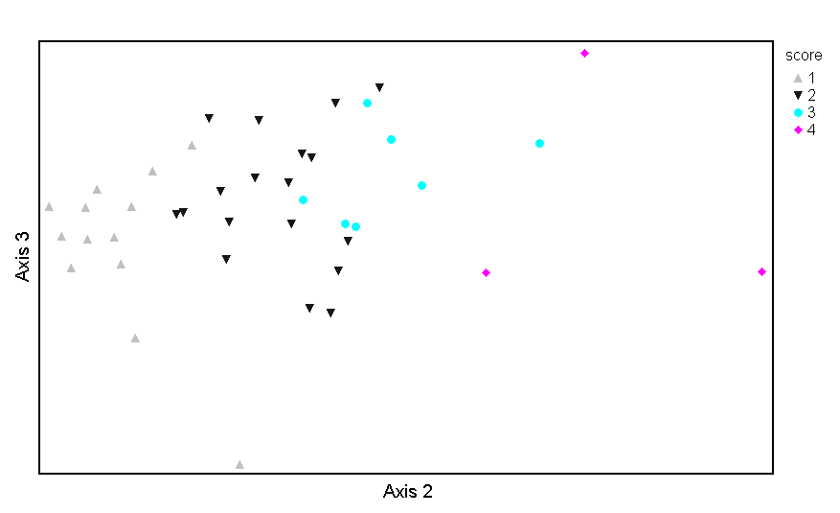
Ordination
Alarmed
Concerned
Cautious
Other

Slide 7
Alarmed
Concerned
Cautious
Other

Slide 8
Organize groups by ordination?
Concerned/Cautious #2
Concerned #2
Alarmed
Concerned
Cautious
Other
Alarmed #1
Cautious/Disengaged/Doubtful/Dismissive
Concerned #1
Concerned/Cautious #1
Alarmed #2

Slide 9
Very similar panel groups are formed by rank orders…

Slide 10
Panel designations (7)
Alarmed #1
Alarmed #2
Concerned #1
Concerned #2
Concerned/Cautious #1
Concerned/Cautious #2
Cautious/Disengaged/Doubtful/Dismissive

