Slide 1
The 6 Olympias Attitudes on Climate Change THE ALARMED GROUP #2
Presented By:
Brittany Gallagher, Robyn Andrusyszyn, Otis Bush, Josiah Narog,
Caitlin Roberts, Joseph Perez, and Floyd Beaman

Slide 2
Introductions
Alarmed #2: Alarmed and vexatious
Methodology
Group Effort
Keywords and Themes
Two matrices: media, levels of understanding of common themes
Two lists: misconceptions and surprising outcomes
Conclusion and Future work

Slide 3
Refined Key Words
Climate Change
Media
Information
Communities
Change (non-climate change)
Education
Nature

Slide 4
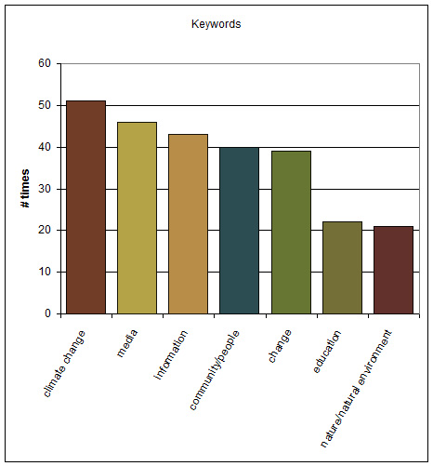
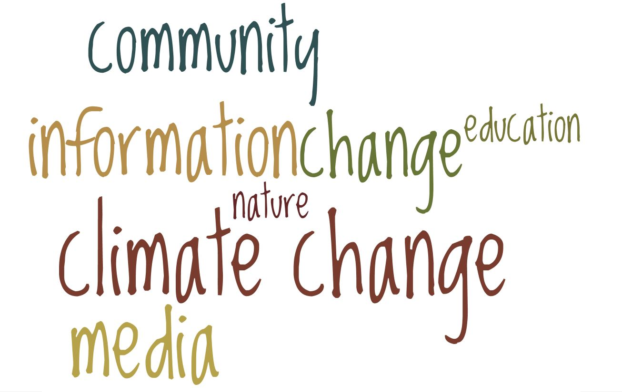
Our “Wordle” of Key Words

Slide 5
Refined Themes
Distrust in Mainstream Media
High trust in science
More scientific information needs to be readily available
Worried about future global and local changes

Slide 6
Matrix #1- The Media
Information Sources | Trusted | Not Trusted
Least Mentioned | MSNBC (1) CNN (1) Government (2) Friends & Family (2) Huffington Post (1) California (1) | Newspapers (1) Cell Phone Alerts (1) Internet (1) Friends & Family (2) Corporations (1)
Most Mentioned | Internet (5) Science (5) NPR (3) Newspapers (3) | Television (6) Fox News (3)

Slide 7
Matrix #2 – Common Themes
Themes | Shallow | Deep
Reliability of Media | 0 | 7
Causes of Climate Change | 3 | 4
Impacts of Climate Change | 2 | 5
Mitigation Options | 4 | 3

Slide 8
Misconceptions
Weather as climate
Smog (and all pollution) is the outcome of climate change
Ozone depletion as a result of climate change

Slide 9
Surprising Outcomes
Discussion on Religion
“Inconvenient truths”
Positive outcomes (restoration, wetland mitigation)
Some were pro-policy and some were anti-policy
Surprised at how many “alarmed” were misinformed

Slide 10
Conclusions
Overall, there is strong trust in science and a distrust in mainstream media
Great concern about the local and global changes to occur in the future
All desired more accessible information
Although Alarmed, they were still misinformed in areas

Slide 11
Future Work
What would be the best mode of spreading information about climate change, besides mainstream media?
In what ways could we get more people to think about climate change?
How might an early education on climate change/science affect that person’s views as they get older?

Slide 12
Questions????
Questions????
?
Questions????
Questions????
Questions????

