Slide 1
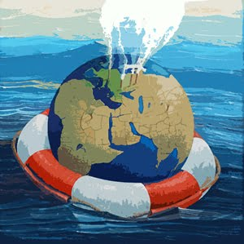
Climate Change: Alarmed #1
Hailey Starr, Sara Potter, Bonnie Blessing, Kwasi Addae, Dianne Dochow, Shelby Proie
www.mrra.gov.mt

Slide 2
The Six Olympia’s: Alarmed
According to Global Warming’s: The Six Americas: An Audience Segmentation Analysis conducted by the Yale Project on Climate Change the “Alarmed” group of citizens are:
Convinced global warming is happening due to human activity.
Involved and worried about global warming.
Most likely to view global warming as personally threatening.
Believe global warming is currently happening.

Slide 3
Qualitative Methods Used to Group and Analyze Results:
In-person interview with 13 open-ended questions.
15 question, questionnaire for interviewee to fill out and return onsite.
In depth questionnaire to be filled out and returned within ten days.
Transcription and analysis of key words and themes from live interview process.
Integration of six separate interviews in the “Alarmed” group by comparing and utilizing common key words and themes.

Slide 4
Key Words
Communication/Media
Story, conversation, connection, internet, journal, books, newspapers, radio, articles,
progressive magazine, TV news, TV programs, education,
Nature
Garden, animals, water, environment, trees, lake, shellfish, ocean, natural resources,
ice, snow, rain
Politics/Policy/Government
Republicans, politics, democrats, liberal, elections, anti-government, shifty
politician, conservatives
Climate change effects
Temperature, drought, ocean warming, carbon dioxide, sea level rise, wetter,
weather, chain reaction, fluctuation
Perception of Science
Science, data, sources, funding, credibility, scientists, journals, truth, relevance,
research, “coming home”

Slide 5
Themes
Experiences in Nature
Land Development/Destruction
Information Accessibility
Weather
Misconceptions

Slide 6
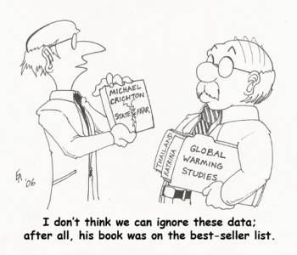
Information Sources Comparison
Trusted:
Not Trusted
Mass Media
T.V.
Scientists
Scientific Journals
Research
Books
Public Radio
http://scienceblogs.com/corpuscallosum/images/Finalist10-350px.jpg
Notes:
-We did a comparison rather than a matrix
-Did not have many sources stated a few number of times that were trusted or not trusted
-The sources stated were stated in abundance.
-That’s why we did a comparison.

Slide 7
Trusted Information Sources
Scientists
Those who weren’t backed by oil.
Scientific Journals
Any that are available.
Research
Climate change science in general.
Books
Public Radio
NPR
http://a.imageshack.us/i/2119173.jpg/
Notes:
Scientists:
They are the ones doing the research so they would be the best to represent it correctly.
Trust scientific method.
3) Trusted because they connect the dots between fossil fuels and increased global temperatures.
Scientific Journals:
Again those who write the journal articles are those who are doing the research, scientists.
More factual less of a political stance or motive.
Research
Climate change science in general.
Nothing backed by alteriro motives just pure research
User friendly. The way the information is presented (Graphs) are easy to understand and see relationships between anthropogenic use and climate change. Which brings it close to home.
General Consensus
Trusted Scientific Method
Not alternative motive scientists
Not sciences back by corporations or political stances.

Slide 8
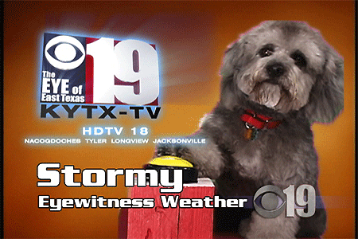
Not Trusted Information Sources
Mass Media
Ex. T.V.
Can be confusing, too many opinions.
Present false information
http://chocolatedogblog.files.wordpress.com/2007/06/stormyweatherdog.gif
Notes:
Mass Media:
T.V.
Can be confusing with the over whelming amount of opinions backed by different motives, political corporate.
Don’t provide accurate information.
Can be confusing. Too many opinions. Opinions backed by different motives.

Slide 9
Education important
50% of our alarmist interviewees considered education a top priority
Methods include
Community meetings
Signage
On-line blogs to report observations
Engaging with scientists important

Slide 10
Bring climate change home to Olympia
Sea level rise could inundate parts of downtown.
Make downplayed signs: ‘Alternate route when sea-level covers 4th Avenue’
Makes people think its real, even if possibly worse in other countries in the future

Slide 11
EDUCATIONAL OBJECTIVES
Bring climate change home to our garden
Scientists engage public about how
climate change is
pertinent to them

Slide 12
Proposal: Thurston county citizen-scientist blog
Sample observations possibly related to climate change:
1)fog
2)plant or lawn growth
3)bee and bird activity patterns
4)seawater coming through manholes
Some citizens reticent to describe observations at community meetings
Citizens report possible climate change observations on website or blog
Scientists review and respond with literature

Slide 13
Expectations of the Alarmed as Described by “Six Americas”
Active in communities
Open and candid in speech
Generally higher incomes and better educated
Educated or honestly uneducated on subject
Egalitarian beliefs
Community-minded classlessness
Less religious
No traditional religious affiliation
Favor government action in climate change
Hope for government action
Source: Maibach et al., pg. 30.

Slide 14
Fit with “Six Americas”
 | Fit | Disagree
More Occurrences | Open and candid in interview | Hope for Government Action Egalitarianism
Less Occurrences | Educated about subject | Non-religious

Slide 15
Examples of Disagreement
Timid or abrupt behavior
Use of vague language
Declaring they don’t know what they mean
Distracted or brief in interview
Factual misunderstandings
General confusion of climate change versus general environmental problems
Caused by fireworks, decreased snow = increased population, ocean warming, plastic

Slide 16
Example of Disagreement
Arrogance
Many instances of disdain for others of differing opinion or education
Religious ties
Traditional religion mentioned
Very mistrustful of government
Ability of regulations to change people
Ability of government to create effective regulations

Slide 17
Surprising Outcomes
Expectations | Unsuspected results
Open and candid in speech | Timid or abrupt behavior
Passionately educated | Factual misunderstandings
Community-minded egalitarianism | Arrogance
Not traditionally religious | Religious ties
Hope for government action | Widely varied, leaning toward distrust

Slide 18
Conclusions –Six Olympias
At first glance, this group of Alarmed respondents appeared to be fairly homogeneous in their attitudes about climate change. However, closer examination of the data revealed similarities and contrasts, as well as some inaccurate and unexpected underlying beliefs among interviewees.

Slide 19
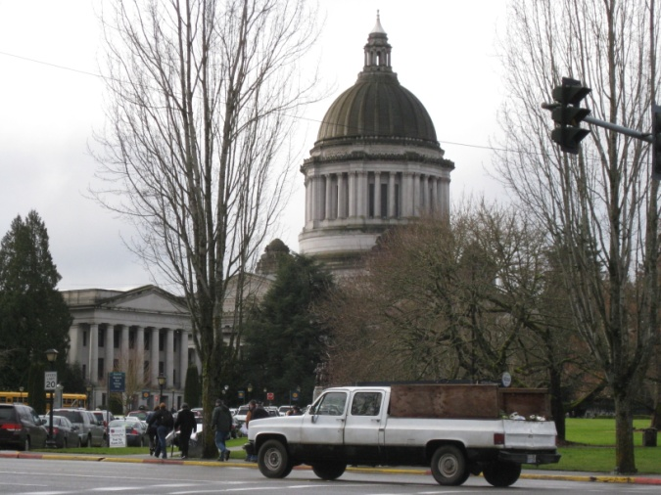
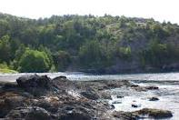
Additional thoughts
Our team hypothesized that the difference between Dr. Carri LeRoy’s analysis that reported 32% of Olympians were Alarmed versus 18% in the Six Americas study may be due to several factors:
Proximity to the state capital, policymakers, and legislative activities.
Elevated community awareness and commitment to environmental issues.
Regional pride in outdoors.
Varied regional topography. Water, mountains, prairies, deserts are within a two hour drive.
Non-random sampling.
Notes:
Elevated awareness – for example recycling is more prevalent in Olympia than in southern states or Alaska.
NW pride – Changes in environment may be more apparent to those actively engaged in outdoors and people might be motivated to work toward change.
Smaller group – and study respondents lived in a similar region.

Slide 20
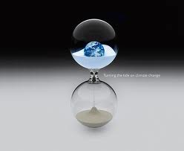
Looking to the Future...
Improve communication between scientists and the public.
Do not rely on government to take the lead on climate change.
Construct campaigns and develop educational tools to build awareness of climate change and address misconceptions.
Enlist public support for CO₂ mitigation and overall reduction measures.
Engage with elected officials to bring climate change issues to the forefront of policy and decision making.
Turning the tide on climate change by Robert Kandel

