Slide 1
The Six Olympias Concerned/Cautious #2
Dennis Aubrey, Kim Jones, Cory Mounts, Charles Rambo, Laura Thelen

Slide 2
Introduction
Concerned
Global warming is happening
Not extremely important issue to participant
Less likely to perceive global warming as a threat to themselves and future generation
Cautious
Somewhat convinced global warming is happening
Only thought a little bit about global warming
Half believe human activities are the primary cause

Slide 3
Keywords and Themes
Keywords: Pollution, Nature, Government, Climate Change, Hokey/Hocus Pocus
Themes: Doubt of Extent, Uncertainty About Causes, Closeness to Nature, Media Coverage, Pollution

Slide 5
Information Sources and Government Action
Information Sources | Trusted | Not trusted
Least mentioned | Grain bureau; farm bureau; tribal elders; colleague; Bernstein Bears; IPCC | Family, tv
Most mentioned | Oyster growers; CNN; National Geographic, NPR;US Fish and Wildlife paper; Media, National Geogrphic | “experts”; Internet, science; Media
Government Action | Trusted | Not trusted
Least mentioned |  | Managing nature and wildlife;
Most mentioned | Pesticide/pollution control; garbage service; Car emission/fuel standards; State Agencies; Recycling, LEED Buildings, Local government | Climate Change panels; National interests in Oil reserves, energy policy

Slide 6
Participant’s Understanding
Climate Change : Participant’s Understanding | Shallow Under-standing | Deep Under-standing | Background Beliefs | Peripheral Beliefs
Pollution | 7 | 3
Nature | 1 | 11 |  | 7
Government | 4 | 3 | 8 | 2
Climate Change | 12 | 11 | 6
Hokey/Hocus Pocus |  |  | 3 | 3
Themes
Doubt of extent | 2 | 7 | 8 | 1
Uncertainty about causes | 3 | 2
Closeness to nature |  | 9 | 5
Media Coverage | 4 | 8 | 4
Pollution - more tangible remediation goal | 3 | 2 | 2

Slide 7
Perception of Others’ Understanding
Climate Change : Perception of Others' Understanding | Shallow Under-standing | Deep Under-standing | Background Beliefs | Peripheral Beliefs
Pollution | 3
Nature | 2 | 1
Government | 2 | 2 | 4
Climate Change | 9 | 4 | 1
Hokey/Hocus Pocus |  |  | 2 | 3
Themes
Doubt of extent | 1 | 1 | 2 | 2
Uncertainty about causes | 3 | 1
Closeness to nature |  | 1 | 3
Media Coverage | 4 | 2
Pollution | 1

Slide 8
Surprising Quotes

Slide 9
Surprising Outcomes
Al Gore
Growing glaciers and polar bears
Confusion between pollution and climate change
Desire for tangible proof of climate change
Surprising respondent contradictions

Slide 10
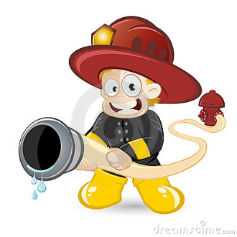
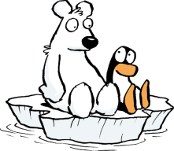
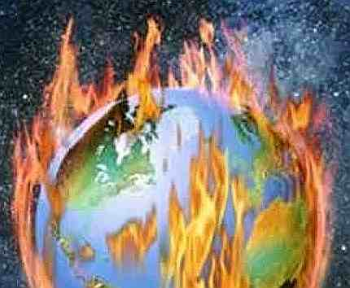
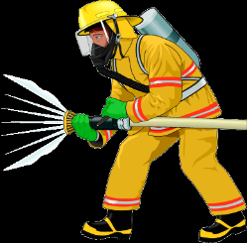
Conclusions and Future Work
Climate change information
More accurate
Widely available
Trustworthy
Non political
Non polarized
Future directions
Design education program
Qualitative research
Employ program
Save humanity and all life on Earth

Slide 11
Acknowledgements
Judy Cushing, Ph.D.
Martha Henderson, Ph.D.
Carri LeRoy, Ph.D.
Interview Partners
Participants

