Slide 1
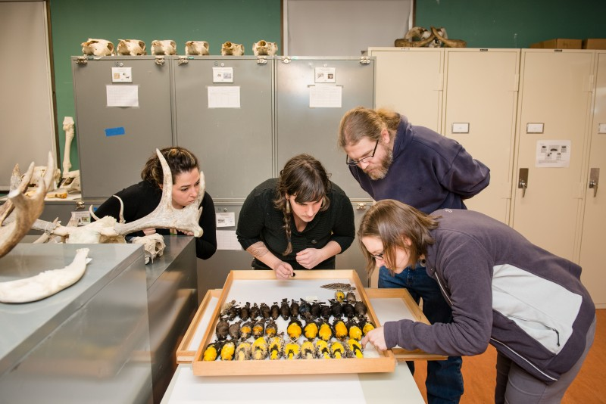
A Case for Purchase of New Cabinets for the Natural History Collections

Slide 2
Dermestids: How do we control outbreaks
Prevention:
Sealed cabinets- 1st line of defense
Temperature and humidity (not working currently)
Freezing specimens (no currently enough staff or freezer space to effectively control outbreaks)
Monitoring- (requires more staff hours)
Treatment- (requires more staff hours)

Slide 3
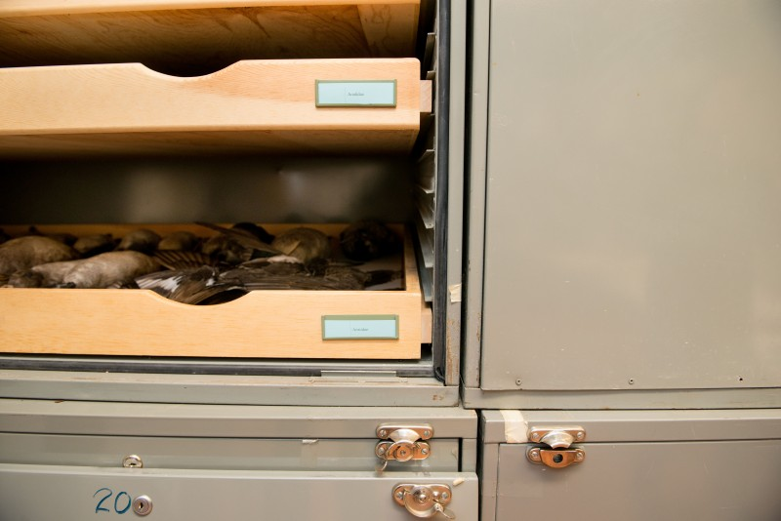
Worn and broken seals
Bent and gaping doors
Broken latches

Slide 4
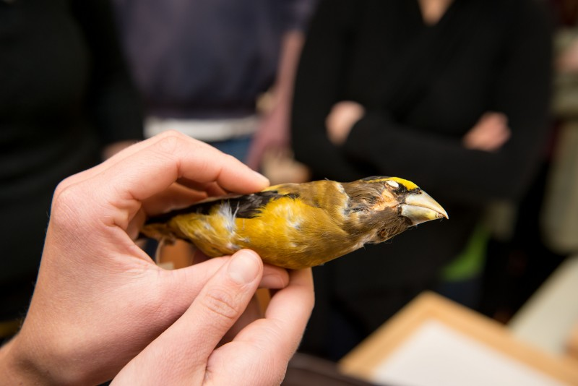
Skin and feather eaten off of bird face by dermestids

Slide 5
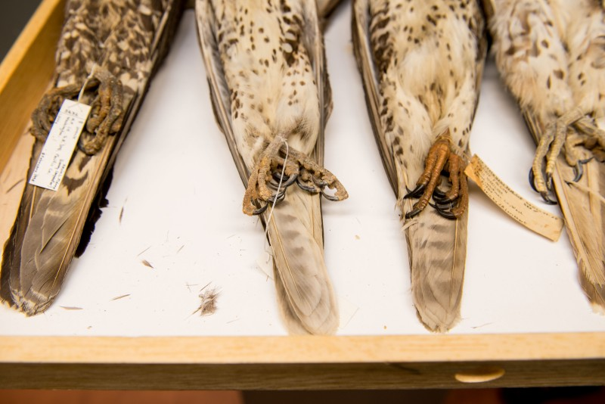
Frass and feathers- a sign of dermestid infestation

Slide 6
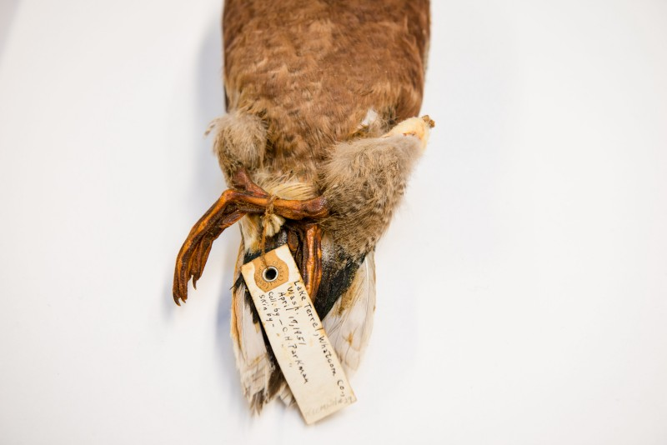
Leg damage due to dermestid infestation

Slide 7
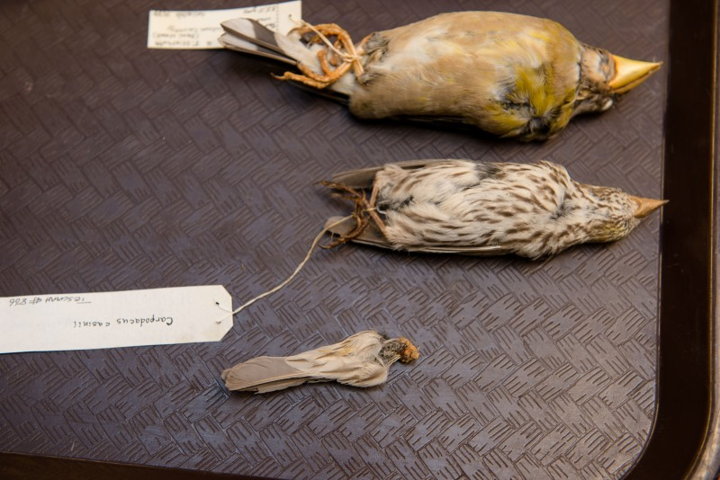
Tail eaten off by dermestids

