Slide 1
VISTAS Project Directions
Already there, or soon: multiple scenes on same window, save projects across sessions.
2D graphs and dynamic bar charts (User specifies what data fields go on the bars) (Setup to map any data fields to X and Y)
Performance enhancements, friendlier UI, increased documentation
Complete VISTAS fly-through feature (Edit the path, play time animation at the same time)
Generate MPEG4 files (data animation, fly-through animation)
VISTAS back-end for Envision (lower priority – for VELMA)

Slide 2
VISTAS Project Directions
Enhanced use of color (opacity, desaturation). Example: turn uncertainty into desaturation of colors (User must specify amount of confidence? How? Normalized 0-100?)
5D Visualization: XY on ground, contours, height, color (Setup to map any data fields to the contours, height, and color)
Data Extrusion (Time)
Annotation (Setup so can add text boxes and 3D arrows running from the text box to a specific place on the 3D terrain)
Research projects separate from VISTAS: 3D flow visualization
Research project separate from VISTAS: Stereographics

Slide 3
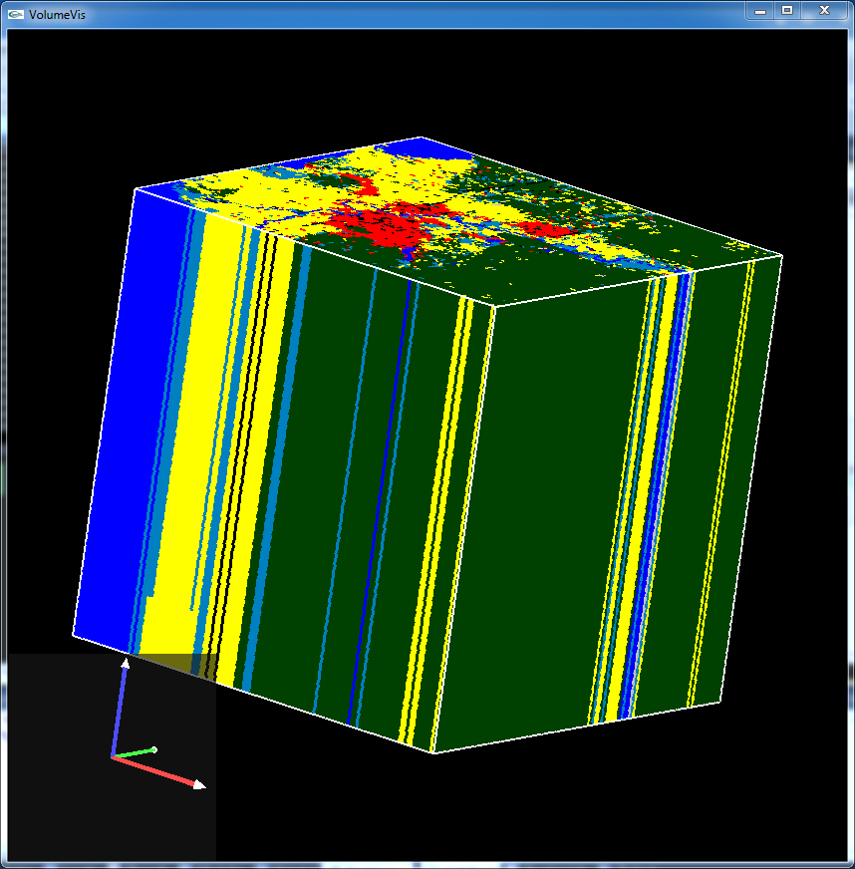
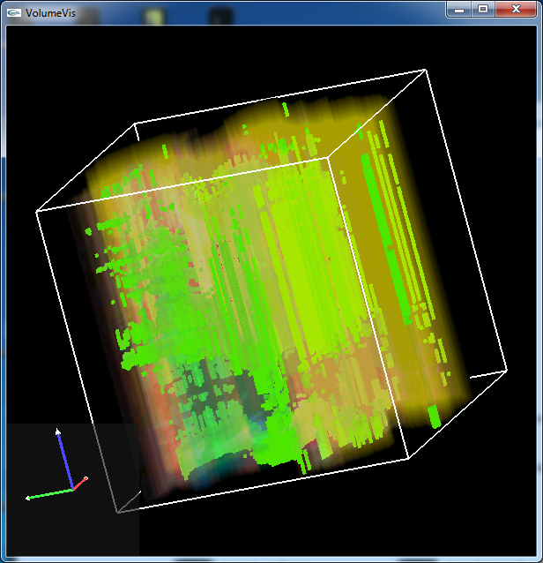
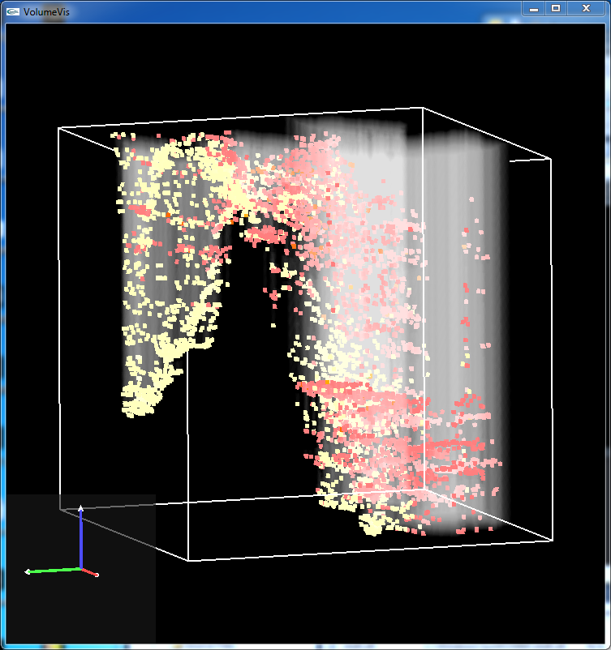

Slide 4
Don’t Touch
Video editing
Statistics
Networking (next proposal?)
Lidar

